Slide 1

City to Soil presentation:
What a Waste - the challenge of food loss and waste
6 February 2019
Presented by: Shane Anderson

Slide 2
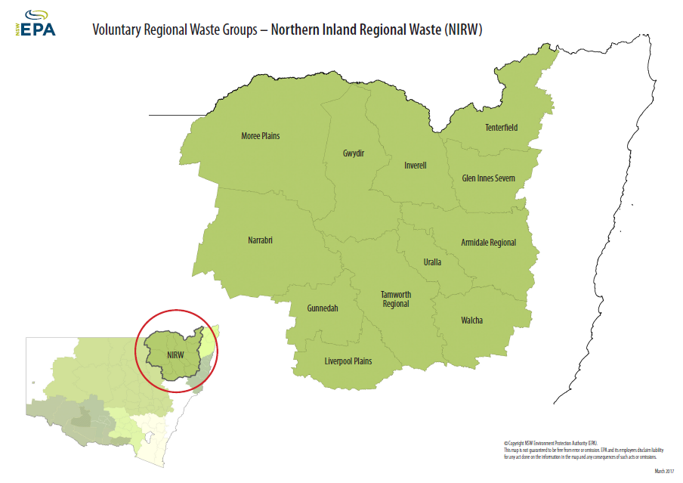

Armidale Regional Council
What: A local government authority
Where: Located
Area
Who: Residents
Partners

Slide 3
Council’s traditional waste services
Traditional kerbside collection services
Landfilling all kerbside waste
MRF and transport recyclable product
Garden, general waste and recycling drop off area at landfills/transfer stations
Tip shop

Slide 4
Why change
Landfill expanding and more resources to maintain
Waste diversion strategies/targets – Minimise C02
Separate organic waste (FOGO) from the general waste stream
Potential to produce a beneficial sustainable saleable product

Slide 5
What changed
  Initiated a FOGO collection trial of 200 households based on an existing C2S program in regional NSW
  Static fermentation process (aerobic & anaerobic decomposition)
  Process overview

Slide 6
What changed continued
  Successful trial of 200 households resulted in adoption of Armidale wide FOGO collections and composting
  Comprehensive community education program
  Kerbside collection service
  Free kitchen caddy and compostable bags to reduce kitchen odours
  Impressive community interest in compost – outstrips supply

Slide 7
Acceptable Kitchen Caddy/Wheelie Bin Waste
Kitchen Caddy | Wheelie bin
Raw or cooked food | Clean, loose green waste such as
Tea bags, coffee grounds | Leaves, branches, prunings
Fruit & vegetables, peelings | grass clippings
Leftovers | Pizza boxes
Paper towels, tissues | Soiled wet paper
Meat, fish, chicken | Compostable kitty litter
Cooking oil | Paper/cardboard takeaway containers

Slide 8
Unacceptable Kitchen Caddy/Wheelie Bin Waste
Kitchen Caddy | Wheelie bin
Bottle tops | Nappies
Glass | Coffee pods
Plastics | Cigarette butts
Metals | Glass, Plastics, Metal
Medicines | Treated timber
Chemicals | Chemicals, fertilisers, insecticides, poisons, toxic or dangerous substances

Slide 9
      What is next ... Creation of financial value for FOGO
April and May 2019
  Streamlining of Long Swamp Road City 2 Soil Process
May and June 2019
  FOGO Diversion Community Education Armidale and Guyra
    24% of Red Bin Waste potentially FOGO
July 2019
  Guyra FOGO collection service
    Next Year
      Commercial sector FOGO
      Bin audits/Technology to capture data
      Value add products and increase compost processing efficiencies

Slide 10
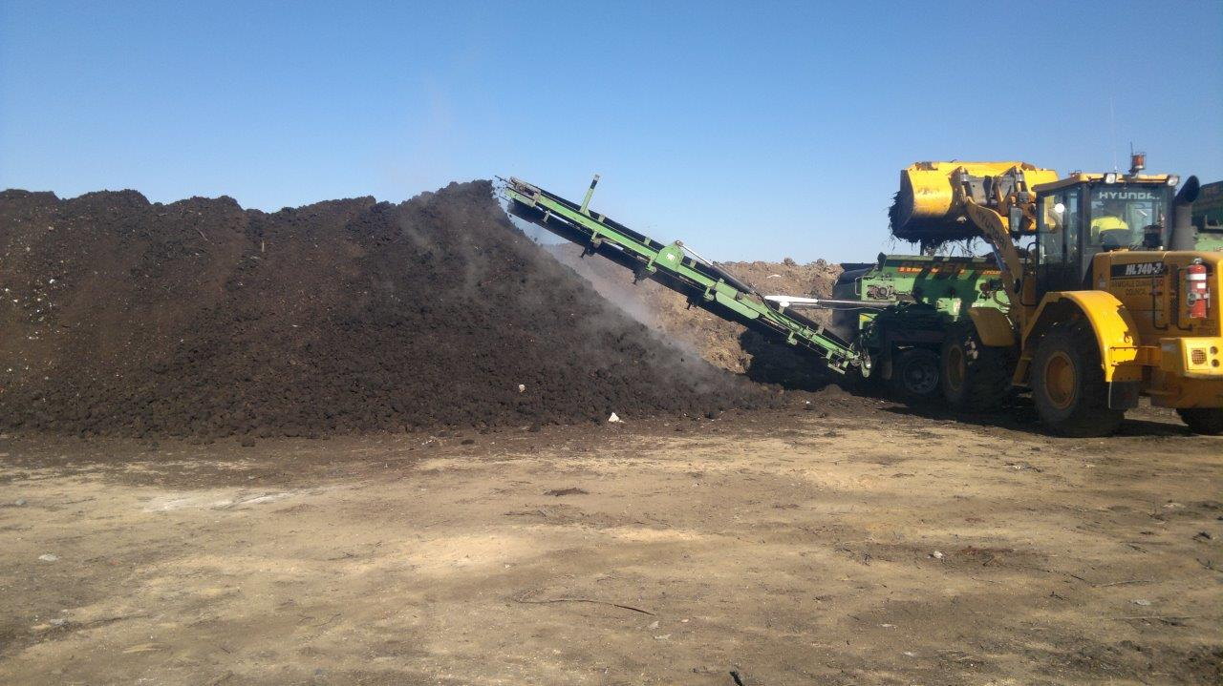
Composting

Slide 11
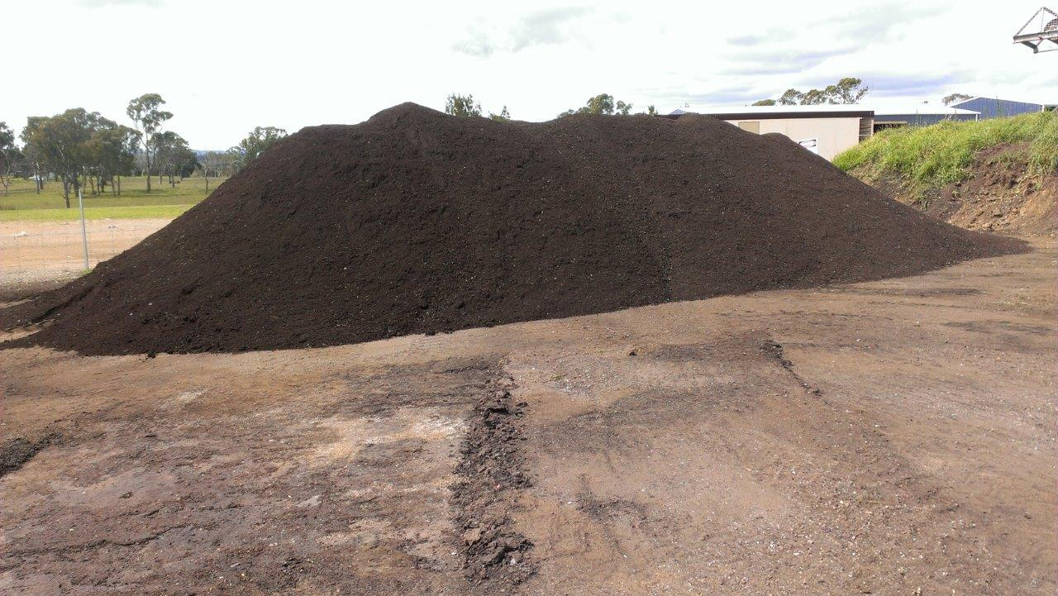
Compost for sale

Slide 12
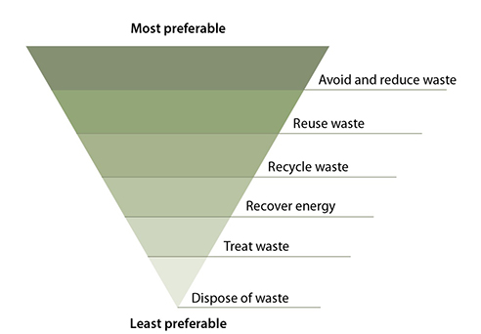
Compost “Black Gold” is not the answer!
It is too late ...
Communities must transition to avoidance of “consumption”
to not create waste
Waste avoidance hierarchy
The debate must always start at avoid

Slide 13
Conclusion
Thank you

