Slide 1

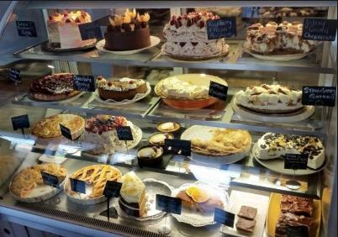
Y Waste App
Your Logo
Here

Slide 2

What is Y Waste?
Y Waste is an App developed to help food retailers
reduce the amount of end of day unsold food that gets
thrown away every day
With focus on food retail Y Waste's purpose is to reduce both
food insecurity and the negative environmental and economic
impacts of food waste
.

Slide 3
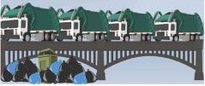

Problem with food waste?
One third of the food produced in the world for human consumption every year — approximately 1.3 billion tonnes — gets lost or wasted. Food losses and waste amounts to roughly US$ 680 billion in industrialized countries and US$ 310 billion in developing countries.
Of the processed/eatable food that gets thrown out 80% is simply because it’s not sold at the end of the day and charities have challenges
in redistributing due to: small quantities, nature of food, logistical challenges etc.
Conclusion
Unsold surplus food is a great potential resource which haven’t successfully been targeted before.

Slide 4


Retail problem?
Shops need to look presentable also at the end of the day which means stock on shelves
Stock on shelves gives more sales but also increases risk of more waste which increases wastage costs
Cost of throwing one meal away is approx. $2

Slide 5
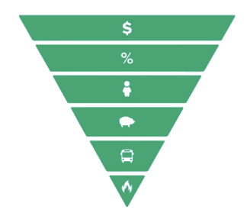


Resources
Best way of utilizing food in your business
Full price
Discounted price
Donation
Animal food
Compost + Biogas
incineration

Slide 6
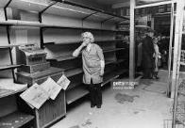

What is the solution?
Y Waste provides a channel to sell end of day unsold perishable inventory.
Selling excess stock drives more customers to your shop. App reaches up to 5 km in radius shops can upsell i.e. coffee etc

Slide 7






Sales
$$ %
$$
$$ %
Magic Portion
Customer
Merchant

Slide 8
Economics
Makes money on what is normally thrown out.
The money goes straight in to shops books
Eco-conscientious marketing.
Ability to sell surplus food at reduced prices.
No extra workload as process is automated with fixed portions.
Y Waste handles all customer inquiries.
Strong CSR Profile!
Yearly overview of Y Waste App sales, excluding fees.
QTY/Price | $5 | $8 | $10
4 | $7,300 | $11,680 | $14,600
6 | $10,950 | $17,520 | $21,900
7 | $12,775 | $20,440 | $25,550
8 | $14,600 | $23,360 | $29,200
9 | $16,425 | $26,280 | $32,850
10 | $18,250 | $29,200 | $36,500
15 | $27,375 | $43,680 | $54,750
20 | $36,500 | $58,400 | $73,000

Slide 9
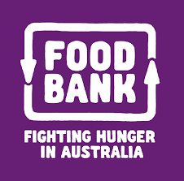



Food Donation Platform
Activates code
Finds donated/free food
Orders donated/free food
Issues code
Picks up donated/free food
Magic Portion
Recipient
Merchant

Slide 10
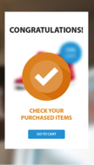
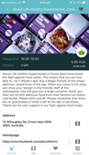
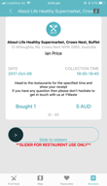
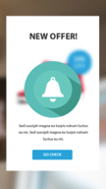
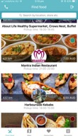
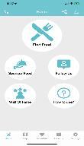
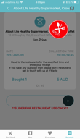
Purchase and donation process
Start at dashboard
Merchants food
is posted on app
Customer search
for food on app & pays
Customer shows receipt
at pickup time
Receipt is swiped and
customer leaves with
food
Commercial platform
Food donation platform
20% transaction fee of all transactions
Merchant paid monthly
Sponsorship plans
Corporate CSR funding

Slide 11
Food Donation Challenge
40% of food purchased for stock ends up in the bins of restaurants, cafes and other foodservice businesses. Up until now accessing the short-life prepared food generated by cafes and quick serve restaurants has always been logistically challenging for the food rescue sector. Food charities unfortunately only have resources to rescue 2-6% of this food.
Charities mostly accept unprocessed/uncooked food which they can prepare and distribute centrally and a lot of turn down donated food due to the nature of food, logistic challenges, amount of food etc. Many people can’t be reached due to great distances.

Slide 12
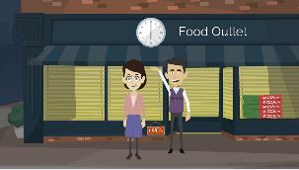

Our solution
The Y Waste DONATION module is a platform where food merchants will post and donate their end of day unsold surplus food as magic portions. Charities identify the needy who will be issued with a code that will allow a free daily purchase on the Y Waste app.
Food is picked up in shop
No logistical challenges
$
No storage challenges

Slide 13
Y Waste Food Donation
The Recipient is registered with a charity and is issued with a code which he/she uses to log in on the app.
The code allows the Recipient to ‘purchase’ 1 free meal per day. Children under 18 will be added to the Recipients account so they will be allowed their own free meal but without being registered.
The receipt will look no different from a regular purchase receipt for the Recipients discretion.
The Recipient picks up the meal directly in the shop which he/she has found and booked on the app.

Slide 14
Y Waste Food Donation
Will reach out to even the smallest shop any where in Australia
By decentralizing the food donation the food will be picked up directly at the shop
More discretion to families with children.
Reduce transportation, volunteer and storage issues
Shops giving back directly to their local community

Slide 15
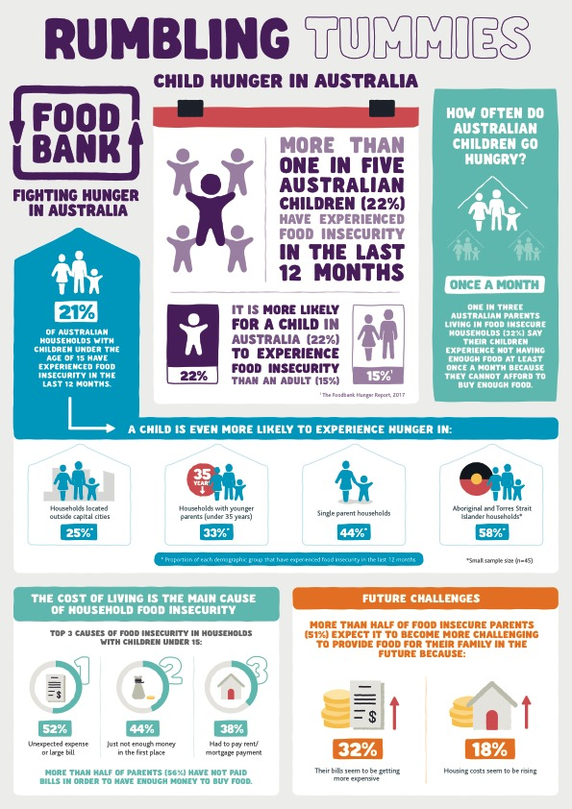
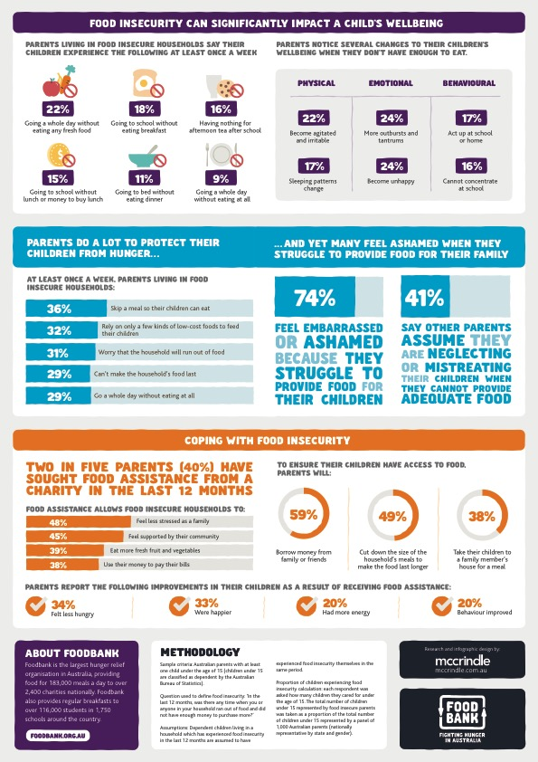
The “market”

Slide 16

















































Selection of merchants
John from Chirn Park Bakery, Labrador, QLD says:
“ I post 3 portions of bread and 3 portions of cake on Y Wastes app daily and I am almost always sold out.
So not only am I making $36 every day, which is $13,140 per year, I am also reducing my end of day waste by at least 20kg, which is over 7 tons per year. This was bread and cakes I would normally have thrown out before and now that I don’t have that much waste I also save money on wastage costs. Y Waste is definitely a win/win for my business and I can’t find a reason not to use it.

