Slide 1
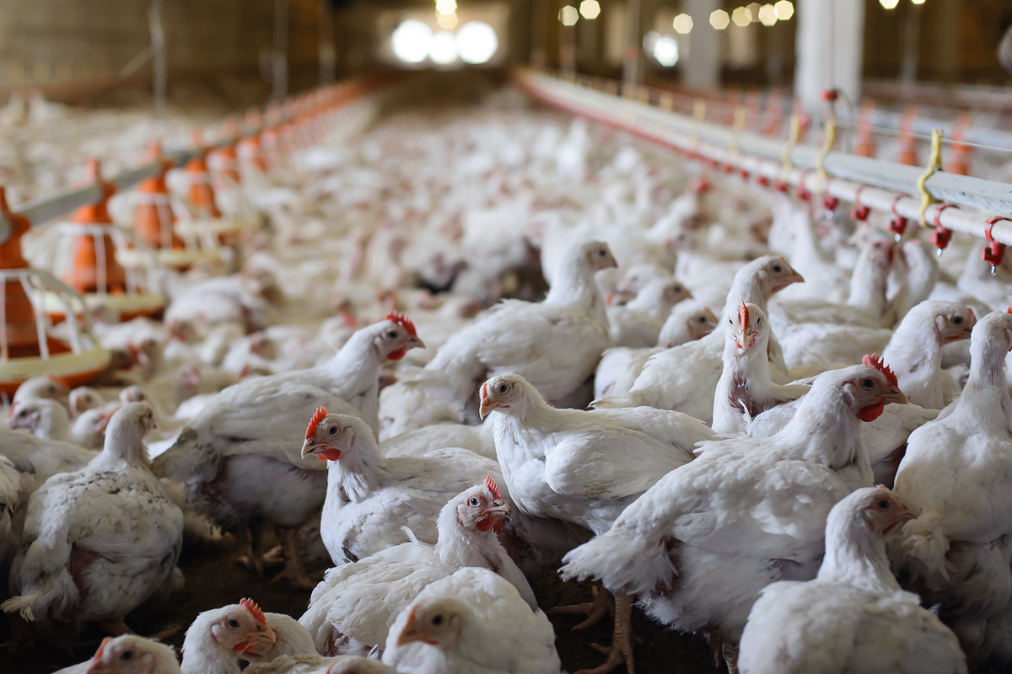


Unlocking the Power of Digital for the Chicken Meat Sector
Wednesday 6 November
Room 410, Level 2, UTS Building 10

Slide 2
Digital Innovation Workshop
Our Goals for Today
What does success look like in digital transformation of chicken meat?
What is the key data in the supply chain and production system?
What are the key transformations needed to unleash the power of digital
What are the benefits and cost of change?
What are the next steps?

Slide 3
Unlocking the Power of Digital in Chicken Meat
Workshop participants
ATTENDEE | ORGANISATION
Farshid Hadifar | Cordina
Juan Corredor | Darwalla
Jonathan Millard | Darwalla
Peter O’Neill | Inghams
Jorge Ruiz | Baiada
Graham Kirby | PRO-TEN
Prof Derek Baker | University of New England
Dr Masood Azeem | University of New England
Dr Tim Parsons | Food Agility CRC
Ashley Rootsey | Food Agility CRC

Slide 4
OVERVIEW OF THE PROJECT (15 mins)
Derek Baker, Professor of Agribusiness and Value Chains
Dr Masood Azeem, Postdoctoral Fellow - UNE Business School

Slide 5
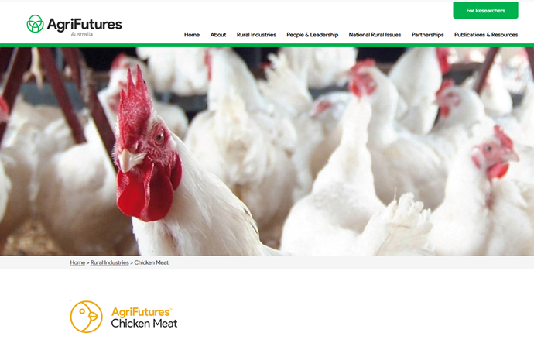
Unlocking the Power of Digital in Chicken Meat
Explore the potential value of new digital transformation for the chicken meat sector
Offer a Roadmap for future development
Part of AgriFutures’ Australia’s Chicken Meat Program
Recognises various actors inside and outside the chicken meat supply chain

Slide 6
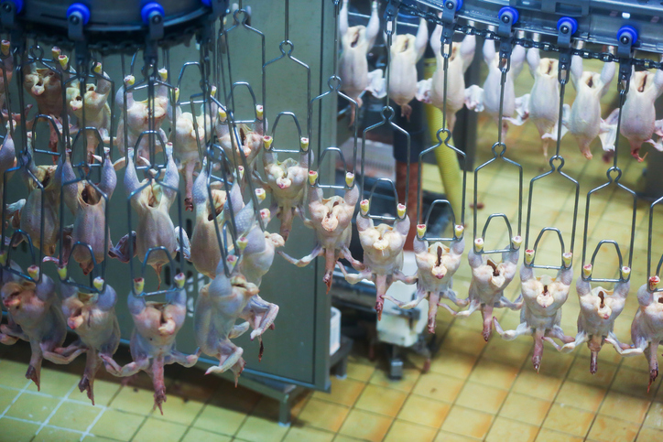
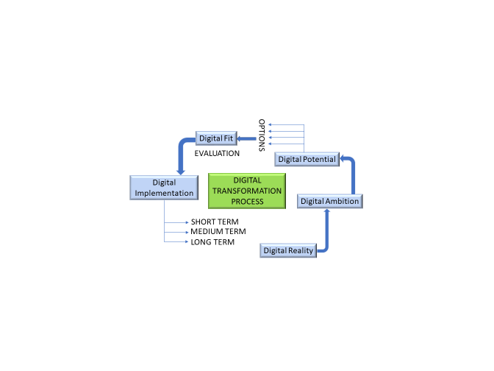
Unlocking the Power of Digital in Chicken Meat
Industry consultation
Understanding of Digital Transformation as a process
3) Firms’ Reality, Ambition, Potential, constraints and ideas
4) The Roadmap

Slide 7
Unlocking the Power of Digital in Chicken Meat
Powerful Learnings so far
Centrality of Return on Investment, within contract time frames
Drive for system co-ordination and product standardisation
Multiple incentives around data:
  Producer’s competitive advantage
  Preservation of margins
  A little data is a dangerous thing if in the wrong hands
  Costs and Benefits have different homes to go to
New skills needed, to complement existing ones
Variety of understanding and ambition within a firm
Difficulties in Technology supply:
  The gear
  The direction
  The repairs
  The brand
  The format
Who owns the data?
“We don’t know what we don’t know”

Slide 8
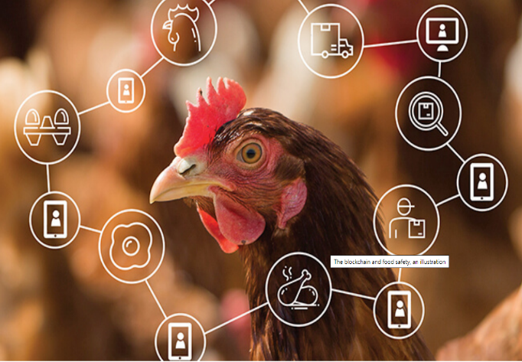
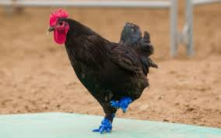
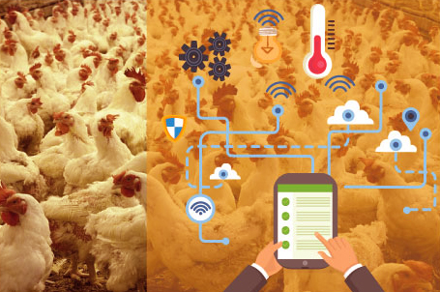
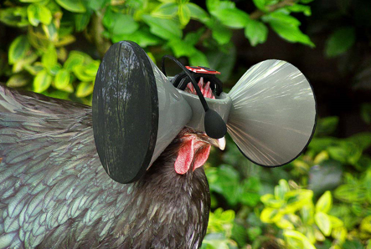
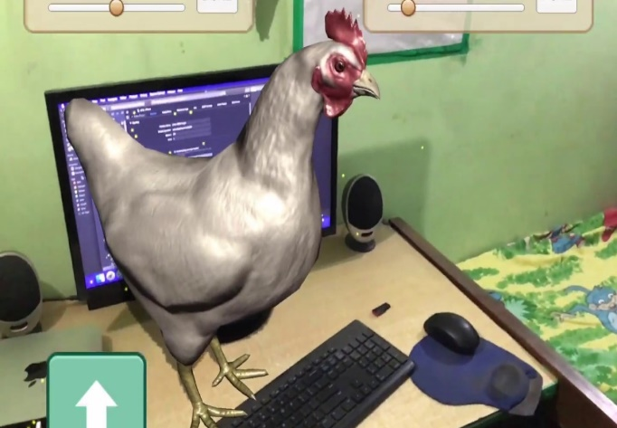
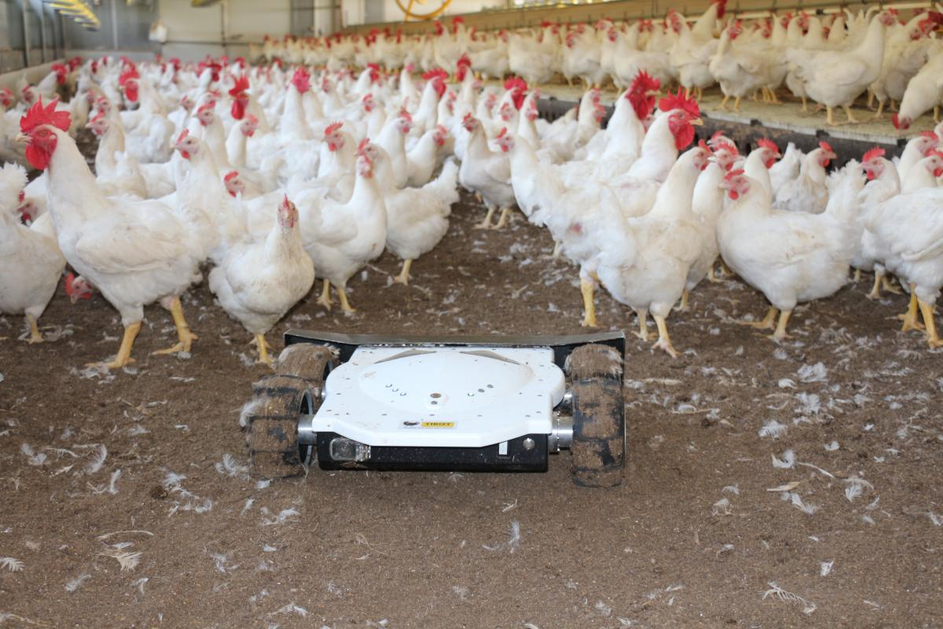
Timothy (2019)
De Julio (2015)
Proximvo (2018)
Technology – Initial Focus
Connolly (2017)
Enteriosoft (2019)
Connolly (2017)

Slide 9
What can we learn from digital masters about DT?
Digital Capability
Leadership Capability
Operations
Vision
Customer Engagement
Initiatives
Business Models
Employee Engagement
Governance
Adapted from Westerman et al. (2014).

Slide 10
Levels of Digital Mastery
Digital Capability
- 11%
+ 26%
Fashionistas
Digital Masters
- 24%
+ 9%
Beginners
Conservatives
Leadership Capability
Adapted from Westerman et al. (2014).

Slide 11
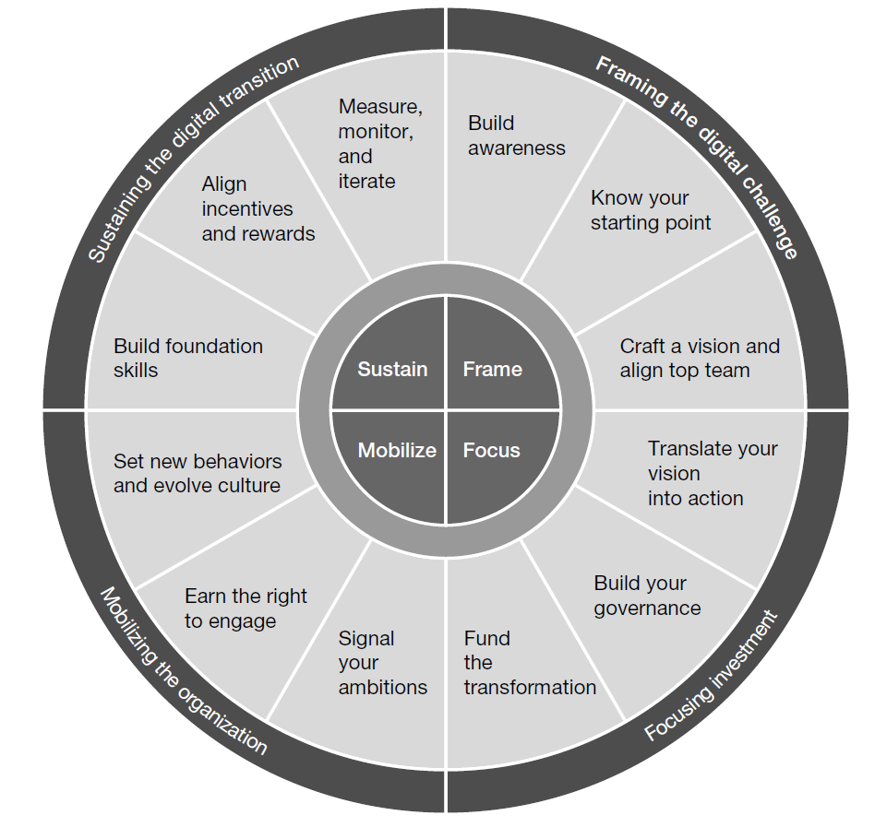
12
1
11
2
Digital Transformation Compass
10
3
9
4
8
5
Westerman et al. (2014).
7
6

Slide 12
Primary User Profiling (45 mins)
1) Meeting our stakeholders
2) Findings so far and their implications

Slide 13
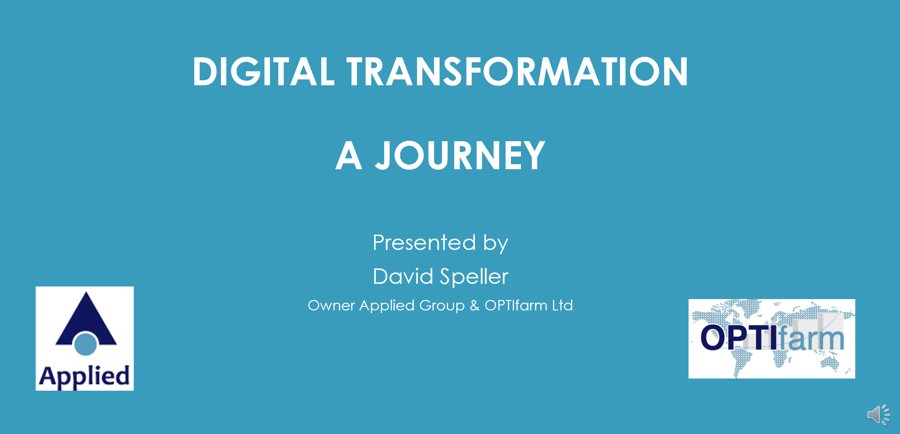

Unlocking the Power of Digital in Chicken Meat
Digital Transformation: A Journey (click below to play)

Slide 14
Unlocking the Power of Digital in Chicken Meat
Powerful Questions that emerged…
What are the incentives for digital transformation?
How can stakeholders best communicate the benefits of digital (both internally and externally)?
How can we reduce the time and resources it currently takes to process data into insights?
How can we shift data collection from a box-ticking exercise into a key component that drives competitive advantage?
Do we have sufficient digital leadership?
How can we improve data flow along the value chain, both upstream and downstream?
Can we get to a point that we no longer have to rely on the manual input of data?
How can we overcome the data integration / interoperability challenge?
How does the position of contract vs owned farms influence the capacity for digital intervention?
How do we overcome the infrastructural deficit between old and new sheds?

Slide 15
Unlocking the Power of Digital in Chicken Meat
Powerful Questions that emerged…
What operational processes can be digitally enhanced?
What cultural changes are necessary for digital transformation?
What should be the KPIs to monitor the progress of digital transformation
How can we overcome educational challenges in the industry?
“Which comes first?” – What role does the value of eggs play in chicken meat?
Can there be benchmarks implemented by industry or government, based on data exchange?
Is the time right for digital transformation? (yes)

Slide 16
Value Chain Map + Gaps (1hr)
Deep walkthrough and review
Who are the players and what are their needs?
What are the critical pieces of data in the value chain?
What can we add? What’s missing?

Slide 17
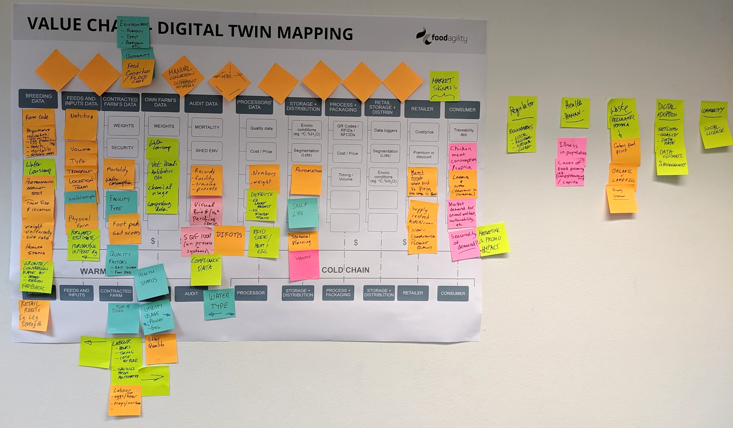
Unlocking the Power of Digital in Chicken Meat
Session 2 – Value Chain Map: Digital Twin

Slide 18
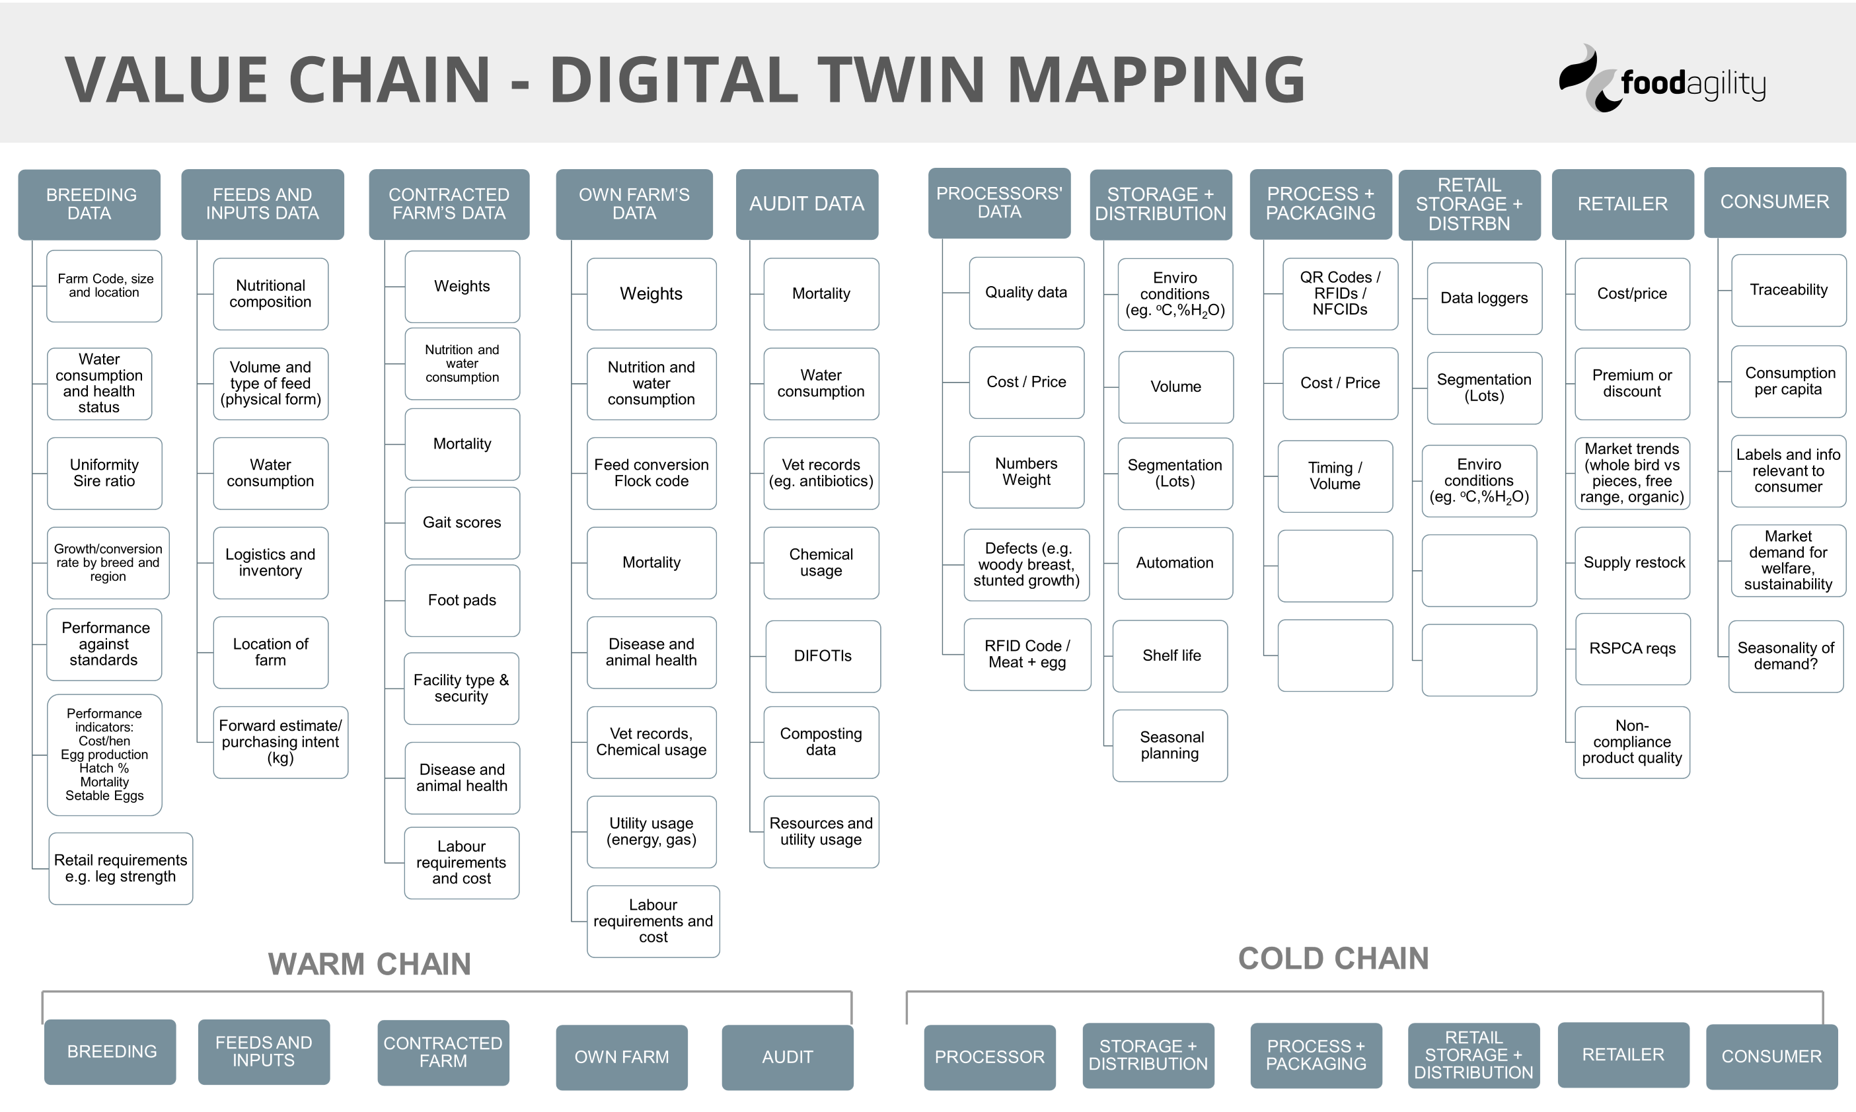
Unlocking the Power of Digital in Chicken Meat

Slide 19
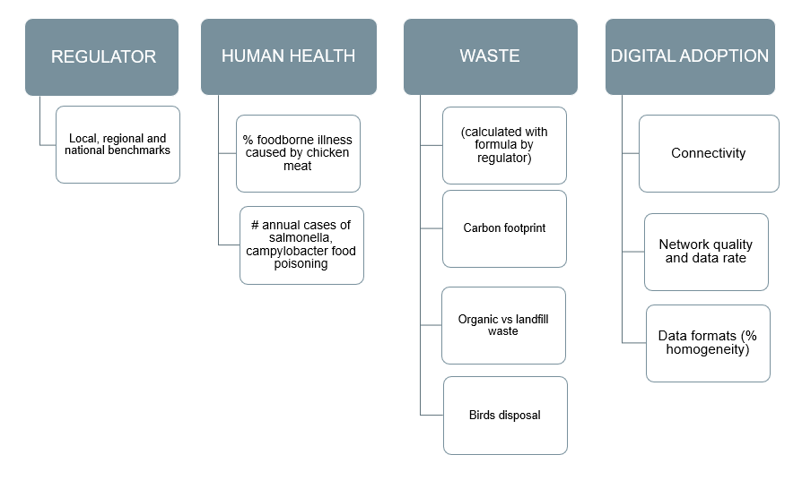
Unlocking the Power of Digital in Chicken Meat
Session 2 – Value Chain Map: Enabling Data

Slide 20
LUNCH-TIME SURVEY
& SURVEY OUTCOMES
bit.ly/DigitalChickens
Notes:
https://www.surveymonkey.com/r/DigitalChickenMeat

Slide 21
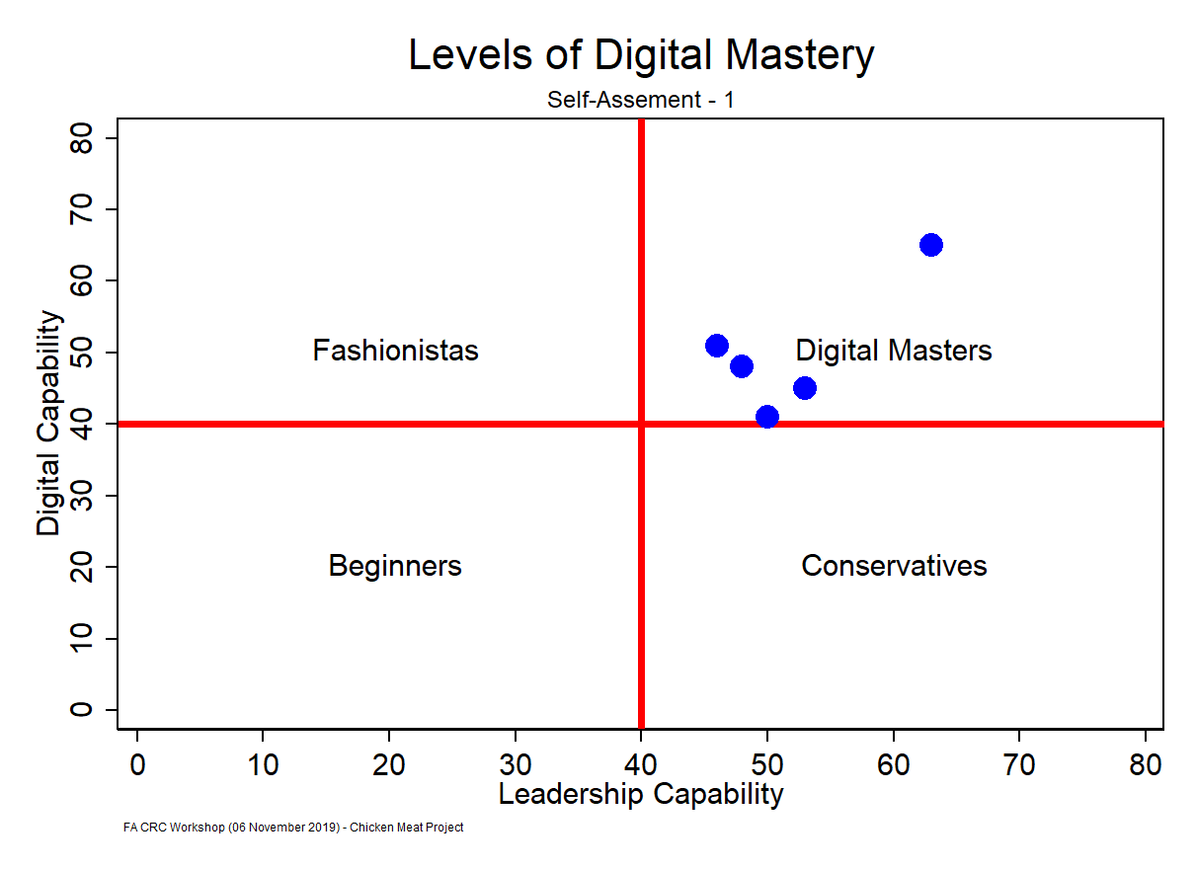
PG 21
Notes:
Added page numbers - Masood

Slide 22
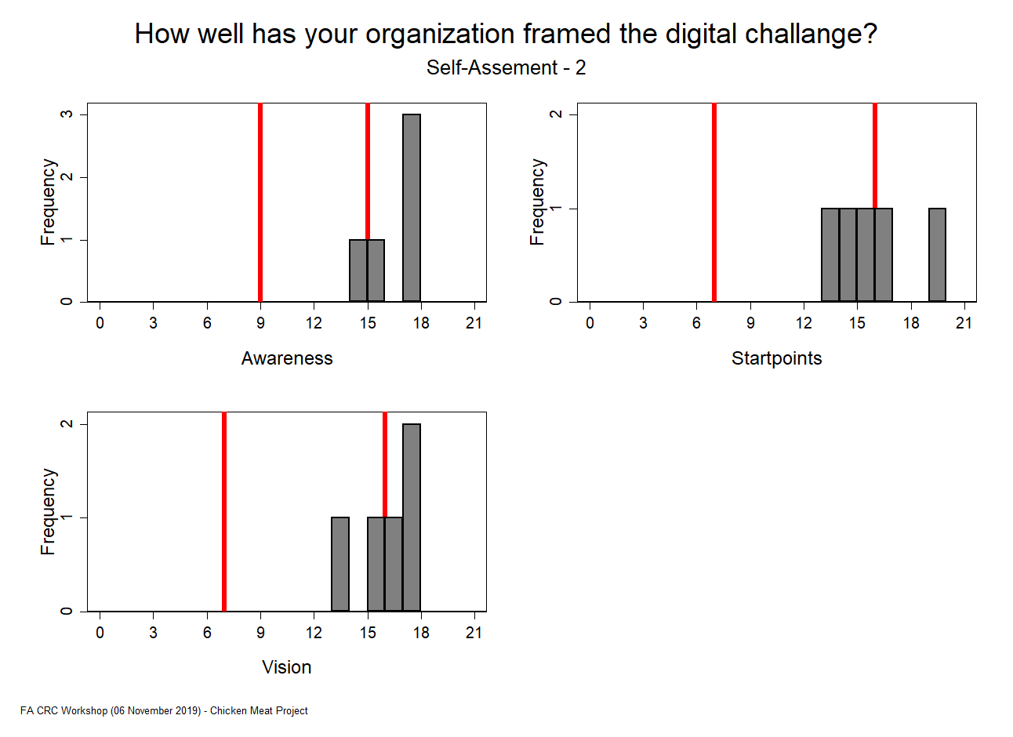
PG 22
Notes:
I have updated this graph – made some minor change in the vertical axis labels in the first panel. Masood

Slide 23
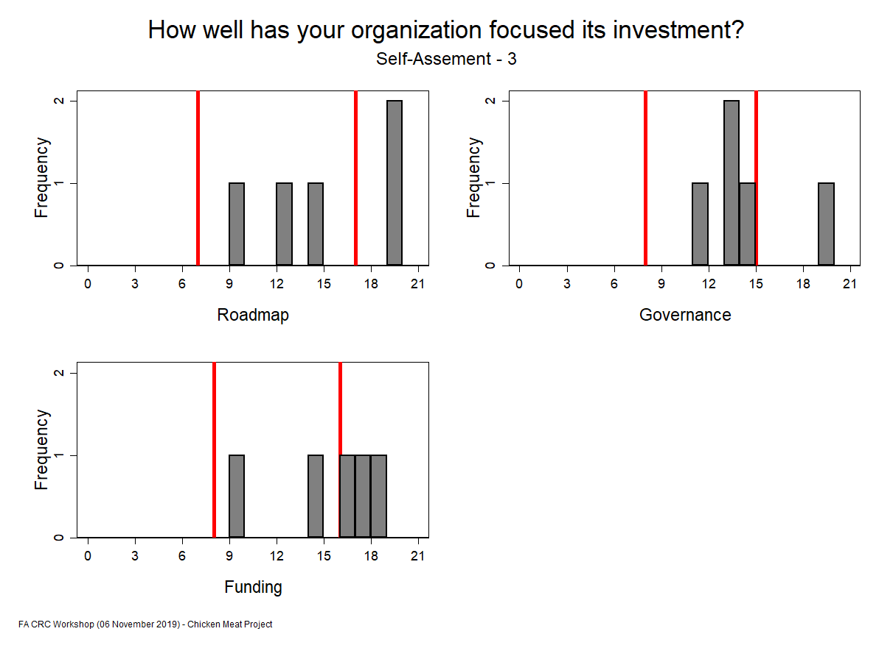
PG 23

Slide 24
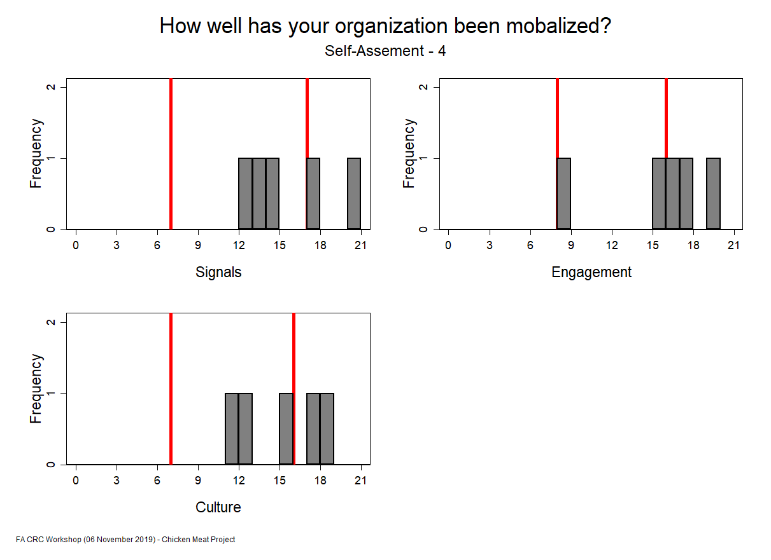
PG 24

Slide 25
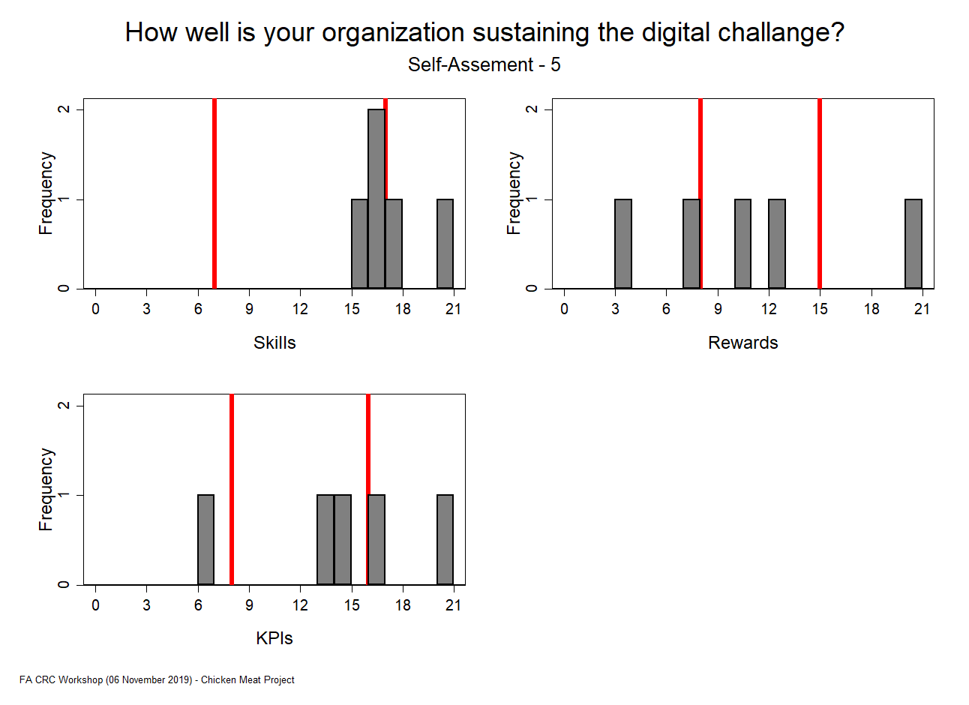
PG 25
Notes:
There was a coding error in the bottom panel (KPIs). I have fixed this and updated the graph here. Masood

Slide 26
FUTURE-CAST (25 mins)
Find your theme
What might success look like in 2030?

Slide 27
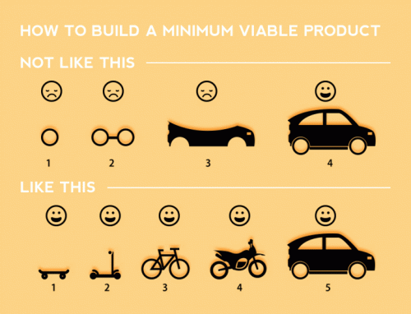
The Power of Digital in Chicken Meat
Developing a Minimum Viable Product
– The Skateboard Theory
PG 27

Slide 28
Unlocking the Power of Digital in Chicken Meat
#MASSIVE – Digital Capability
By 2030 success will mean…
Margins increase by more than 10% for production and processors, via an increase in price and reduction in costs
Better production methods utilise predictions and analytics
Data is connected throughout the system and interactive decision-making is embraced and engaged.
PG 28

Slide 29
Unlocking the Power of Digital in Chicken Meat
#MASSIVE – Data Fragmentation
By 2030 success will mean…
Different platforms may be used but there is one source of truth.
Data is collected, uploaded, integrated and responded to live (in real-time).
Decision making is increasingly automated, letting people focus on the other issues that require human intervention
PG 29

Slide 30
Unlocking the Power of Digital in Chicken Meat
#MASSIVE – Incentives for Data Sharing
By 2030 success will mean…
Having a system in place that is useable by all stakeholders and optimises performance and cost opportunities.
The incentive for this system will be the growth in industry competitiveness
PG 30

Slide 31
Unlocking the Power of Digital in Chicken Meat
#MASSIVE – Digital Leadership
By 2030 success will mean…
Culturally, people are not afraid to embrace new technologies and learn from any failures
Teams are trained with adequate skills in digital tech
Committees or leadership groups are specifically responsible for digital transformation
A digital scorecard is used to monitor and measure digital transformation
Leadership creates a strong position and unified views of the power of digital
PG 31

Slide 32
Unlocking the Power of Digital in Chicken Meat
The #MASSIVEs – Metrics that will measure success
Financial profitability and economic performance of the industry and its constituents
Strong social acceptance (social licence) of industry
Positive animal welfare outcomes
Food safety
PG 32

Slide 33
BACK-CAST (40 mins)
What might the first steps be on the journey towards the future we’ve imagined?

Slide 34
Unlocking the Power of Digital in Chicken Meat
BACK-CAST – Possible routes to transformation:
Better use of existing technologies,
Deployment of new technologies,
Capacity building of existing staff or hiring of skilled employees,
Rewards and incentives for employees to take risk to experiment and innovate,
What should be the KPIs to measure the digital transformation roadmap?

Slide 35
Unlocking the Power of Digital in Chicken Meat
SKATEBOARD – Digital Capability
What if we…
Conducted an departmental/organisational gap analysis on the current collection and use of data (e.g. what is collected digitally vs manually)
Using…
Flowcharts and checklists to follow the process,
Our path to #MASSIVE would then be…
Data collection in a central database (no double handling) to be used for analysis and improvements
Other Partners Needed:
Department managers
Stakeholders

Slide 36
Unlocking the Power of Digital in Chicken Meat
SKATEBOARD – Data Fragmentation
What if we…
Deploy a simple (and cheap) sensor PLC that detects:
spot in shed,
Temperature/humidity/ammonia
and sends data wirelessly to a central database
Using…
Existing or new sensors and available mobile networks
Our path to #MASSIVE would then be…
Auto analysing data and tools for increasing performance
Other Partners Needed:
Contract farms
Sparky/electrical PLC suppliers
IT department
Communications company
OptiFarm?

Slide 37
Unlocking the Power of Digital in Chicken Meat
SKATEBOARD – Incentives for Data Sharing
What if we…
Improve data sharing across all functions (internal and external)
Using…
MTech (as a common platform)
Our path to #MASSIVE would then be…
To use data to its full potential!
Other Partners Needed:
Mostly integrated
External suppliers

Slide 38
Unlocking the Power of Digital in Chicken Meat
SKATEBOARD – Digital Leadership
What if we…
Held a Rockefeller dinner titled “Digital and our national target [PIX]
Using…
A nice restaurant and company CEOs / C-Suite / Board
Our path to #MASSIVE would then be…
Increased top-down awareness and participation in digital transformation
PG 38

Slide 39
Thankyou for a great workshop!
Your contribution has been much appreciated.
Your feedback is welcomed via our 2 min survey:
bit.ly/Chicken6Nov
We look forward to working with you again soon. In the meantime, if you have any questions about the Food Agility process or would like to know more about us, visit www.foodagility.com.

