Slide 1
Australian Flora and Fauna
By Lily, Bella and Izzy

Slide 2
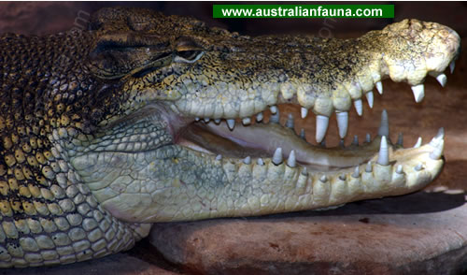
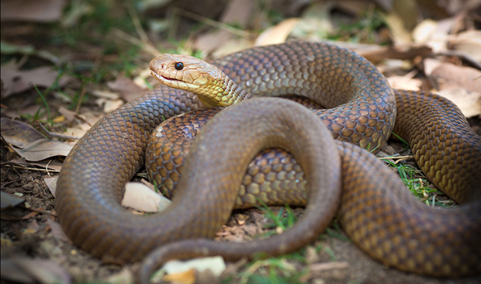
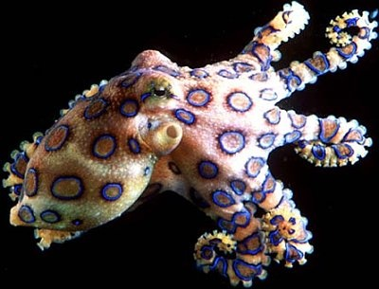
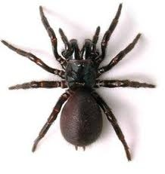
The Deadly and Dangerous!
The Salt Water Crocodile
Eastern King Brown snake
Blue Ringed Octopus
The Funnel Web Spider

Slide 3
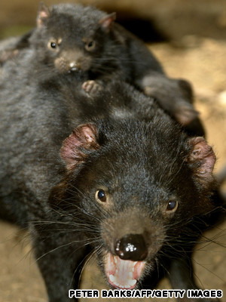
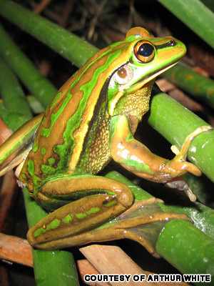
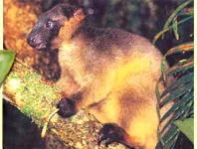
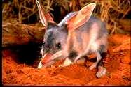
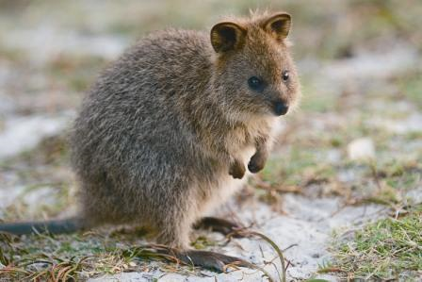
Endangered animals!
Tasmanian Devil
Green and Golden Bell Frog
The tree kangaroo
The greater Bilby
Quokka

Slide 4
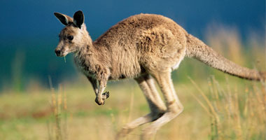
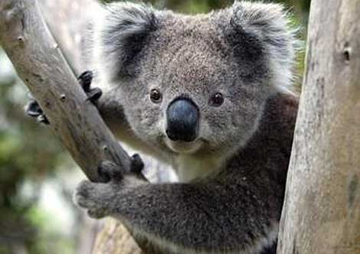
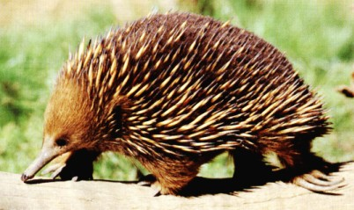
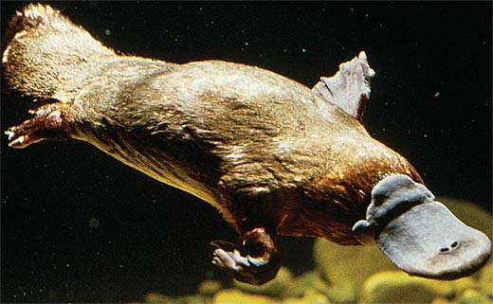
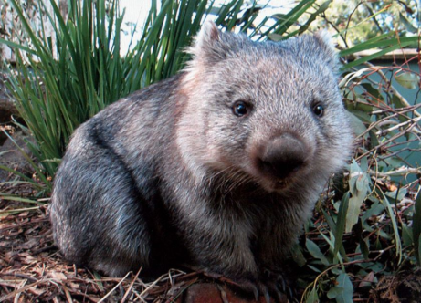
Iconic Australian Animals!
Kangaroo
Koala
Echidna
Platypus
Wombat

Slide 5

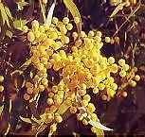
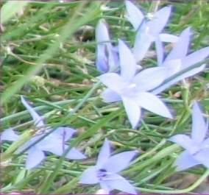
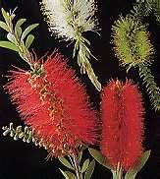
Flora of Australia
Sturts desert pea
Wattle
Royal bluebell
Bottle brush

Slide 6
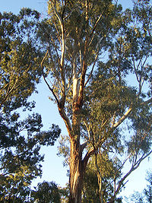
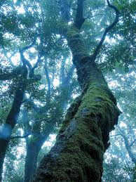
Trees unique to Australia
Eucalyptus
The Antarctic beech tree

Slide 7
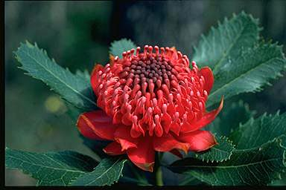
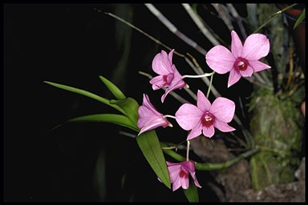
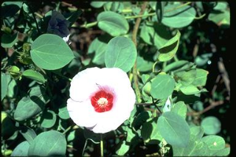
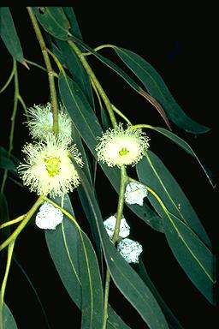
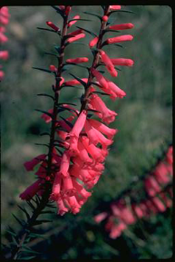
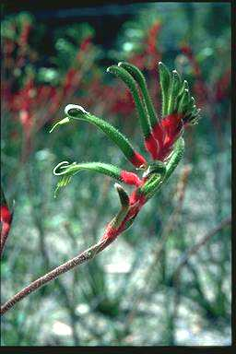
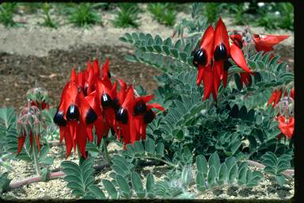
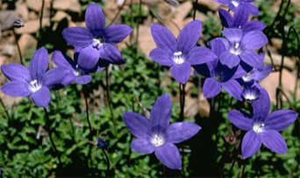
State and territory floral emblem
New South Wales– The Waratah
Queensland – Cooktown orchid
Northern Territory-sturts desert rose
Tasmania- Tasmanian blue gum
Victoria-common health
Western Australia-red and green kangaroo paw
South Australia-sturts desert pea
Australian Capital Territory

Slide 8
Bibliography
http://www.kidcyber.com.au/topics/austendangered.htm
http://www.aussie-info.com/identity/flora/
http://travel.cnn.com/sydney/visit/threatened-and-endangered-species-australia-390436
http://www.factzoo.com/mammals/platypus-duck-bill.html
http://www1.youm7.com/News.asp?NewsID=23738&SecID=89&IssueID=0

Slide 9
Any Questions?

