Slide 1
Australian Animals

Slide 2
Kangaroo
The kangaroo is a type of marsupial.
A marsupial is a type of mammal which carries its young in a pouch.
Kangaroos have large, powerful hind legs, large feet adapted for leaping, a long muscular tail for balance, and a small head.
The kangaroo is a symbol of Australia, and appears as an emblem on the Australian Coat of Arms.

Slide 3
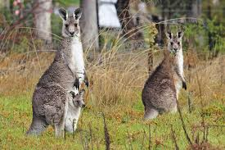
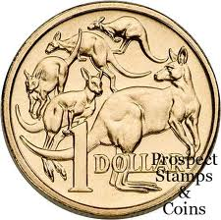
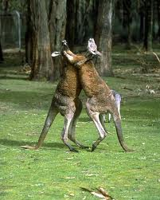
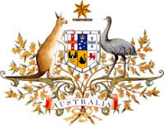
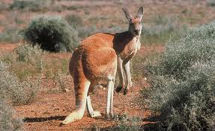

Slide 4
Emu
The emu is a large bird found only in Australia.
It is the largest type of bird in Australia and the second tallest bird in the world.
These flightless birds reach up to 2 metres in height. They have long thin necks and legs.
The emu is very fast and can reach speeds of over 50 kilometres per hour.

Slide 5
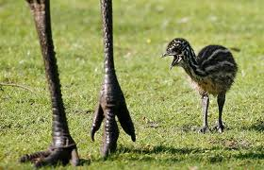
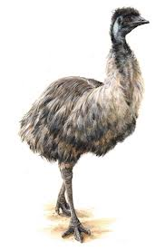
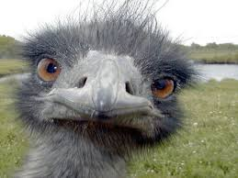

Slide 6
Koala
The koala, like the kangaroo, is a type of marsupial.
It lives in trees and eats leaves.
These leaves provide them with only low nutrition and energy so koalas are largely sedentary and sleep for up to 20 hours a day.
It is easily recognisable by its stout, tailless body, round, fluffy ears and large, spoon-shaped nose.

Slide 7
