Slide 1
Australian Animals
By: Molly, Sabine
and Jordan

Slide 2
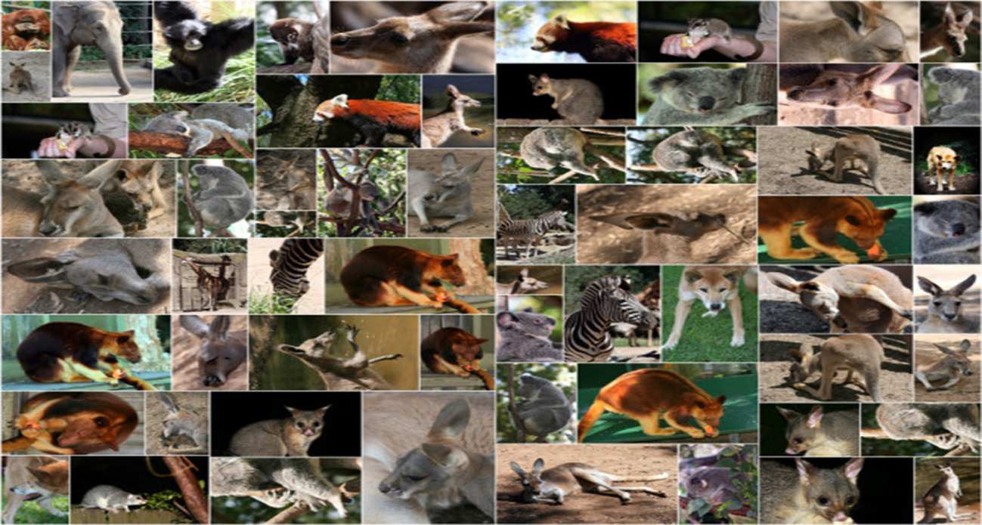
We are going to talk to you about some Australian animals.

Slide 3
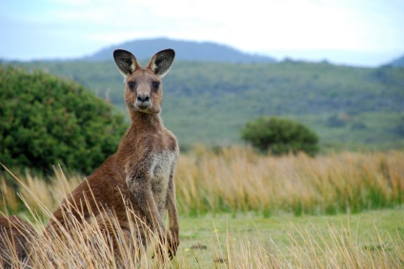
The Kangaroo
Kangaroos have huge back legs with long feet that they use to jump. They eat grass and low growing plants.

Slide 4
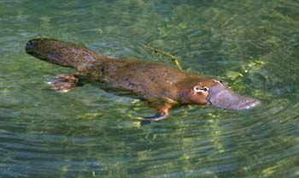
The Platypus
The Platypus lives near freshwater rivers or lakes. They swim underwater for 2 minutes before returning to the surface for air.
Their webbed feet make their swimming easier.

Slide 5
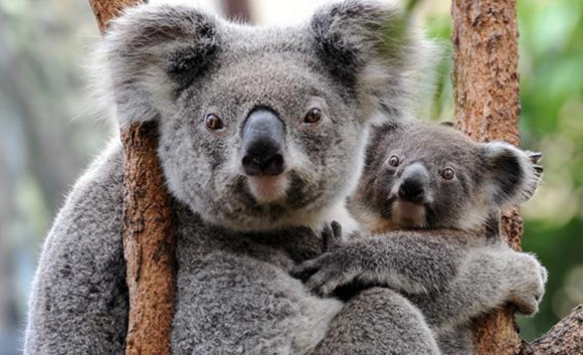
The Koala
The koala eats leaves and sleeps a lot.
At birth the baby koala is blind and has no fur.

Slide 6
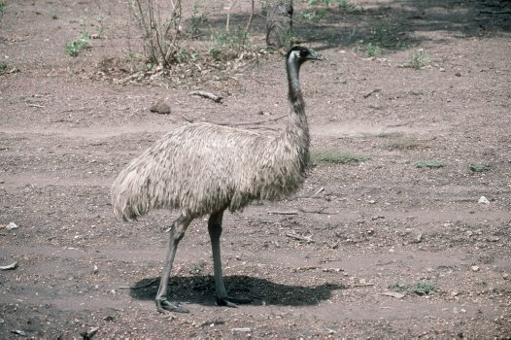
The Emu
The Emu can not fly.
Emu's feed on grass, leaves and small insects.

Slide 7
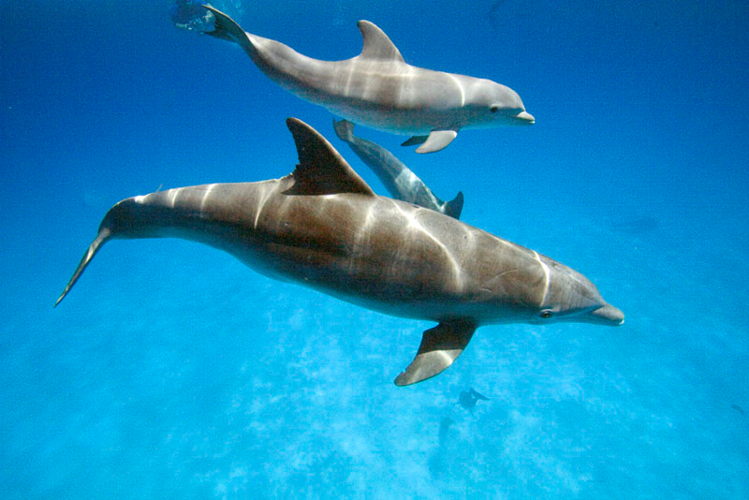
The Bottlenose Dolphin
The bottlenose dolphin has a bottle shaped nose.

Slide 8
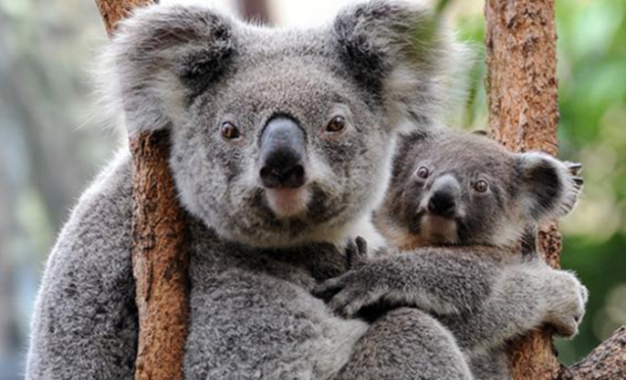
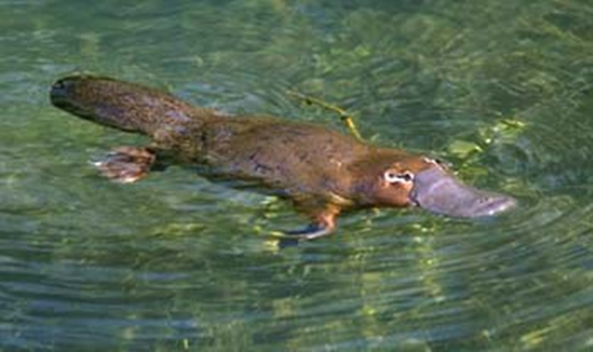
Have you heard of these animals?

Slide 9
Thankyou
I hope that you have all learnt lots about Australian animals.

