Slide 1

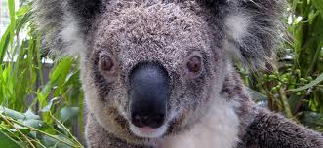
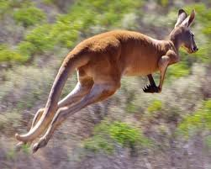
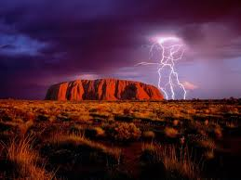
Australia Slang

Slide 2
When visiting Australia
When visiting Australia you may have trouble understanding us when we speak. Australians use a lot of slang words when we speak.

Slide 3
slang
Slang: slang is casual and playful speech

Slide 4
g’day
G’day: good day or hello

Slide 5


cops
Cops: Policemen

Slide 6
snags
Snags : sausages

Slide 7
barbie
Barbie (BBQ) : barbeque

Slide 8
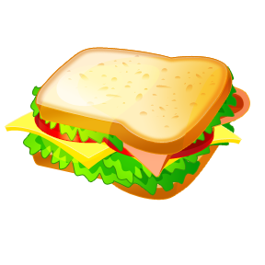
sanga
Sanga : sandwich

Slide 9
mate
Mate : friend

Slide 10
smoko
Smoko : A meal break

Slide 11
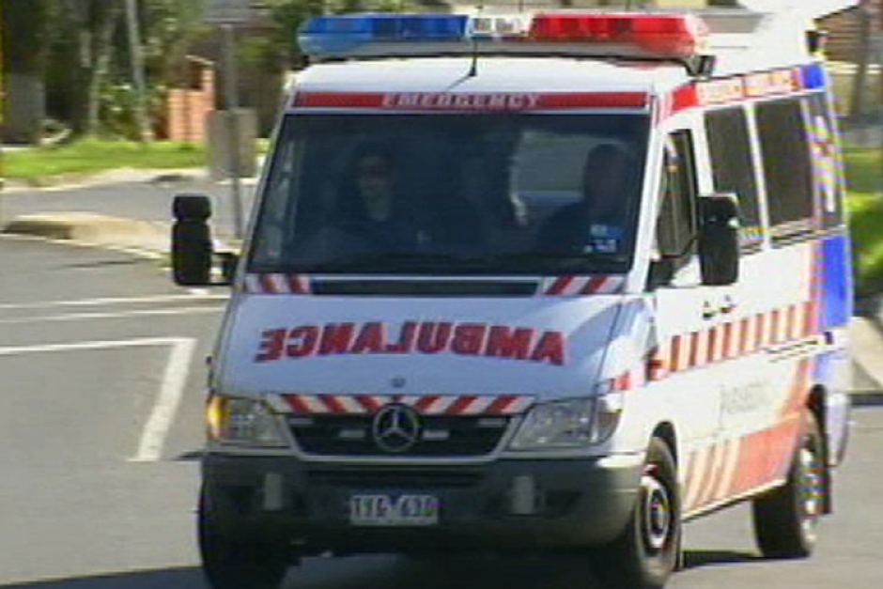
ambo
Ambo : ambulance

Slide 12
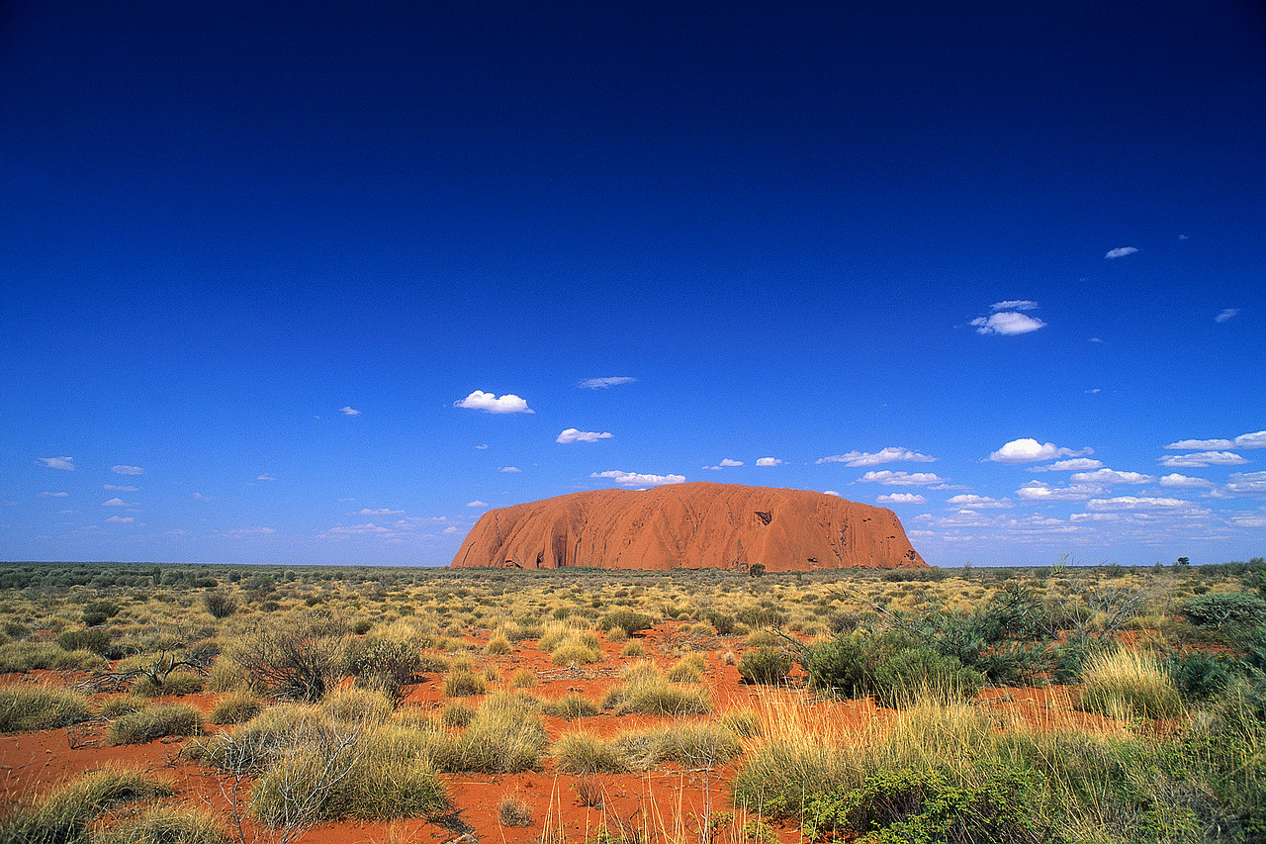
Woop woop
Woop woop : Out in the middle of nowhere

Slide 13
Fair dinkum
Fair dinkum : honest

Slide 14
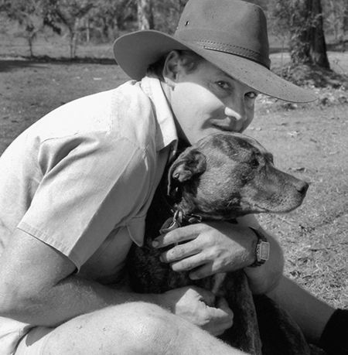
True blue
True blue : genuine

Slide 15
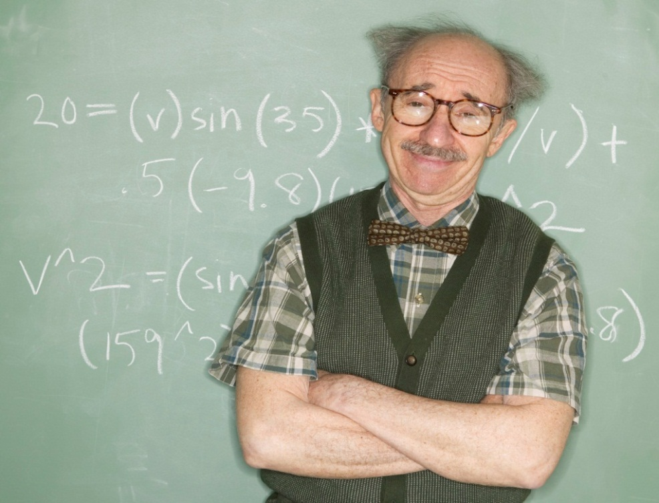
nifty
Nifty : clever

Slide 16
Aussie
Aussie : Someone Australian

Slide 17
whopper
Whopper : something surprisingly big

Slide 18
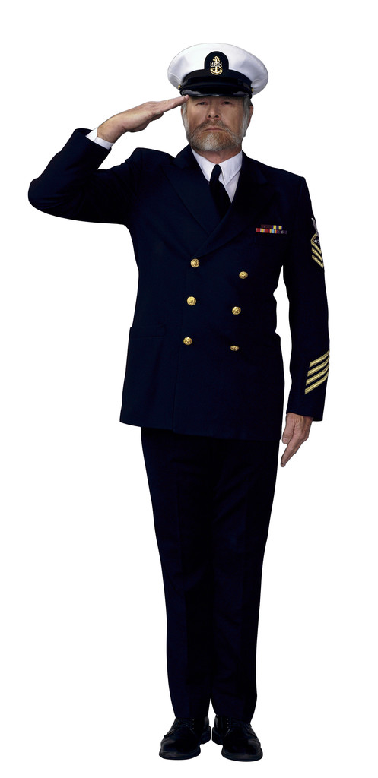
Right-o
Right-o : alright

Slide 19
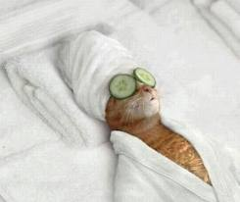
Veg out
Veg out : relax

Slide 20
servo
Servo : A petrol station

Slide 21
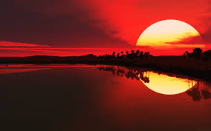

arvo
Arvo : afternoon

Slide 22
dunny
Dunny: toilet

Slide 23
hooroo
Hooroo : goodbye

