Slide 1
☺ School Life ☺
By Pooja, Carly, Kaitlin and Eva!

Slide 2
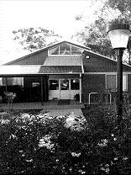
Information on Temora High School
What does “Respice Finem” mean?
Respice Finem is our school motto and it means looking towards the goal.
What year was Temora High School established?
1952

Slide 3
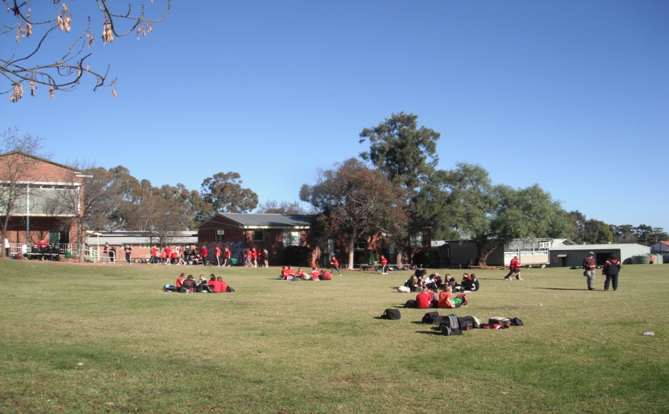
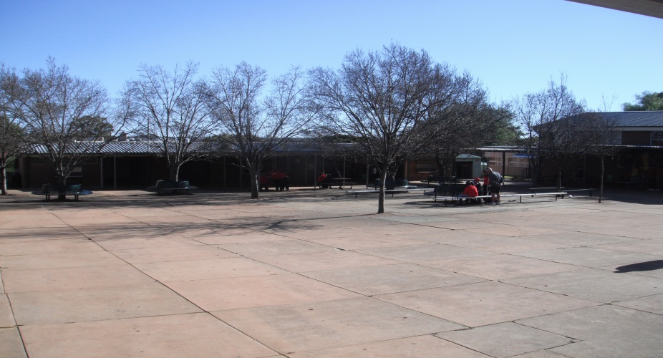
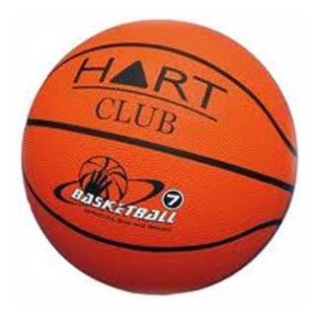
Recess/Lunch
Recess starts at 11:00am and finishes at 11:20am. For recess you can either bring your lunch or buy it at the canteen as it is open all week. After you have finished your Recess you can play on the basketball court or play on the oval, hang in the quad, or just sit and chat on the oval. We don’t have a cafeteria.

Slide 4
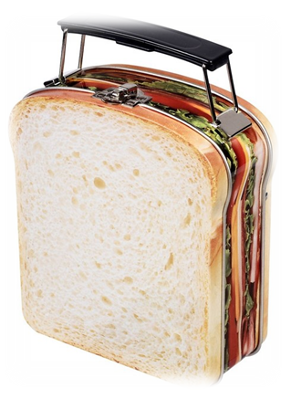
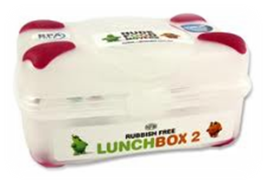
Recess/Lunch
Lunch is mostly the same as recess. It starts at 1:20pm and finishes at 2:10pm. Lunch also has the advantage of having two halves, this means it goes for longer. Most of the extra activities that you can do in school are in lunch time because you have more time.

Slide 5
Subjects
The classes we do in year 7 are:
English
Maths
Science
Korean
Art
Design & Technology
Sport
History
Music
Library
Health
DEAR (quiet reading)
The classes we do in later years are:
Woodwork
Metalwork
Drama
Cooking
Sewing
Auto
Extension Classes
Agriculture
Dance
Computing
Digital Media
Geography

Slide 6
This is one of our school timetables. It shows what subject, teacher and room our next class will be.

Slide 7
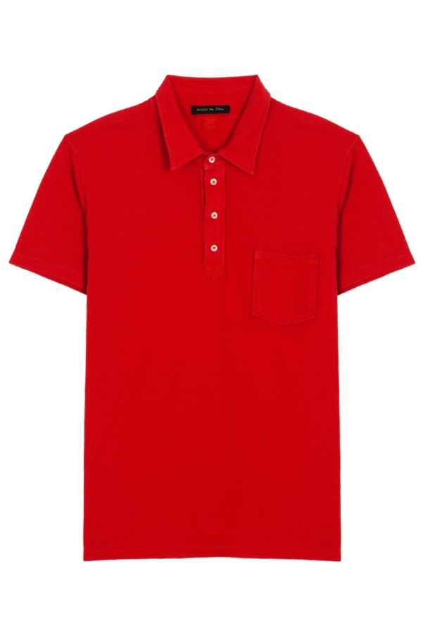
School Uniform
The uniform we wear is simple.
For summer we wear:
Black Shorts
Red school shirt
Leather covered shoes
For winter we wear:
Black Long Pants
Red Jumper
Leather Covered Shoes

Slide 8
Sport Sport at Temora High School happens every Wednesday afternoon during 5th and 6th period. We have a range of different sport choices including:
Tennis
Soccer
Squash
Hockey
Softball
Fitness Walking
Swimming
Badminton
Volleyball
Touch
Basketball
Gym session
Shooting

Slide 9
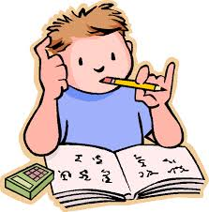
Homework / Study
At Temora High homework isn’t a big thing. Some subjects teachers give you a page or two to complete in year 7. In later years you get some bigger assignments to complete. When you get to year 11 and 12 you get lots of homework and have time during the day for study.

Slide 10
A Typical School Day
School starts at 8:50 for roll call but people usually arrive earlier. At 9:00 we have our first period or lesson. Each period goes for an hour. After the first two periods we have recess. We then have our next 2 classes. Lunch is next which goes for 50 minutes. We then have the last two periods (the first of which is a 20 minute silent reading period) before finishing school at 3:30pm.

Slide 11
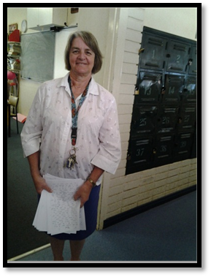
High School Teachers
We have many school teachers here at school. These are just a few of them. Most of our teachers are married. Each year group has a year adviser who takes care of them for the rest of their years at Temora high school.

