Slide 1
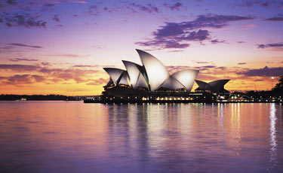
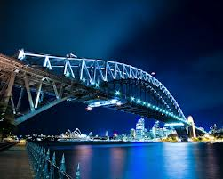
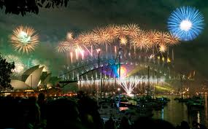
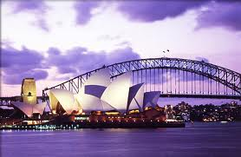
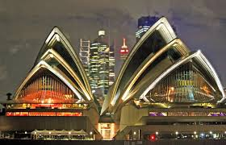
Sydney Opera House & Harbour Bridge
Sydney Opera House
by Yura Cho 7B
Harbour Bridge

Slide 2
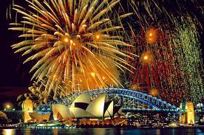
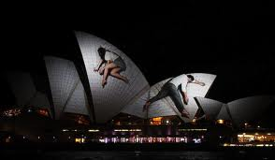
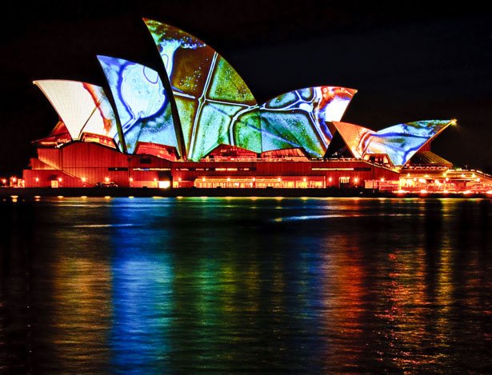
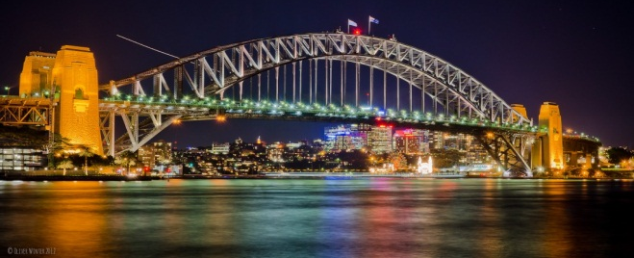
Sydney Opera House and Harbour bridge.
Two of Sydney’s most loved landmarks!
Harbour Bridge, the bridge joined the city of Sydney (at Dawes Point) to the North Shore (at Milsons Point) obviating the need to travel by ferry or make a substantial trip around the harbour foreshores towards Parramatta and back.
The Sydney Opera House is a multi-venue performing arts centre in New South Wales, Australia. It was conceived and largely built by Danish architect Jørn Utzon, opening in 1973 after a long gestation that began with his competition-winning design in 1957

Slide 3
Location
Sydney opera house is located here.
Harbour bridge is located here
Both of these famous landmarks are located in the city and can be seen at anytime.

Slide 4
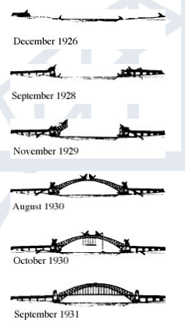
Sydney Opera house and Harbour Bridge; What it is.
The Sydney Opera House was built due to the demand for a bigger theatrical space in Sydney. Planning began in the 1940s and in 1955, a competition was held to find the most impressive architectural design. 233 entries from 32 countries made way for an interesting story that continues today.
The Sydney Harbour Bridge, also known as the 'Coathanger‘, was opened on March 19th 1932 by Premier Jack Lang, after six years of construction. Made of steel the bridge contains 6 million hand driven rivets. The surface area that requires painting is equal to about the surface area of 60 sports fields. The Bridge has huge hinges to absorb the expansion caused by the hot Sydney sun. You will see them on either side of the bridge at the footings of the Pylons.

Slide 5
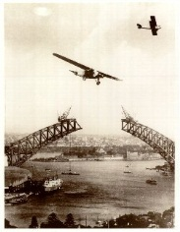
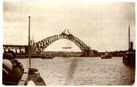
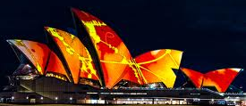
Interesting facts
Sydney Opera House
The sails of the Opera House are made up of 1,056,006 self-cleaning white and cream tiles imported from Sweden.
The money needed to build the Opera House was funded by a lottery
Over 1500 performances are held at the Sydney Opera House each year.
The man who thought of the structure got the idea from cutting up an orange and positioning the orange slices into a random pattern and then created a blueprint with the same structure.
Harbour Bridge
At the time, Grey was the only colour paint available in such quantities. It took 272 thousand litres just to get the first coat on.
Retired cavalry officer, Francis De Groot somehow worked his way into the honour guard at the Bridge opening. Just as the ribbon was about to be cut, he galloped forward on his horse and slashed it with his sword, declaring the Bridge open in the name of 'the decent citizens of New South Wales'. After retying the ribbon as best they could, the ceremony continued. De Groot was carried off to a mental hospital, declared insane and later fined for the cost of the ribbon.
Special projection event

