Slide 1
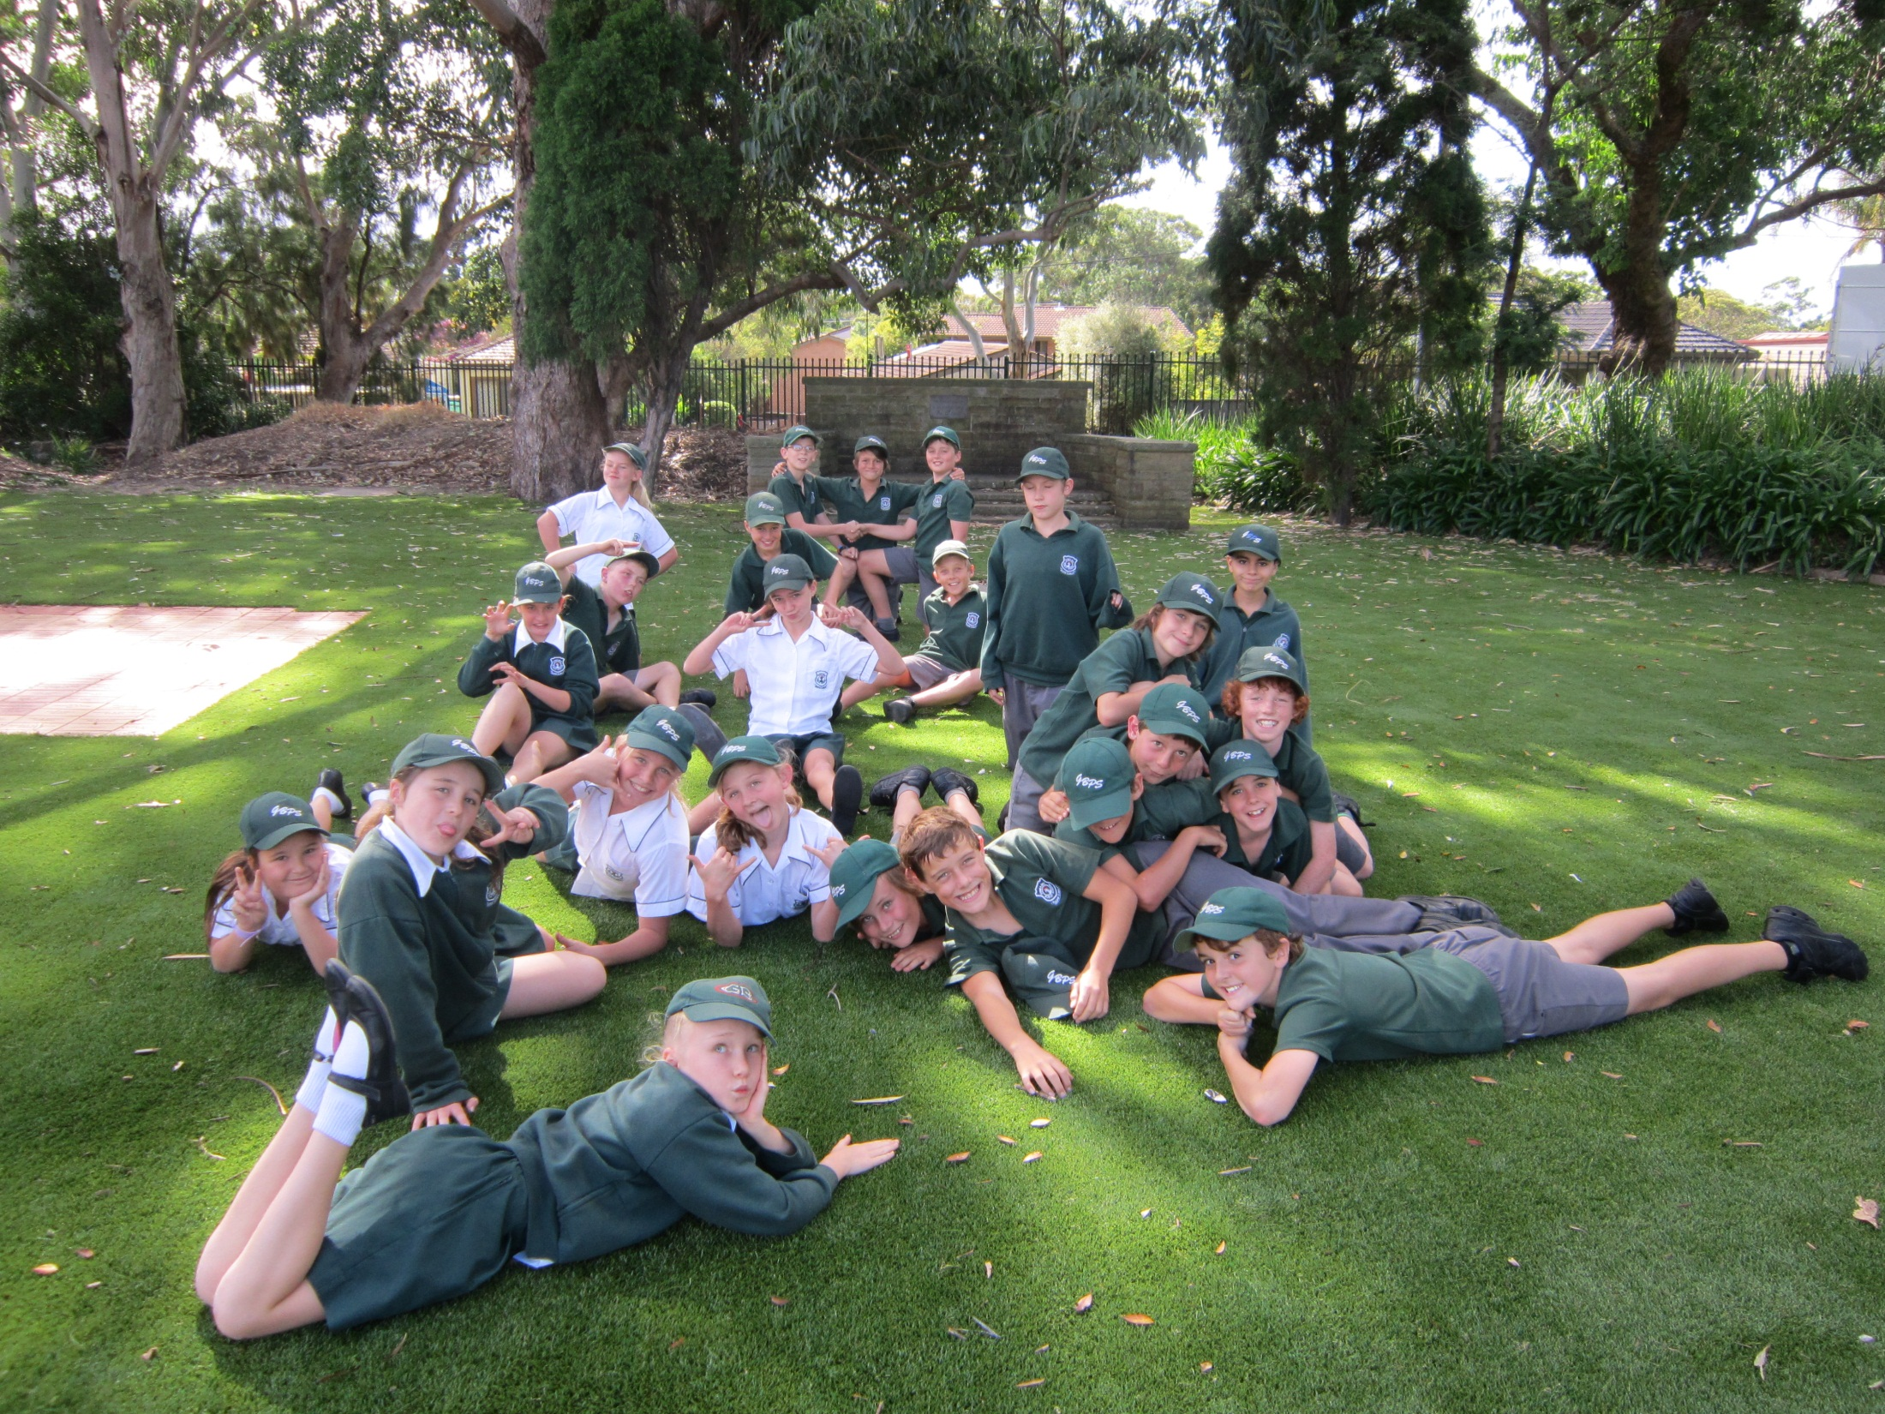
Welcome to
5J
Gymea Bay Public School

Slide 2
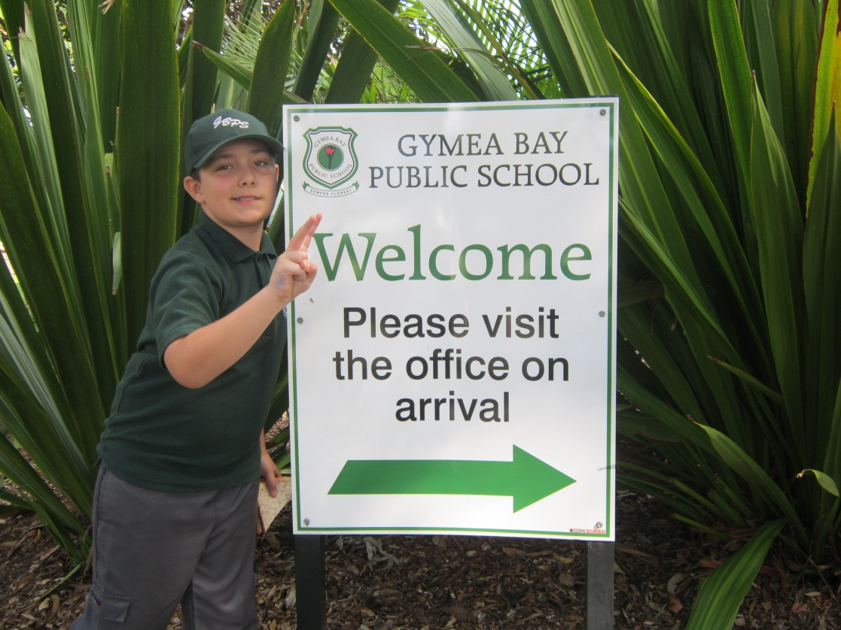
Ryan Kelso
-라영준
Age: 10
Likes: Computers
Dream:
YouTube celebrity

Slide 3
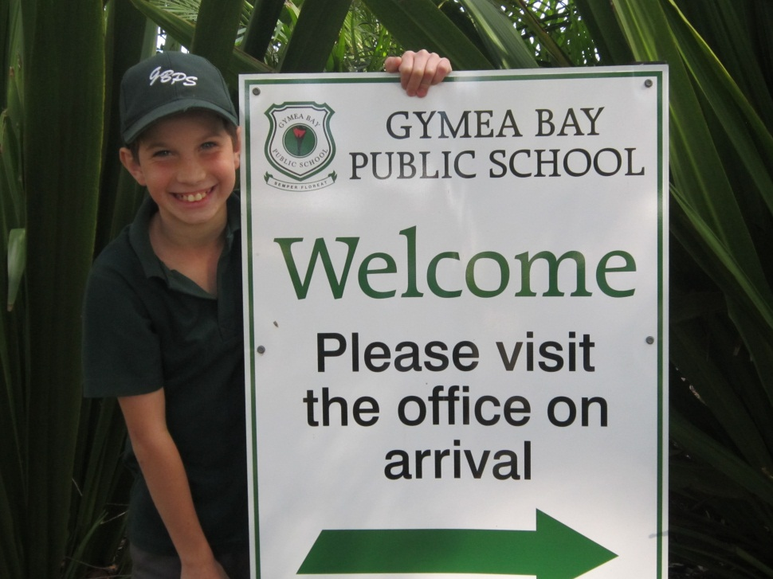
Jacob Solomon
강건
Age: 10
Likes: YouTube ☺
Dream:
To work for Google.

Slide 4
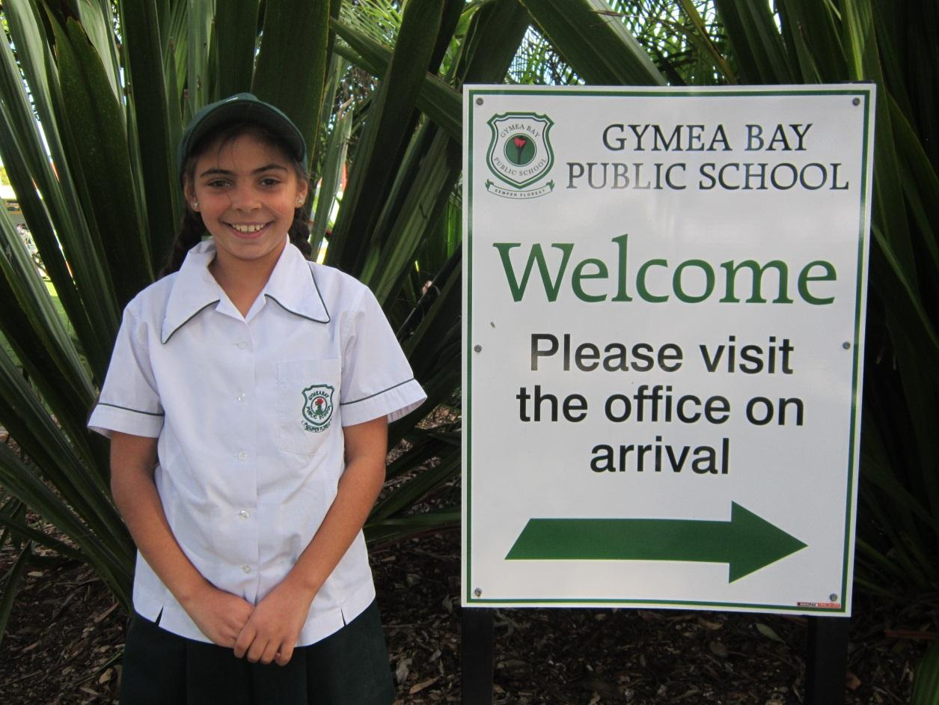
Angelica
김담비
Age: 10
Likes: To play netball
Dream: to become a doctor

Slide 5
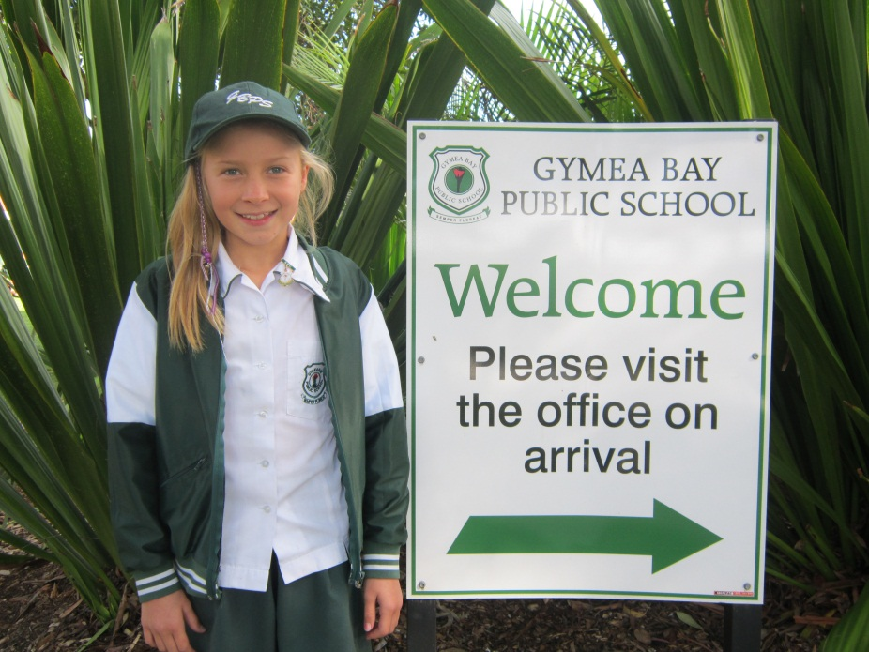
COURTNEY
-최다은
Age: 10
Likes: The colour purple
Dream: To be a famous tennis player.

Slide 6
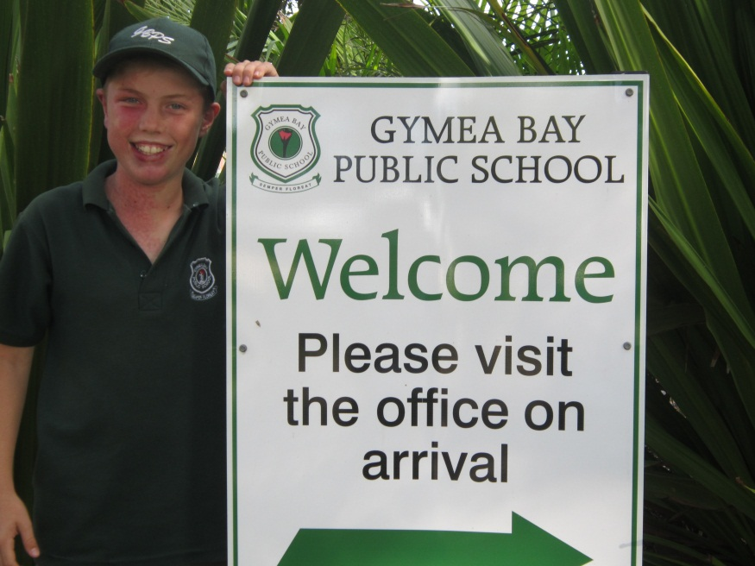
JOSH MURRAY
-강건
Age: 10.
Likes: Wake Surfing, Rugby League and Skating.
Dislikes: Vegetables, Rainy Days and Maths.
Dream: Be A Builder For My Own Company.

Slide 7
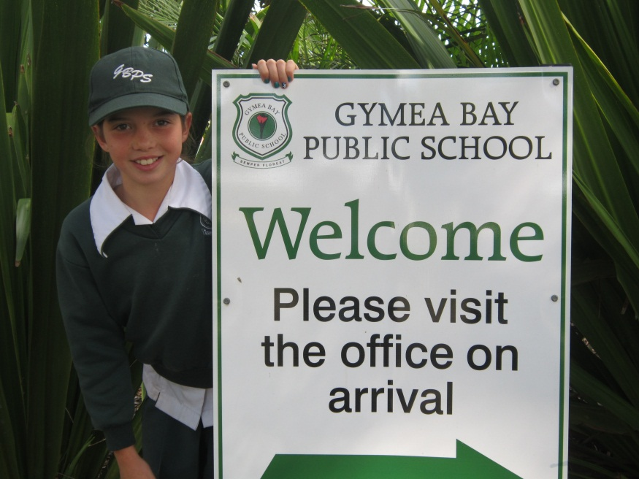
kIrralee
-우은정
Age:10
Likes: One direction, the colour aqua, soccer, dancing, lollies, chocolate and jet skiing.
Dislikes: vegetables and rainy days
Dream: to be either a famous singer or professional actor.

Slide 8
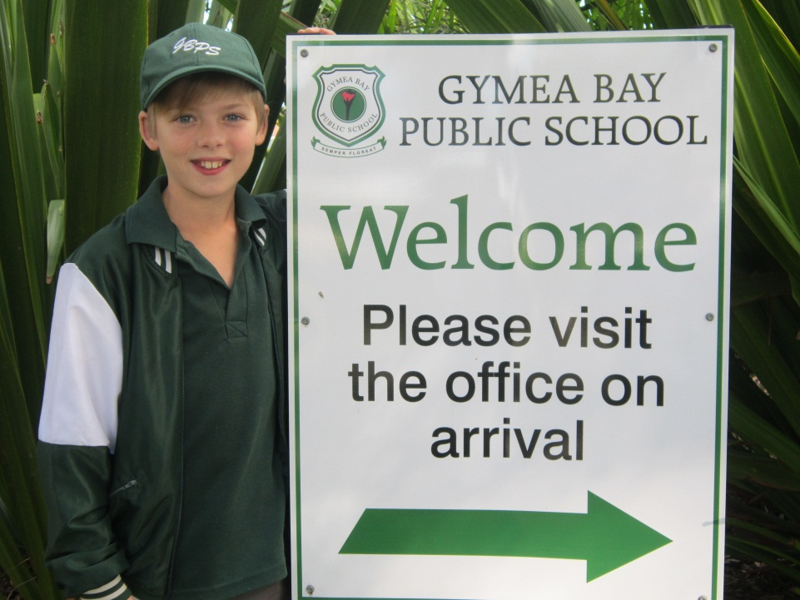
Cody-김현미
AGE: 10
LIKES: I love to dance and do karate. I enjoy playing soccer and playing basketball.

Slide 9
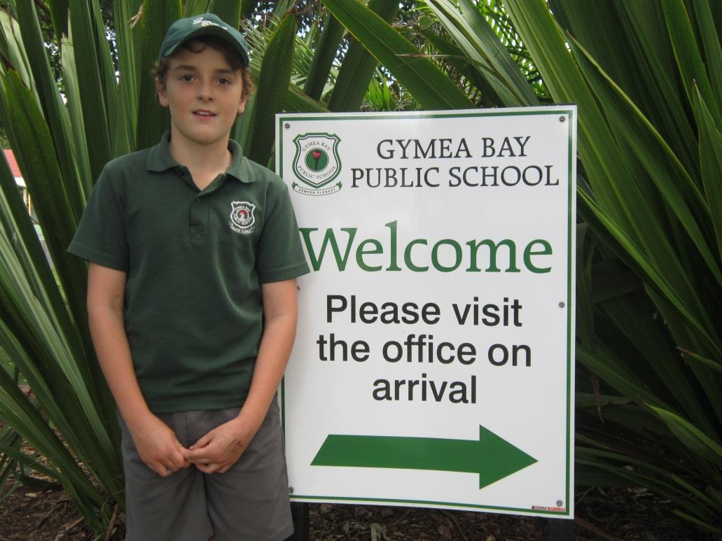
CHRIS
-한송학
AGE: 11
Likes the Cronulla Sharks in the NRL witch is in the rugby league
DREAM: TO BECOME A PROFFESIONAL RUGBY LEAGE PLAYER

Slide 10
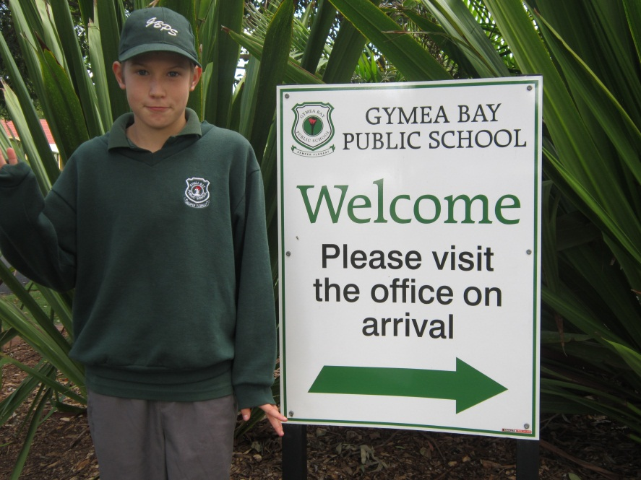
Tyler - 강건
Likes: I Like Computer’s and video games and soccer and likes all friends and Borderlands.
Dislikes: Brussel sprouts and not playing Video Games
Dream: My Dream is to be a video gamer on YouTube and a video game creator!
Age: 11

Slide 11
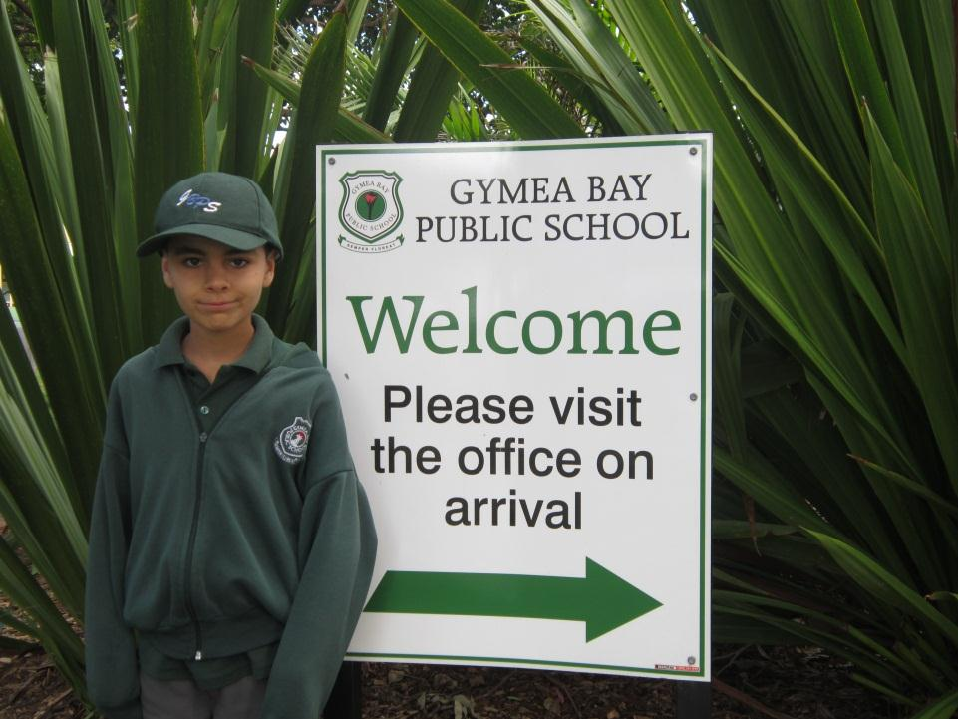
Adrian
-최윤정
Age: 11
My dream: is to be an astronaut

Slide 12
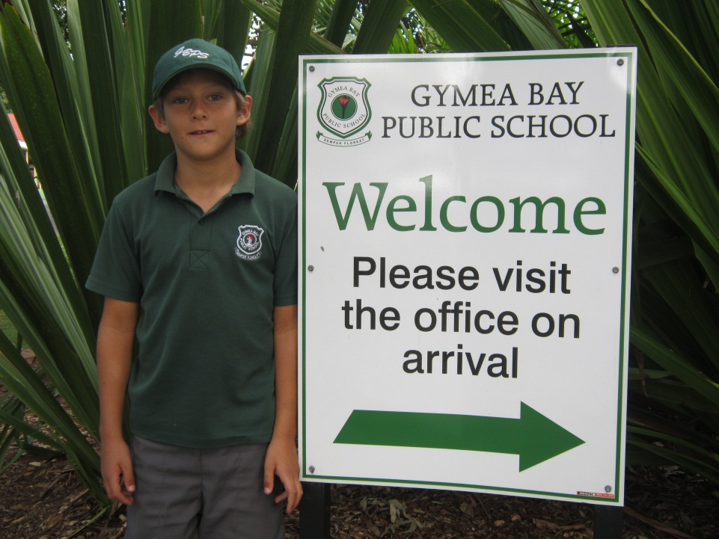
Nathan
-김현미
Age: 10
Favourite sport: football
Dream: famous footballer for Australia

Slide 13
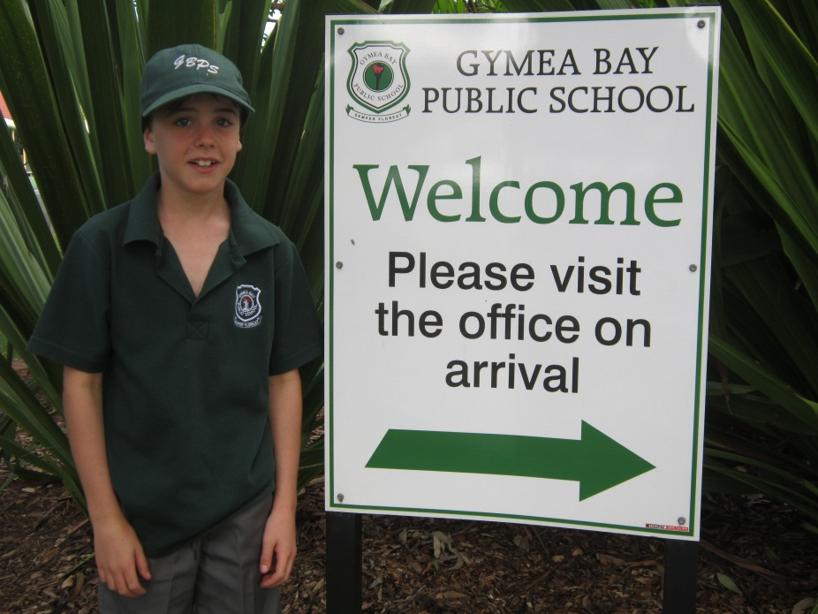
Luca-정이삭
Age: 10.
Likes: The colour blue, Soccer.
Dream: To be an engineer.

Slide 14
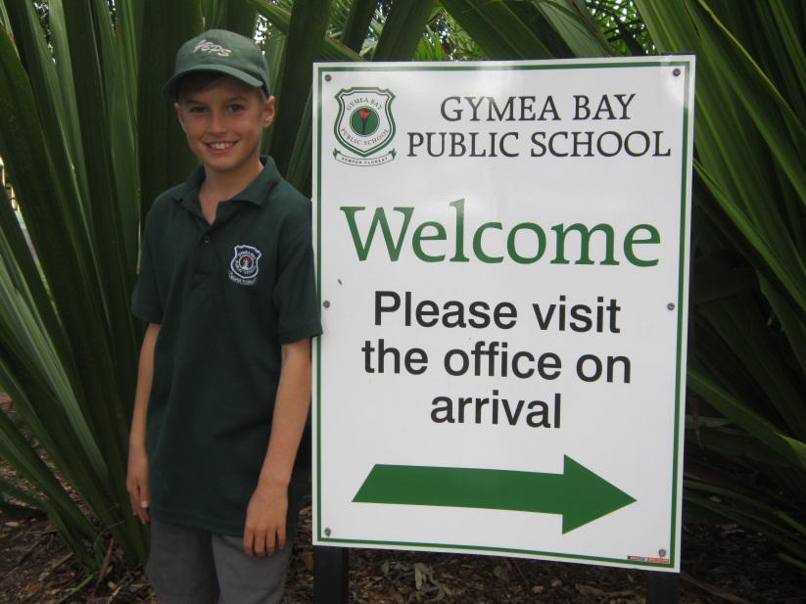
MYLES
- 최윤정
AGE 10
DREAM My dream is to be a baseball player

Slide 15
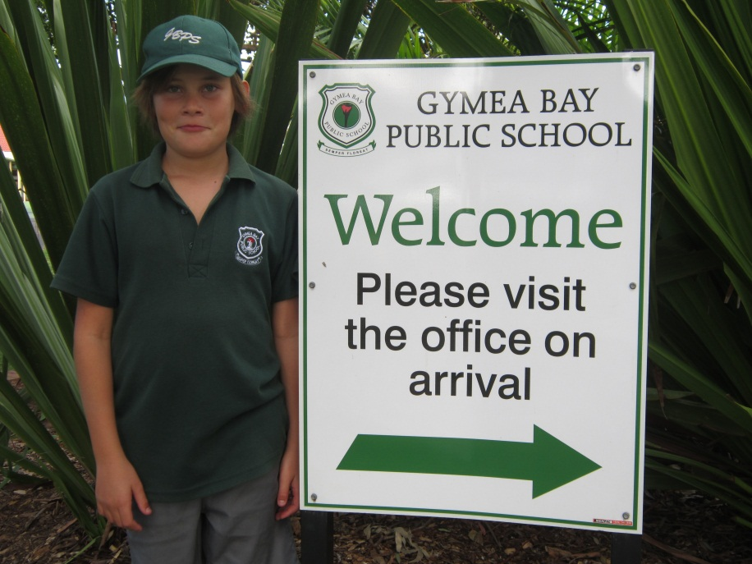
RILEY
-정이삭
Age:11
What I want to be when o grow up: I want to be a builder.

Slide 16
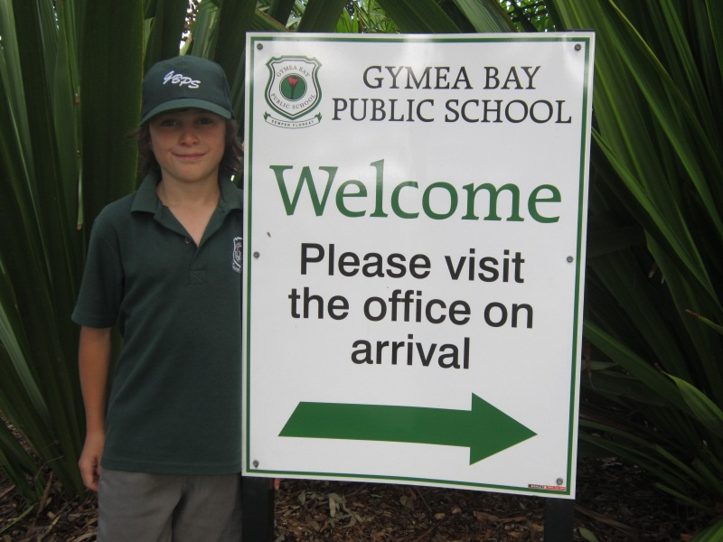
Trae-한송학
Dream: to be a professional Rugby league player
AGE: 10

Slide 17
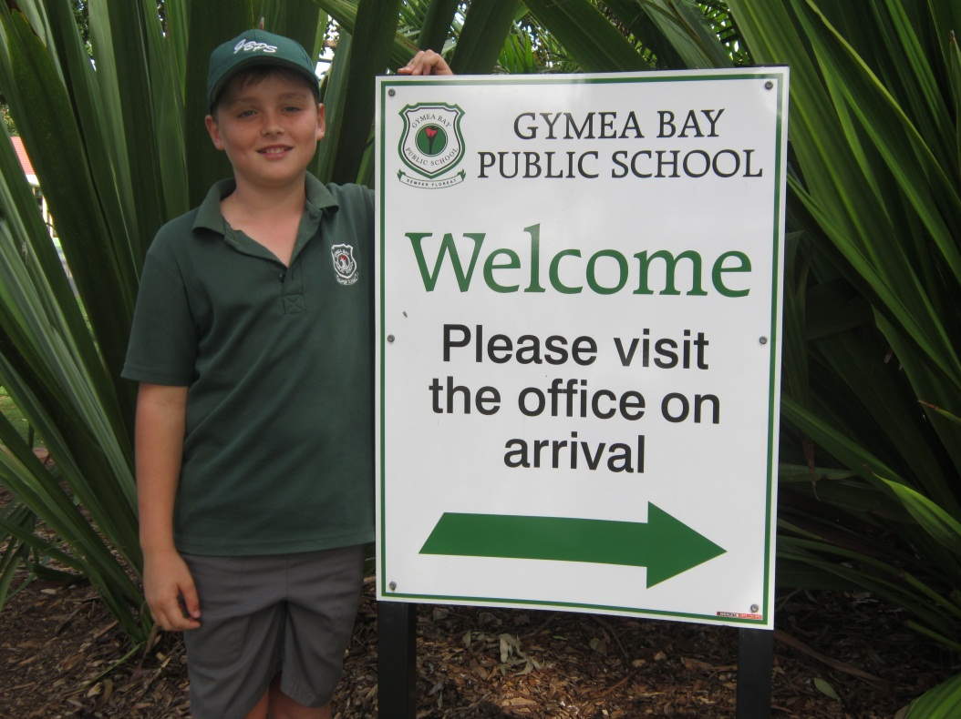
Kye lumsden
-라영준
Dream : is to be a builder
Age:10

Slide 18
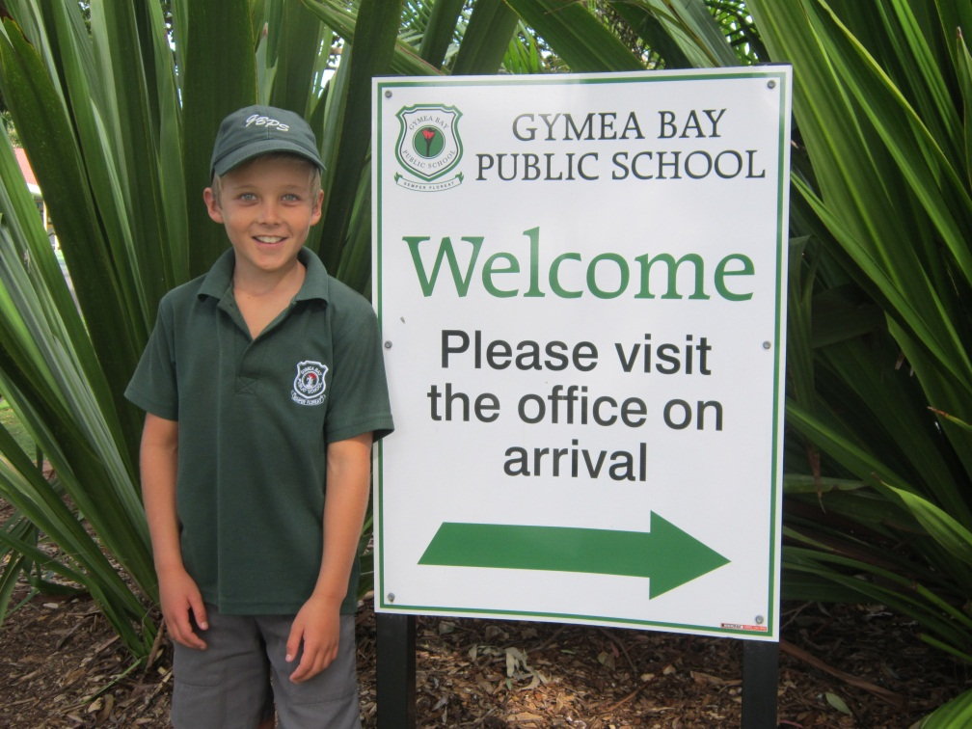
DREAM:PROFESSIONAL SOCCER PLAYER
AGE: 10
LUKE
-최윤정

Slide 19
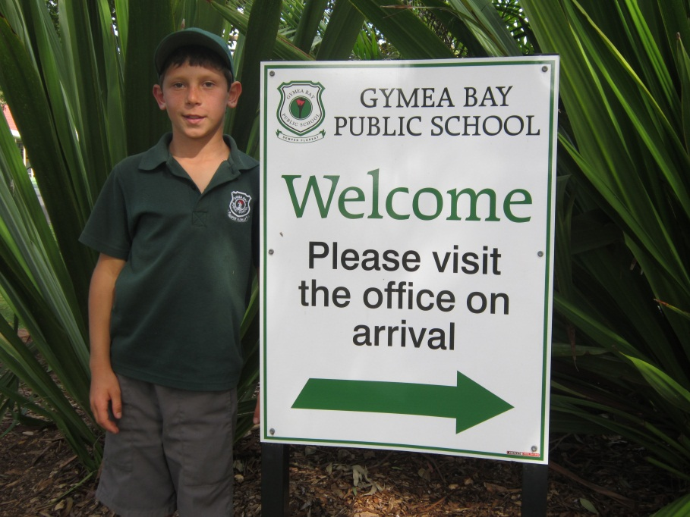
Paul my age is ten my dream is to be a professional football player
- 한송학

Slide 20
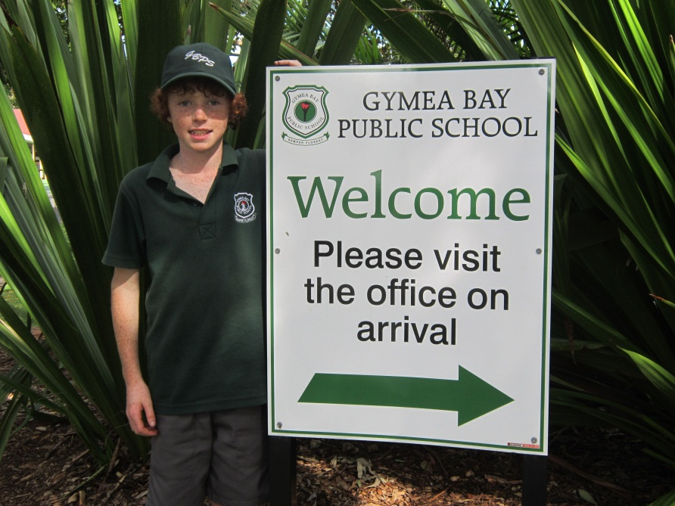
My name is Daymon
My dream is to be a pro skater
-김현미
My age is 10

Slide 21
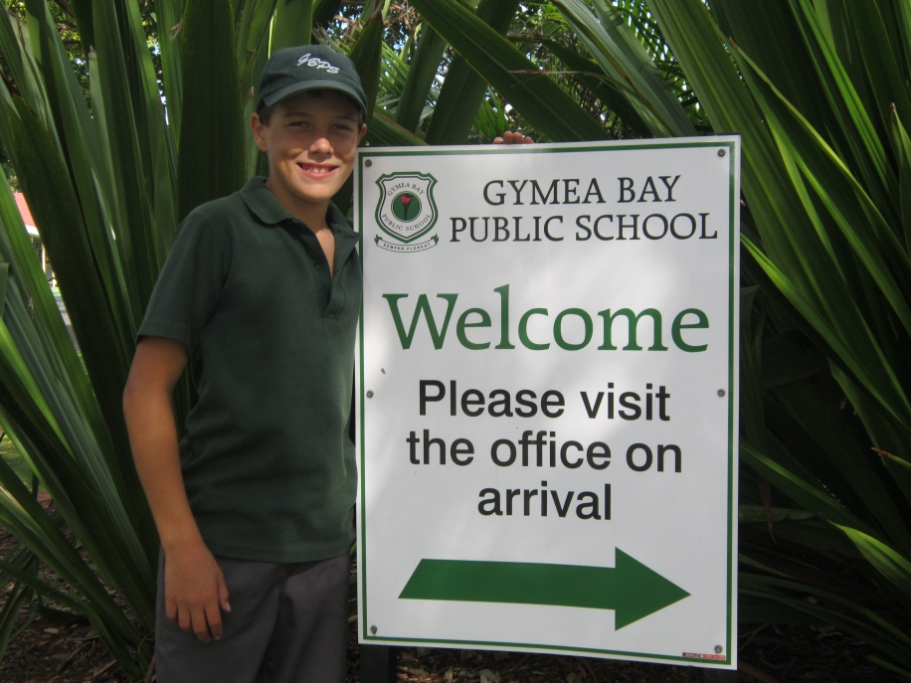
GOOD AT SPORTS
KYLE
LAWTON
AGE 10
라영준
DREAM
FOOTBALL PLAYER

Slide 22
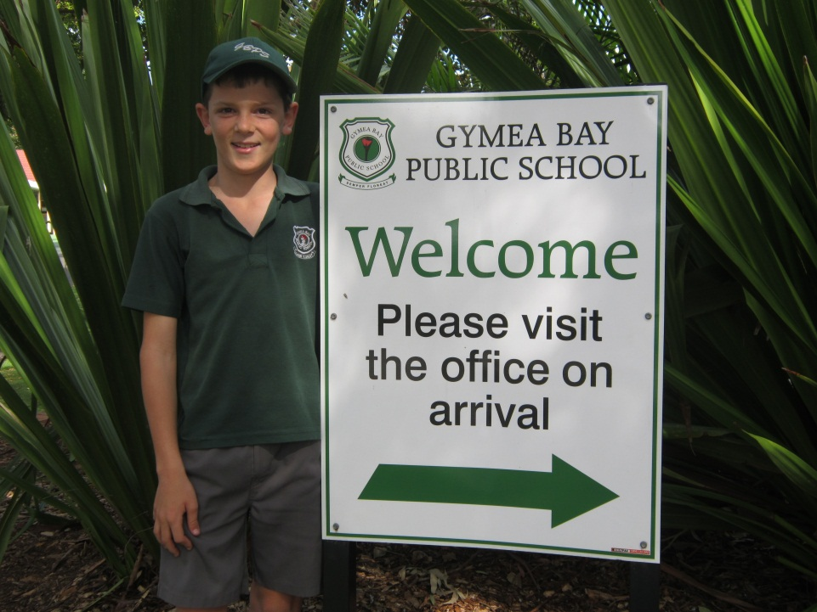
Good at sports
Nicholas Beattie
-최다은
I like footy running and surfing
My dream is to be a builder

Slide 23

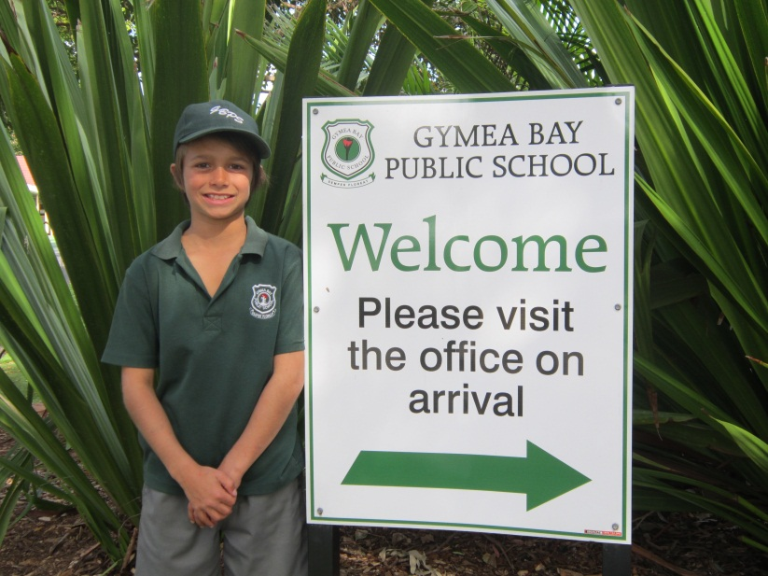
JORDAN TURANSKY
-정이삭
AGE :10
DREAM: TO BE A FAMOUS GYMNAST

Slide 24
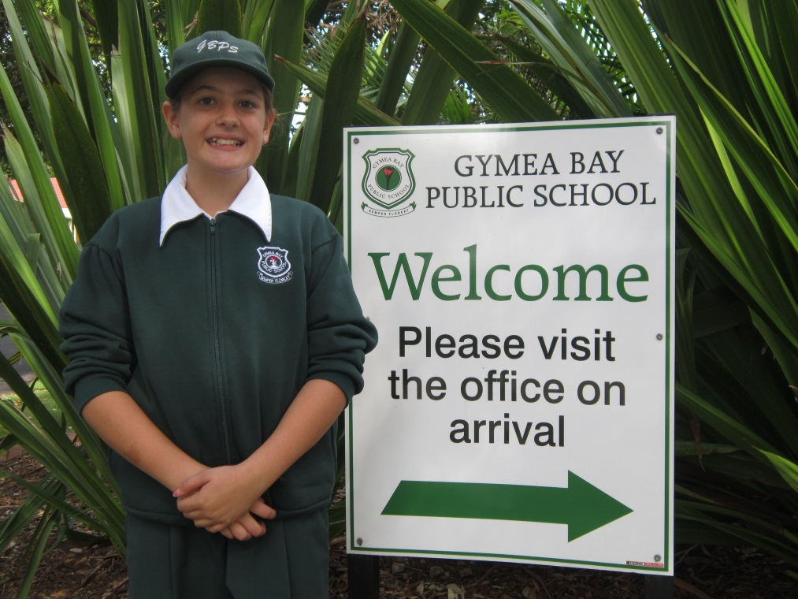
Tahlia
-김현정
Age 11
My dream when I am older is to be a Matilda’s soccer player.

Slide 25
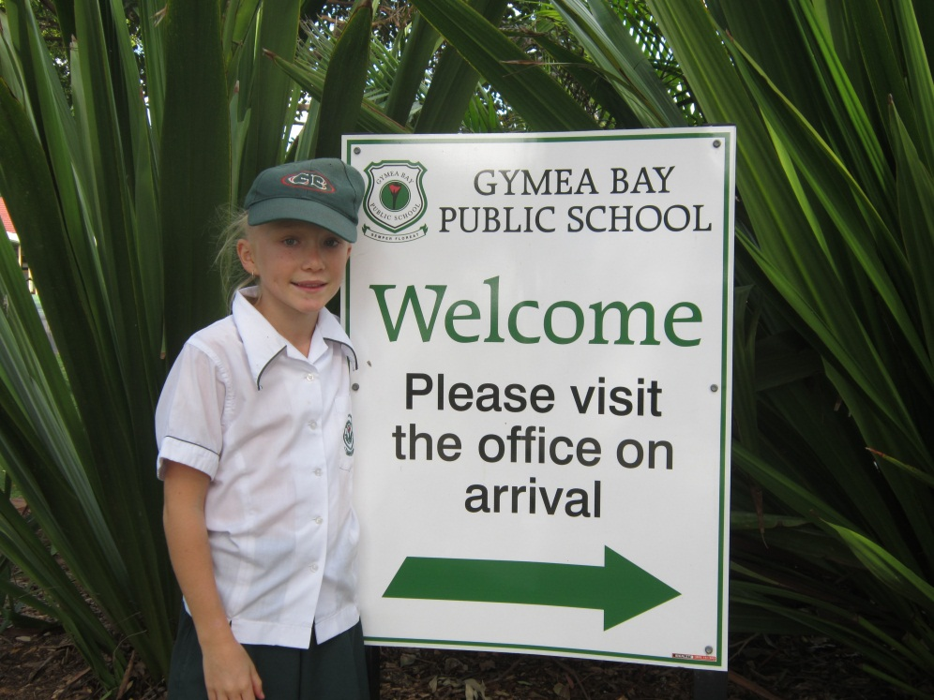
Holly
김담비
Loves dancing ,soccer ,oztag and light green
Dislikes tests
Age I am ten turning eleven this year

Slide 26
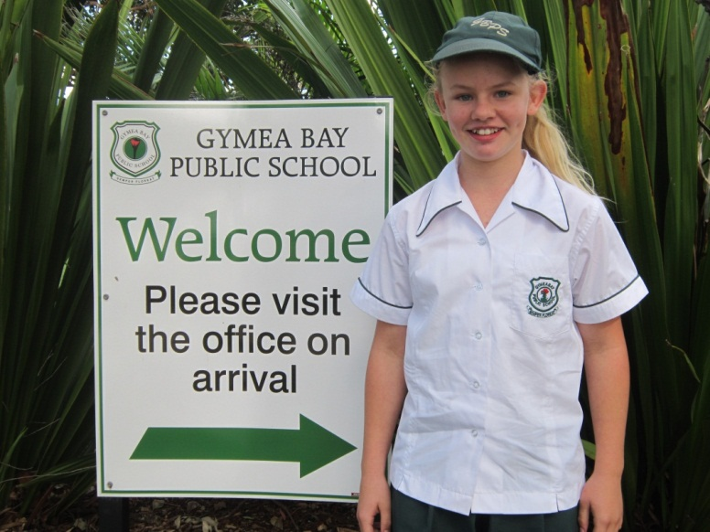
Natasha
김현정
Age:10
Likes: soccer, dancing, oztag, blue, purple

Slide 27
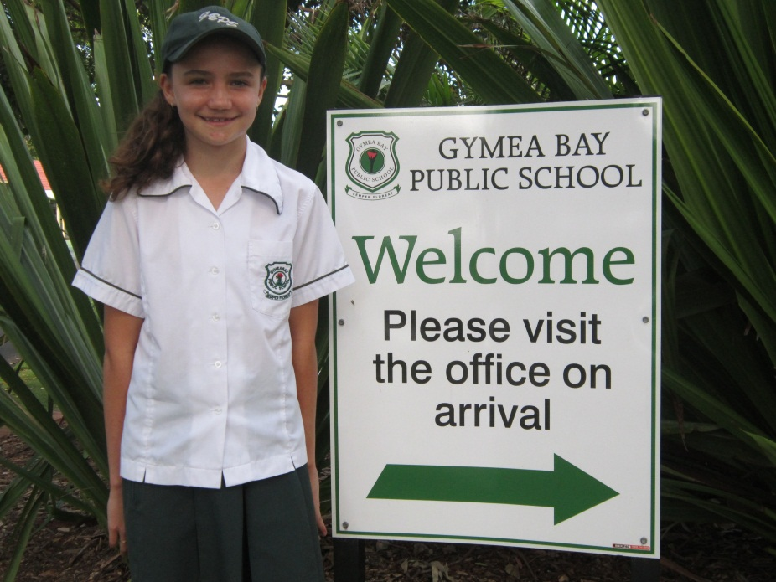
Zoe
김현정
Likes netball, chocolate and purple

Slide 28
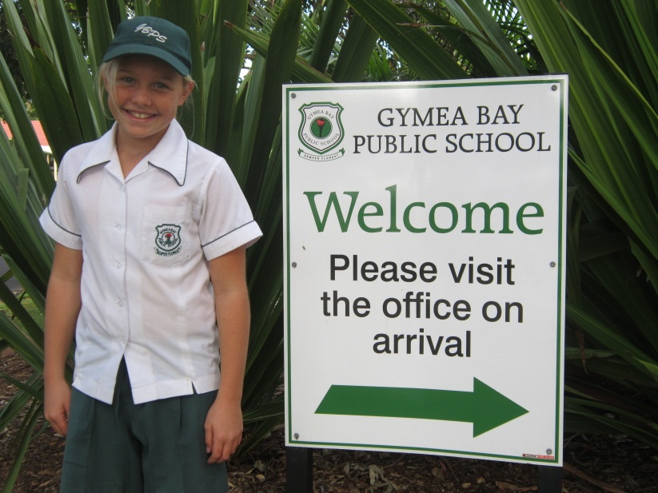
Olivia Eason
I am 10 years old
love to play sport
김담비

Slide 29

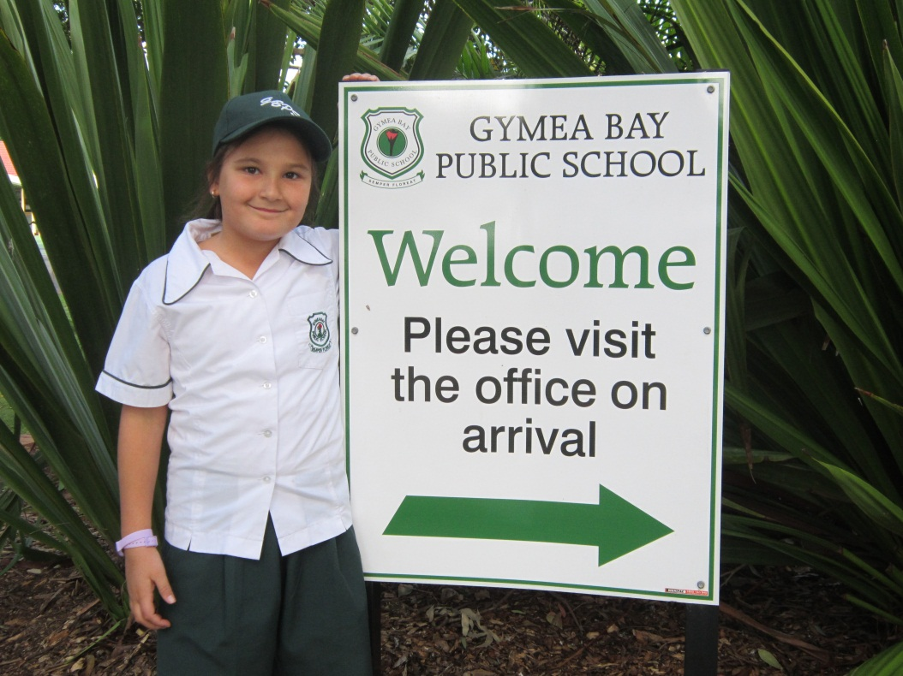
JEMMA!
-최다은
Age: 10
Dream: To be a famous actor
Likes: Ice cream, lollies and art

Slide 30
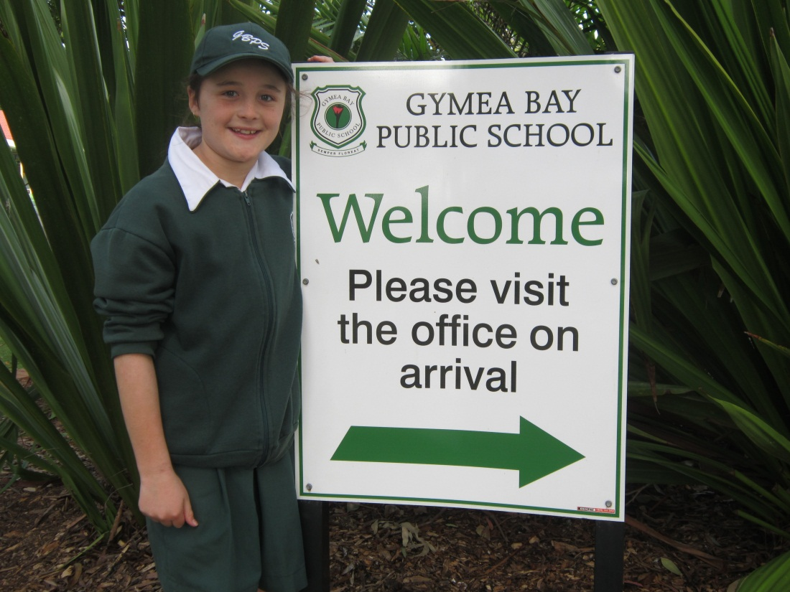
Ella
-우은정
Age: 10
Likes: Dancing, oztag, netball ,baking and blue
Dream: To be a famous dancer or chef

Slide 31
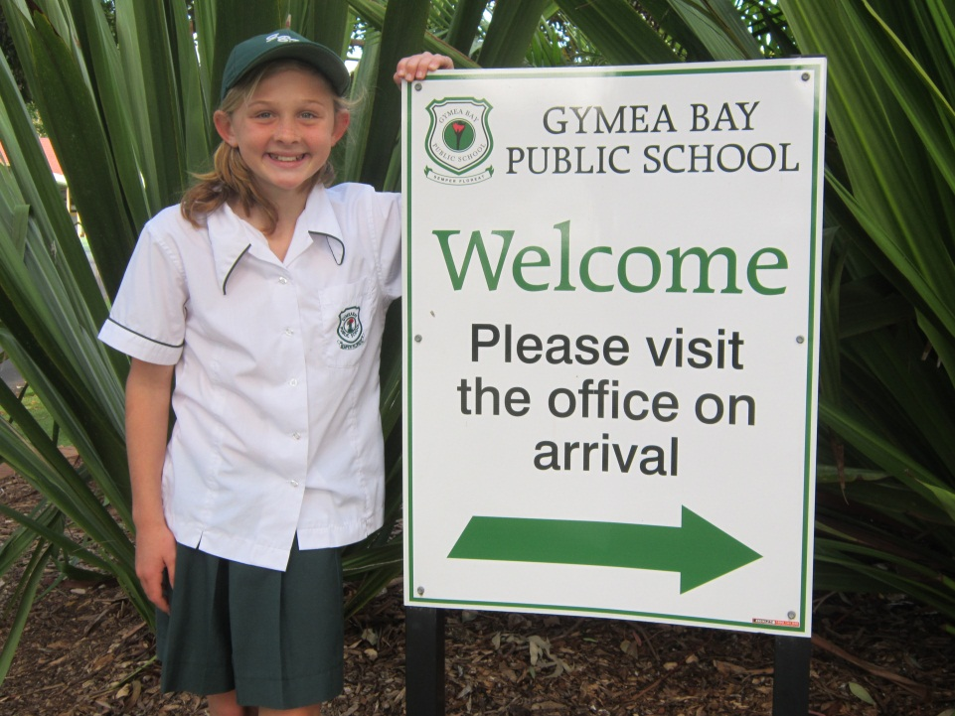
Rachel Sothern, 10 years young .
Loves to swim and go to the beach.
-우은정

