Slide 1
Meet Australia, Sydney & Gymea Bay!
Friday 3 May 2013

Slide 2
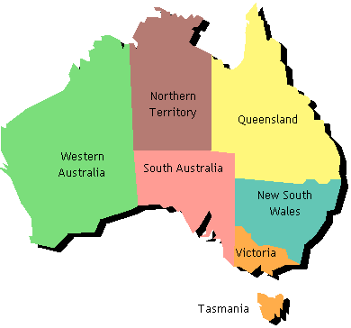
Australia
This is a map of our wonderful country. The coloured sections represent each of the six states and two territories. Sydney is on the east coast of Australia in New South Wales.
The capital city of Australia is Canberra, which is located in the ACT
Sydney
Gymea Bay is located about 27 kilometres south of the city
ACT
Australian Capital Territory (where our capital, Canberra, is located)

Slide 3
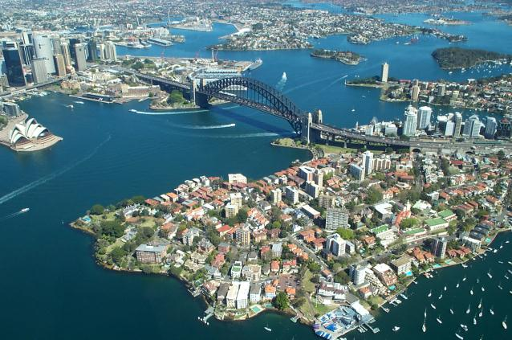
Sydney
Sydney is the beautiful capital city of New South Wales.
Darling Harbour
Sydney Harbour Bridge
Circular Quay
Sydney Opera House

Slide 4
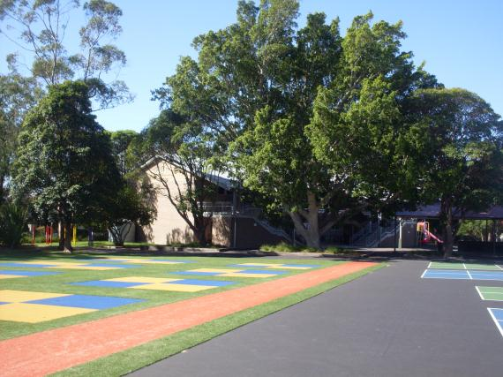
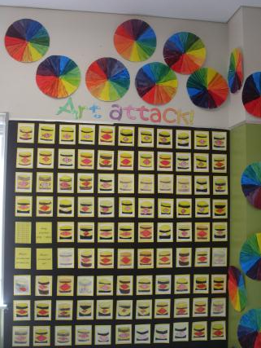
Gymea Bay
As we previously stated, Gymea Bay is located approximately 27 kilometres south of Sydney city in the Sutherland Shire. It is a lovely, leafy suburb.
This is our school’s new playground.

Slide 6
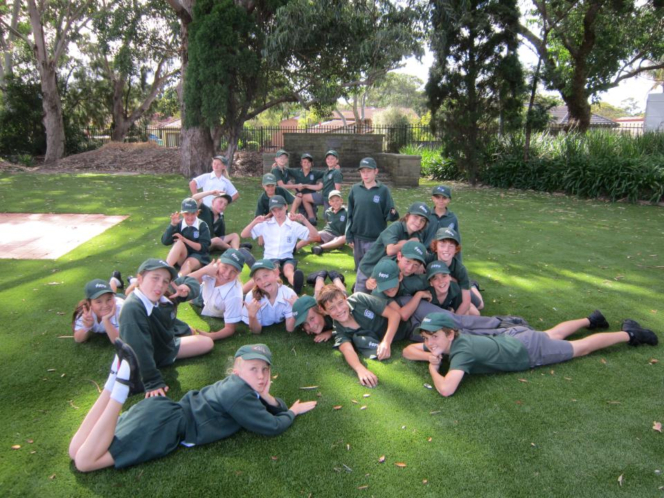

Slide 7
