Slide 1
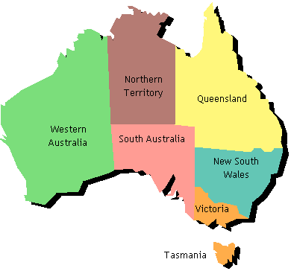
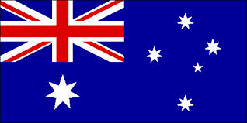
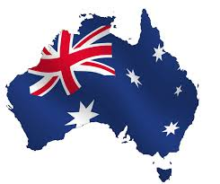
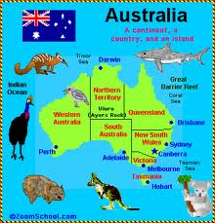
Australia
By Brianna Hardy, Keira Warn and Nina Bruce

Slide 2
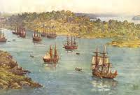
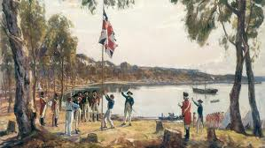
the first fleet
Aboriginals are the world’s oldest civilisation, having lived here for more than 50,000 years.
Aboriginals speak in more than 700 languages
The Aboriginal language used in Wollongong id the Darrwal language
The first fleet arrived with eleven ships.
The first fleet arrived in Australia in 1788.
Passengers consisted of: 10 civil officers, 212 Marines, including officers, an additional 28 wives and 17 children of the marines, 81 free people, 504 male convicts and 192 female convicts; the total number of free people was 348 and the total number of prisoners was 696, coming to a total of 1044 people.

Slide 3
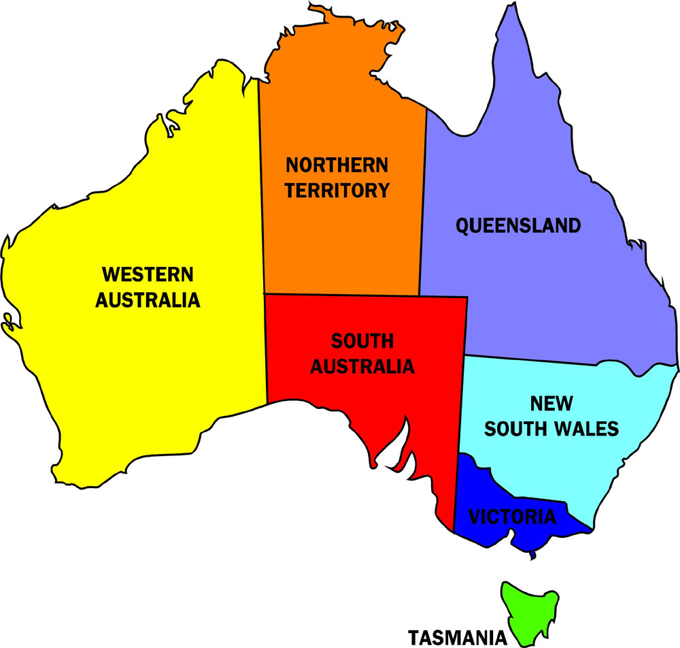
Australia’s states
Australia have six states and one territory. They are:
Victoria-state
New South Wales-state
Queensland-state
Western Australia-state
South Australia-state
Tasmania-state
Northern Territory-territory

Slide 4
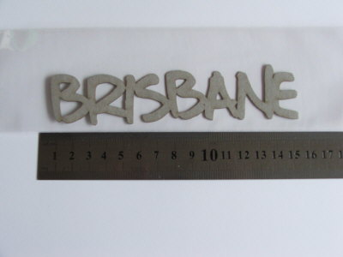
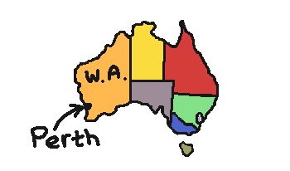
Australia’s capital cities
Each of Australia’s states have a capital city here are just some:
New South Wales-Sydney
Victoria-Melbourne
Tasmania-Hobart
South Australia-Adelaide
Queensland-Brisbane
Western Australia-Perth
Northern Territory-Darwin

Slide 5
Population
Population of New South Wales-7,238,819 (June 2010)
Population of Queensland-4,560,059 (June 2012)
Population of Tasmania-512,100 (March 2012)
Population of South Australia-1,648,700 (September 2010)
Population of Western Australia-2,118,500 (September 2007)
Population of Northern Territory-225,900 (June 2009)
Australian population-22,959,511 (March 2013)

Slide 6
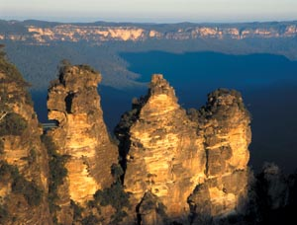
Tourist attractions in new south Wales
Darling Harbour
Sydney Harbour Bridge climb
Powerhouse Museum
Taronga Zoo
Wildlife Sydney
Sydney Aquarium
National Gallery of Australia
Sydney Opera House
Jamberoo Action Park
Jenolan Caves
The Murray River
Port Stephens
Three Sisters

Slide 7
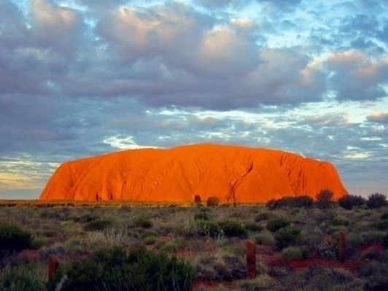
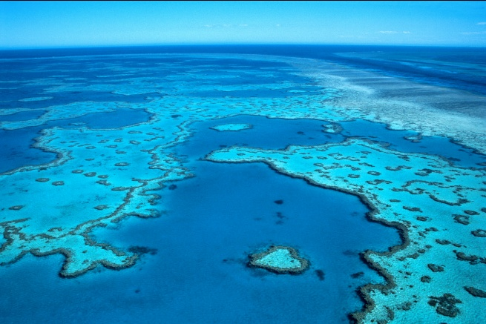
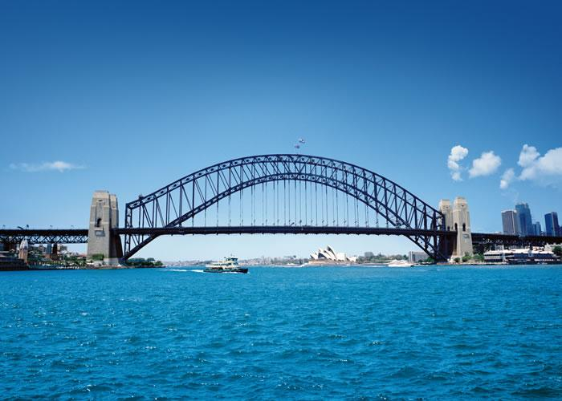
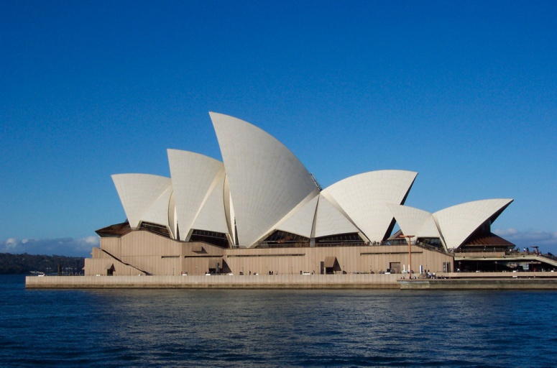
Australian monuments
There are lots of different monuments in Australia such as:
The Sydney Harbour Bridge
The Sydney Opera House
The Great Barrier Reef
Uluru

Slide 8
Thankyou for watching

