Slide 1
Australian History
A story of migration
Part 1
Around 60 000 years ago - 1900
Asquith Girls High School

Slide 2
Our Presentation
1
Aboriginal Peoples
About 60 000 years ago
3
2
The British
1788
Chinese
Mid 1800s
4
Aboriginal Peoples in 1900s
Introduced by Maddie Paemaa
Notes:
In this presentation we will
We hope you enjoy our presentation

Slide 3
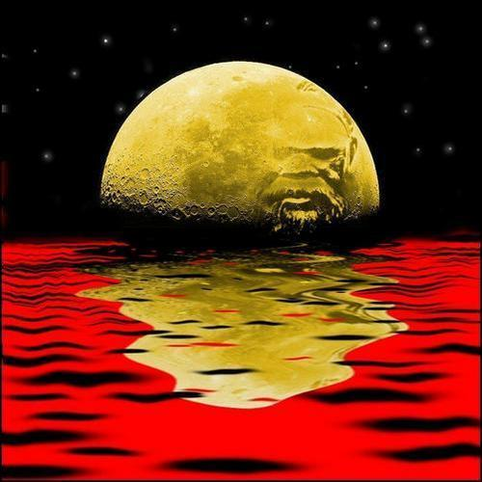
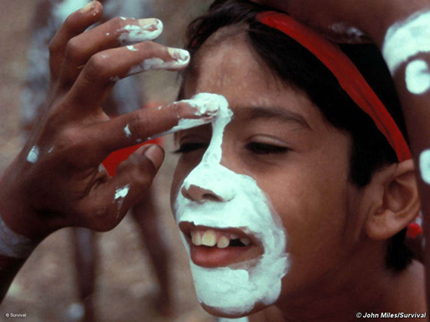
Australian Aboriginal Peoples
Sarita Kharal
Notes:
60k years ago

Slide 4
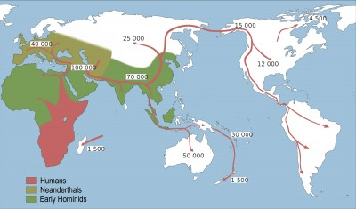
Scientific theories:
Generally agreed
  Aborigines arrived around 65 000 years
  Aborigines came by canoes from South East Asia

Slide 5
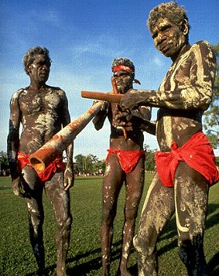
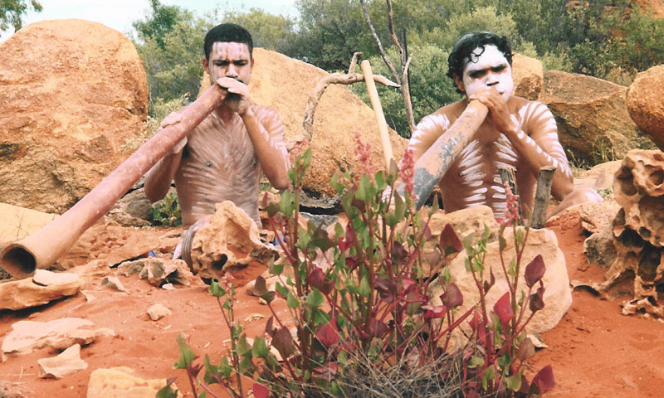
Aborigines believe:
Original inhabitants of Australia.
“We go back, a long way back,
into the Dreamtime,
into the land of our Dreaming.”
“We have been here forever”
Notes:
Australian Aboriginal peoples believe they have been in Australia for all time
They say
“This is our land. It goes back, a long way back, into the Dreamtime, into the land of our Dreaming.”
Australian historians and archaeologists believe that:
Aborigines were the real founders of Australia
they came to this land thousands of years before white people
no one knows exactly where the Aborigines lived before they came to Australia.
it is known that Aborigines came from somewhere in South-East Asia and that they left their homes and travelled to Australia in canoes or on rafts.
Australian Aboriginal culture is the oldest living culture in the world – at least 40,000 – 100 000 years old.

Slide 6
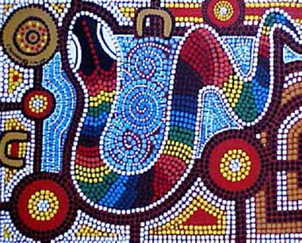
What is the ‘Dreaming’?
Original inhabitants of Australia.
The ‘Dreaming’ to Aborigines was a time when sacred beings created the:
  universe
  land
  people
  rivers, water holes, hills, rocks
  things living.
Aboriginal Art – the Rainbow Serpent – a sacred being
Notes:
Australian Aboriginal peoples believe they have been in Australia for all time
They say
“This is our land. It goes back, a long way back, into the Dreamtime, into the land of our Dreaming.”
Australian historians and archaeologists believe that:
Aborigines were the real founders of Australia
they came to this land thousands of years before white people
no one knows exactly where the Aborigines lived before they came to Australia.
it is known that Aborigines came from somewhere in South-East Asia and that they left their homes and travelled to Australia in canoes or on rafts.
Australian Aboriginal culture is the oldest living culture in the world – at least 40,000 – 100 000 years old.

Slide 7
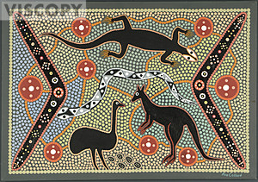
The ‘Dreaming’
gave each tribe their own special ‘Dreaming’
  a strong relationship with land
  totems
  hunting tools
  laws, customs, ceremonies
Aboriginal Art – The Dreaming

Slide 8
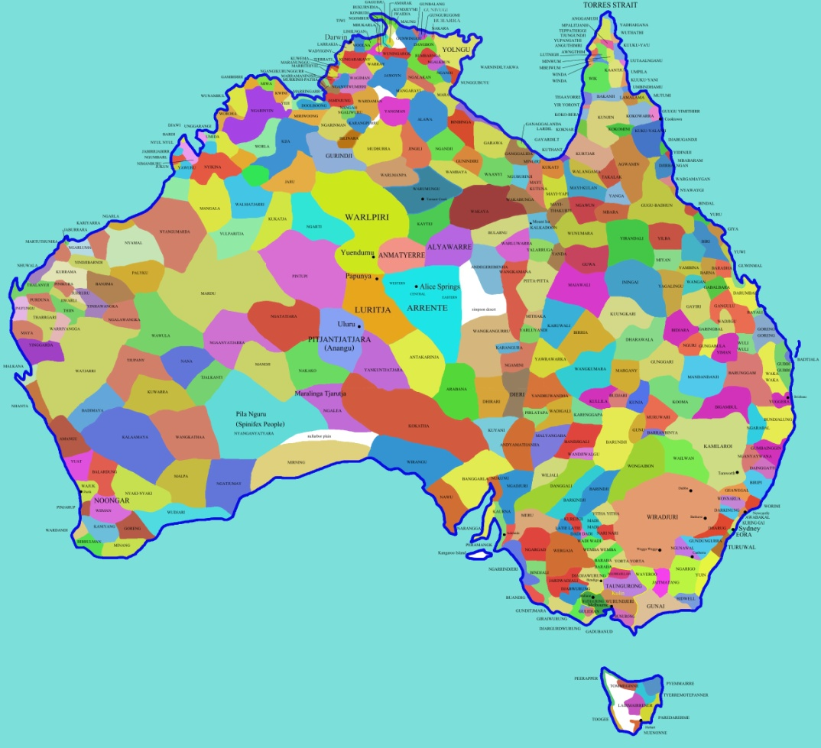
Aboriginal nations before the British arrived in 1788:
around 500 nations and unique cultures
around 200 languages
nations rarely mixed with other nations
they lived off the land
sometimes they traded goods such as
  ochre for body paint and art
  possum furs
Notes:
There were around 500 nations and 200 languages

Slide 9
the British
Bronwyn See and Maddie Paemaa
Notes:
Some Australians now call British colonisation an invasion

Slide 10
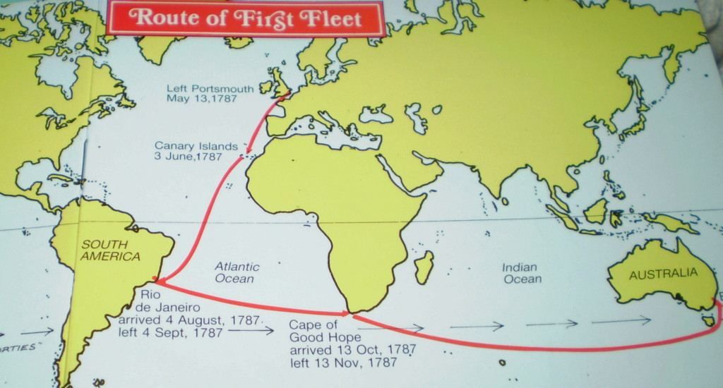
Route taken by the British 1787-1788
Notes:
????ships

Slide 11
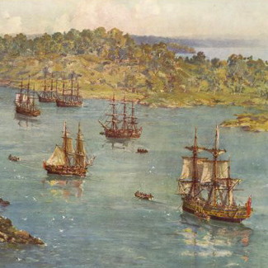
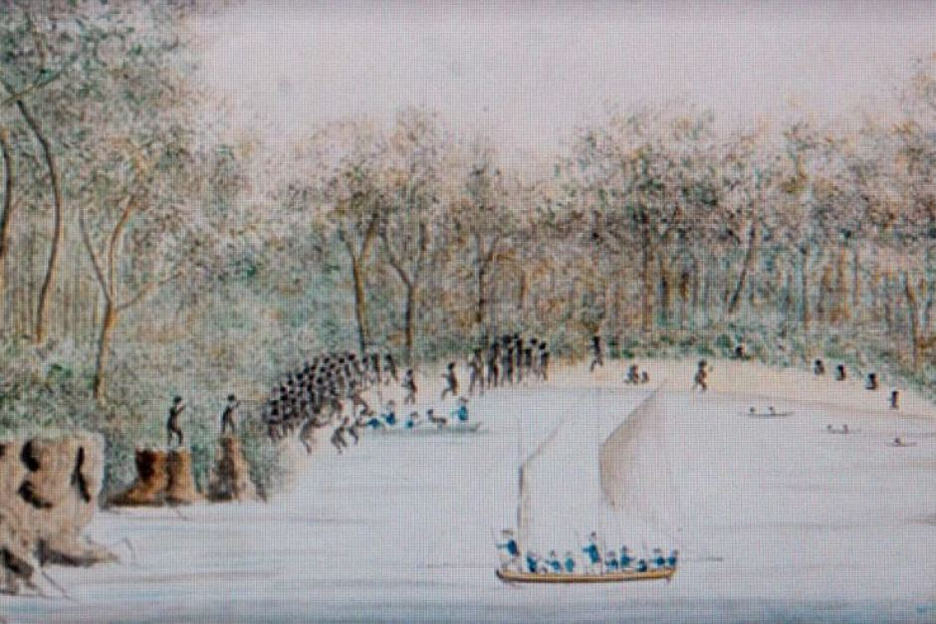
1788 – Sydney Harbour
The British and Aborigines at the spot where the Opera House is today
Ships arriving in Sydney Harbour
Notes:
Artists impressions of

Slide 12
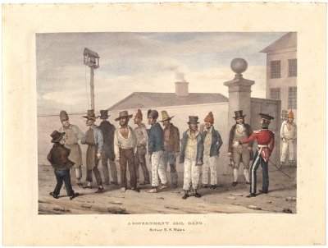
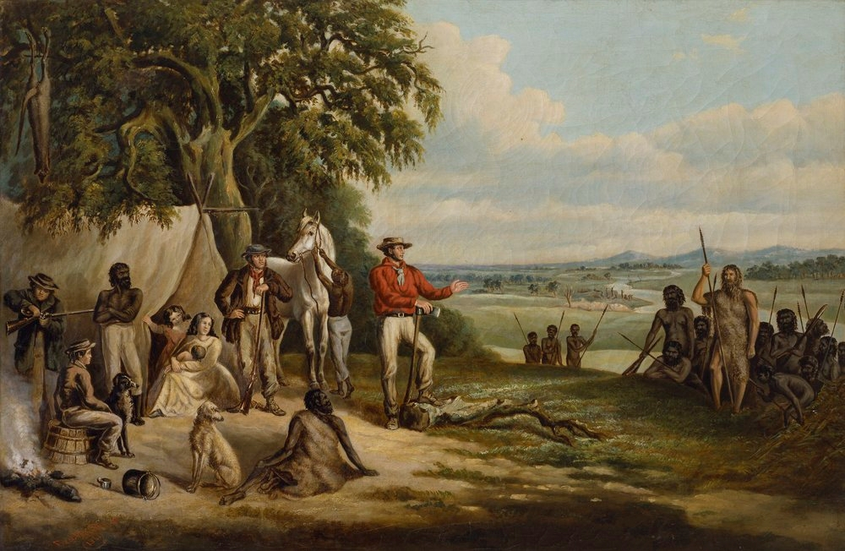
People on the First Fleet
Mostly convicts (prisoners)
Some free settlers
some soldiers
Notes:
753 convicts, 300 soldiers and 20 free settler's

Slide 13
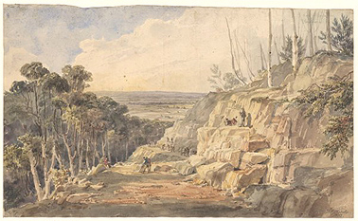
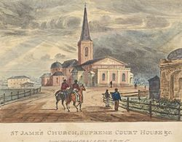
British set up a Penal (prison) colony
Convicts built:
roads
buildings
Notes:
Some are still standing
This road is crossing the Blue Mountains

Slide 14
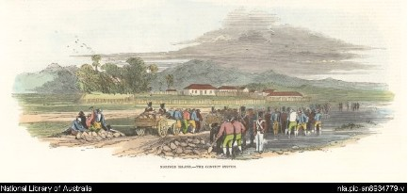
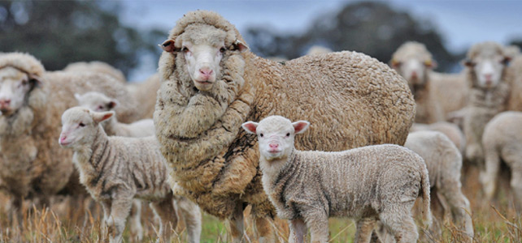
Convicts worked on farms
Growing food for the colony
Wool and wheat to export
Notes:
Supplied food for the colony – milk, eggs, meat for example
Some farms for the wool and wheat export market

Slide 15
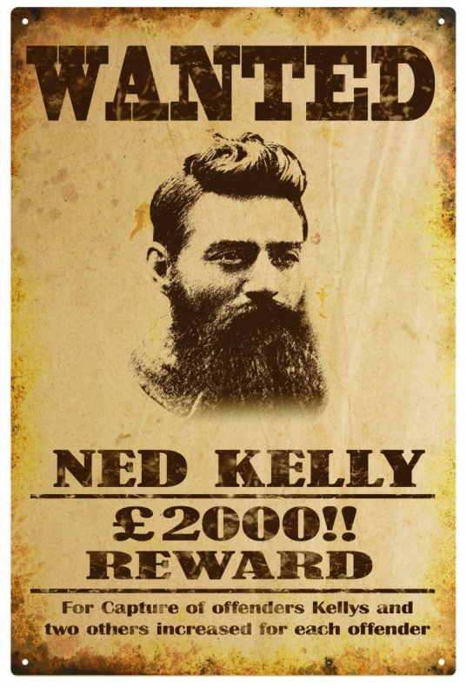
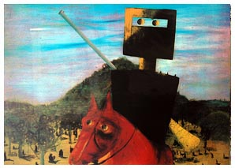
Some convicts became bushrangers
Ned Kelly – most famous
Became legends
Waltzing Matilda
Notes:
Bush rangers were around between 1790 and 1860. They were outlaws and escaped convicts who lived in the bush and stole from free settlers.
When we look at music we might sing this song for you
Folklore and bush songs- Waltzing Matilda

Slide 16
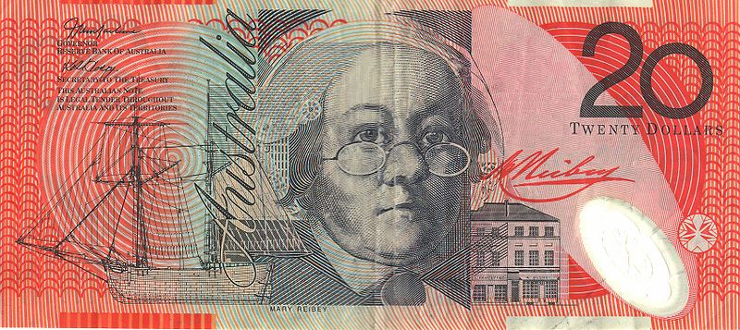
Some convicts became very successful
Mary Reiby
successful business woman
Notes:
Remind them of the notes they showed us in the first presentation

Slide 17
Last British convicts - free
In NSW 1850 last convicts arrived.

Slide 18
Beginning of Chinese migration

Slide 19
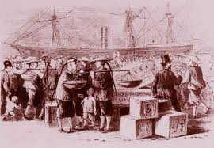
Early Chinese migration – mid 1800S
Thousands of Chinese rushed to Australian gold fields
They worked hard to help support their families in China
Notes:
News of Australian gold rush reached China in 1853,
China had been suffering from years of war and famine.
To get the money they had to borrow money and pay it back
When the Chinese arrived at the goldfields, they stayed together in large teams
They worked hard and lived simply, especially as they sent money home to feed their families and repay their fare.
The Chinese miners re-worked claims that had been abandoned and collected gold that had been missed.
They also saw other opportunities to make money

Slide 20
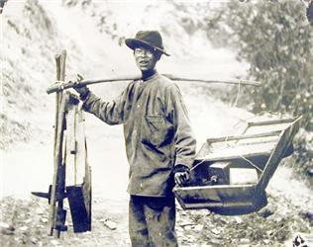
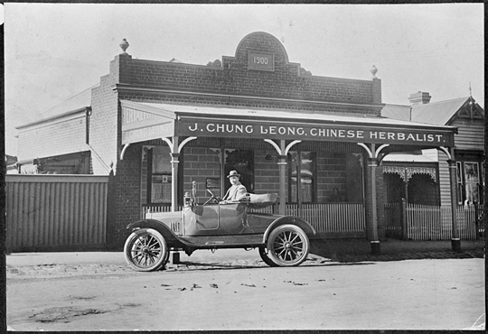
Going and staying
Most returned home after the gold rush
Only a few stayed.
Notes:
Many Chinese came, very few stayed as they …..,.,..,.,…….
Increased dramatically after the 1980s – for example my dad came from Guangzhou in the late 1980s

Slide 21
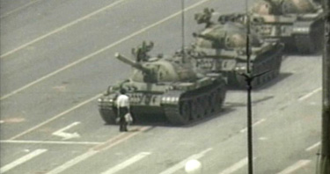
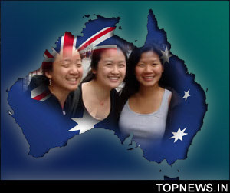
But fast forward to the 1980s
After the Tiananmen Square Massacre 1989
Chinese immigration increased dramatically
Many Chinese students were studying in Australia at this time
They stayed in Australia rather than return to China

Slide 22
What happened to the Aborigines?

Slide 23
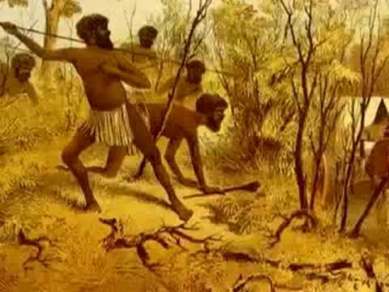
What happened to Aborigines?
1800s
Aborigines fought
for their land
thousands died
  shot
  diseases such as smallpox and measles

Slide 24
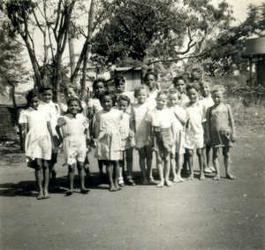
What happened to Aborigines?
lost their land and food sources
many children were taken from their families to live with ‘white’ people
  These children are referred to as the Stolen Generations
Notes:
White people throught they were doing the best thing for the children

Slide 25
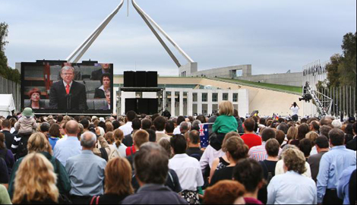
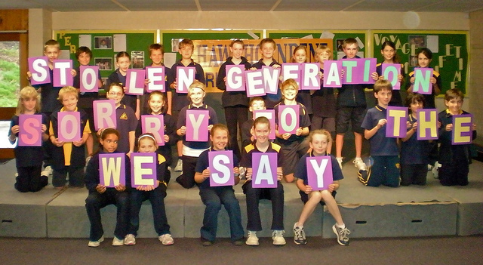
Fast forward to 2008
Saying sorry
In 2008 our Prime Minister delivered a historic speech in Parliament
He apologized to the Stolen Generations for the injustices they had suffered
Thousands of Australians signed sorry books
Notes:
People from around the nation watched the speech on television live and celebrated
Students stopped their lessons and watched
Australians signed sorry books

Slide 26
We hope you enjoyed our presentation and we are looking forward to discussing our History from 1900 to the present next time

