Slide 1
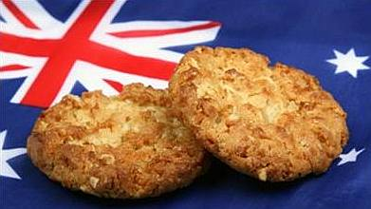
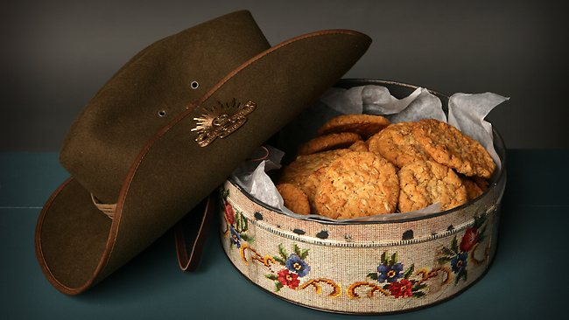
ANZAC Biscuits
By Hannah , Josh and Misty

Slide 2
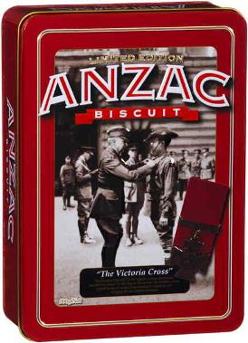
Anzac biscuits
An Anzac biscuit is a sweet biscuit popular in Australia and New Zealand
Anzac biscuits have long been associated with
the ANZACS established in world war 1.
Today, Anzac biscuits are manufactured commercially for retail sale.

Slide 3
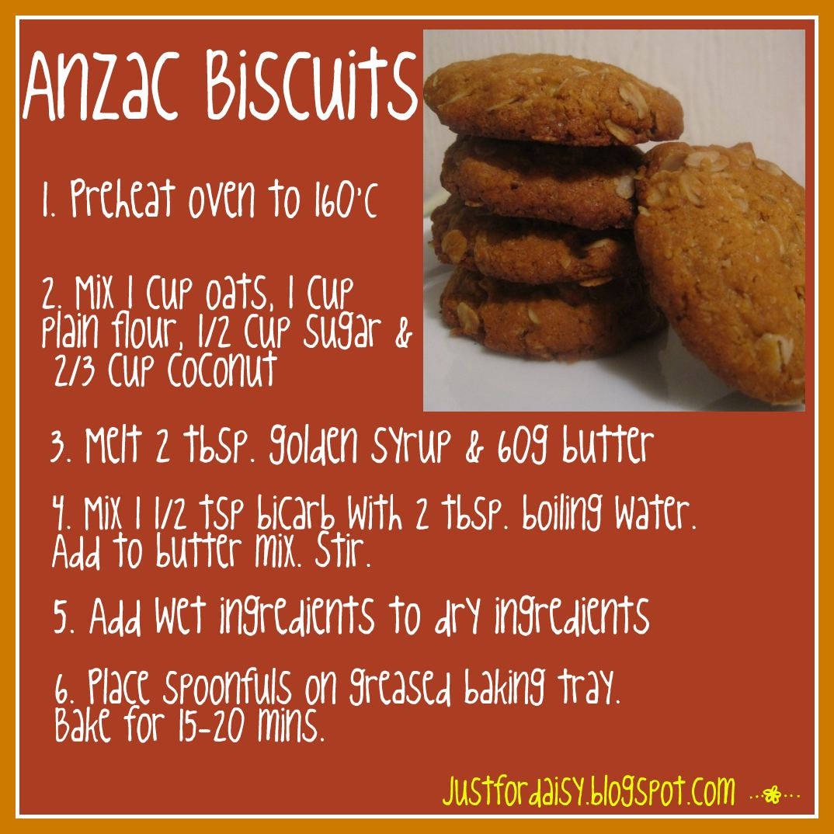
How they are made
The anzac biscuits are made using rolled oats , flour, desiccated coconut, sugar, butter, golden syrup, backing soda and boiling water
It has been claimed the biscuits were sent by wives to soldiers abroad because the ingredients do not spoil easily and the biscuits kept well during naval transportation

Slide 4
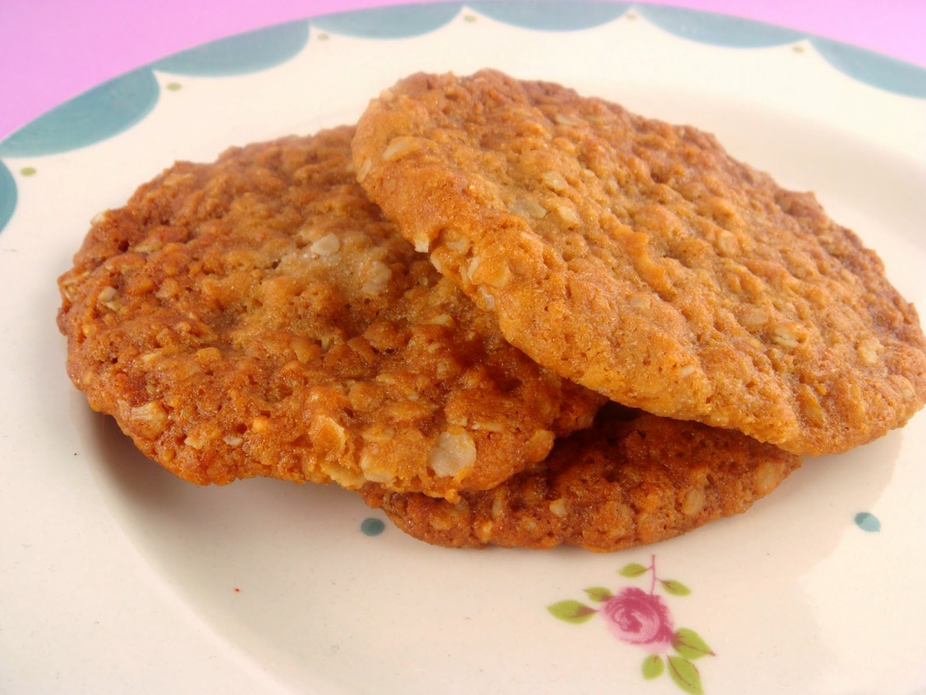
When they would eat them
The Anzacs would eat them throughout the day for snacks. In our days we would eat them on the 25th of April or just as a snack will them many people still eat these delightful treats.

Slide 5
Thank you for watching

