Slide 1
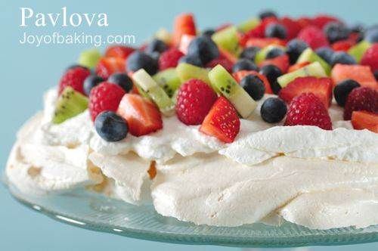
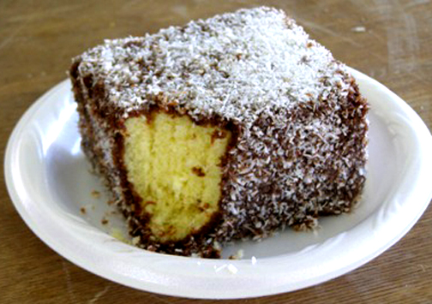
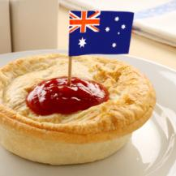
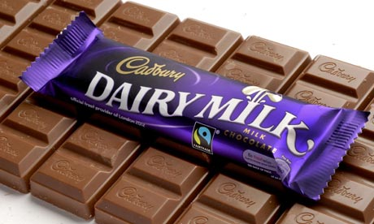
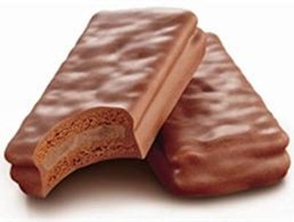
Australian Food
Made by Lisa, Kiara, Anna and Lauryn

Slide 2
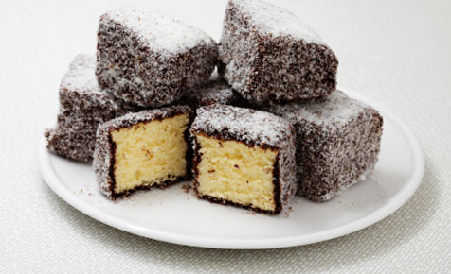
Lamingtons
Lamingtons are a type of small rectangular sponge cake covered in chocolate and coconut.
Lamingtons are sometimes served as two halves with a layer of cream or strawberry jam in between.

Slide 3
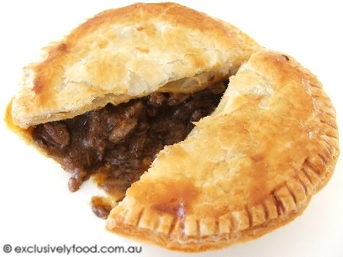
Meat pie
Meat pies are a crusty, hand-sized pastry circle filled with a diced or minced meat and gravy, sometimes with onion, mushrooms, or cheese.
They are often consumed as a takeaway food snack.
Australians consume an average of 12 meat pies each per year.

Slide 4
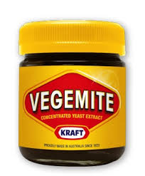
Vegemite
Vegemite is a well known, dark brown Australian food paste made from yeast extract. It is a spread for sandwiches, toast, crumpets and cracker biscuits as well as a filling for pastries.
A Vegemite sandwich may consist of two slices of buttered bread, Vegemite and cheese, but other ingredients such as lettuce, avocado and tomato can be added as well.

Slide 5
Vegemite Song
We're happy little Vegemites
As bright as bright can be.
We all enjoy our Vegemite
For breakfast, lunch, and tea.
Our mummies say we're growing stronger
Every single week,
Because we love our Vegemite
We all adore our Vegemite
It puts a rose in every cheek.
http://www.youtube.com/watch?v=0yA98MujNeM

Slide 6
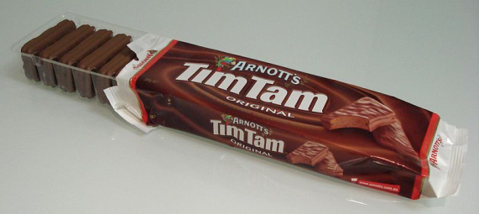
Tim Tams
Tim Tams are chocolate biscuits with a chocolate paste in the middle and coated in chocolate. They are delicious.
The cream used in Tim Tams is a delicate mixture of vanilla, butter and chocolate that complements the biscuit base and the chocolate. It’s this unique cream which sets Tim Tam apart from any other chocolate biscuit.

Slide 7
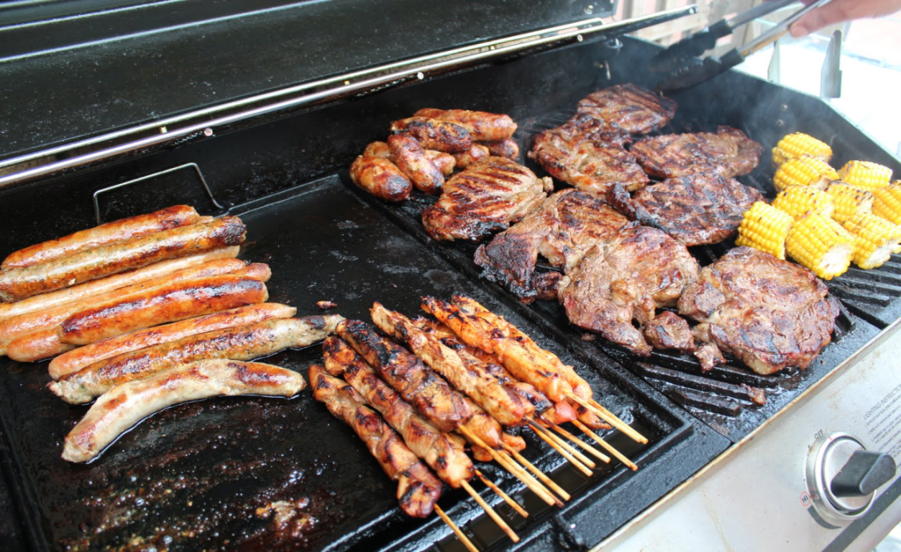
BBQ (Barbecue)
A BBQ is a hot black surface used to grill food.
You can cook sausages, kebabs, steak, fish and vegetables.
Australians like to spend a lot of time outdoors and we have a lot of BBQs during the summer for picnics.

Slide 8
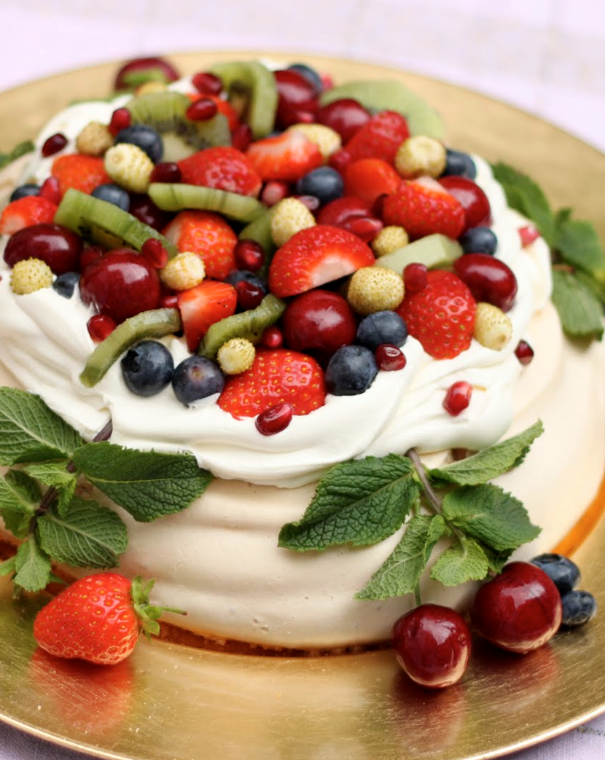
Pavlova
Pavlova is a dessert made out of egg white (meringue) and topped with cream and all kinds of fruit.
Pavlova is a named after the Russian ballet dancer Anna Pavlova in honour of the dancer either during or after one of her tours to Australia and New Zealand in the 1920s.
Simple recipe that is served during celebratory and holiday meals. It is a dessert most identified with the summer time, but is eaten all year round.

Slide 9
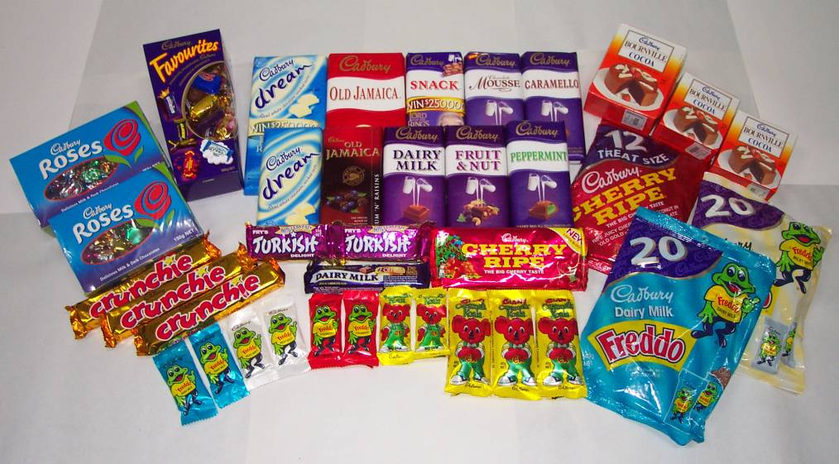
Cadbury chocolate
Cadbury chocolate comes in many different flavours like normal dairy milk chocolate, dark chocolate, white chocolate strawberry, caramel and peppermint. It comes in blocks, bars, boxes and animal designs.

Slide 10
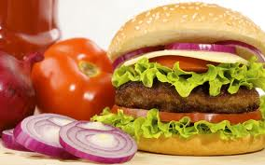
Hamburger
Hamburgers are a delicious sandwich with all different vegetables/salads and meat.

Slide 11
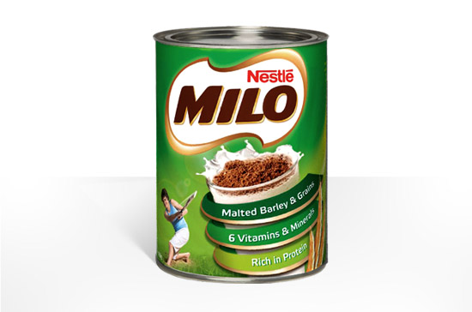
Milo
Milo is a chocolate and malt powder which is mixed with hot or cold water and/or milk. It is made by Nestlé and was originally developed by Thomas Mayne in Sydney, Australia in 1934.

Slide 12
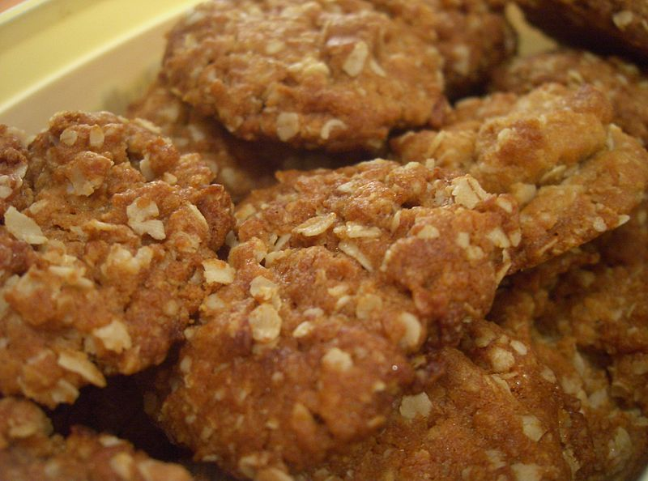
Anzac Biscuits
An Anzac biscuit is a sweet biscuit popular in Australia and New Zealand made using rolled oats, flour, desiccated coconut, sugar, butter, golden syrup, baking soda and boiling water.
Anzac biscuits have long been associated with the Australian and New Zealand Army Corps (ANZAC) established in World War I.
It has been claimed the biscuits were sent by wives to soldiers abroad because the ingredients do not spoil easily and the biscuits kept well during naval transportation.

Slide 13
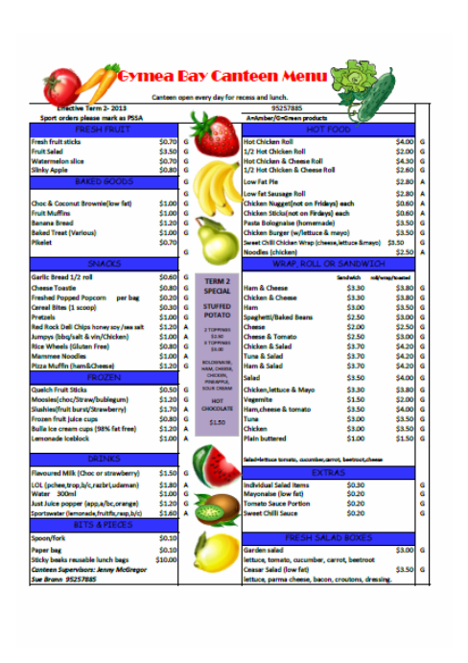
Our school canteen menu
http://www.gymeabayps.nsw.edu.au/uploads/9/6/8/7/9687343/canteen_menu_2013.pdf

Slide 14
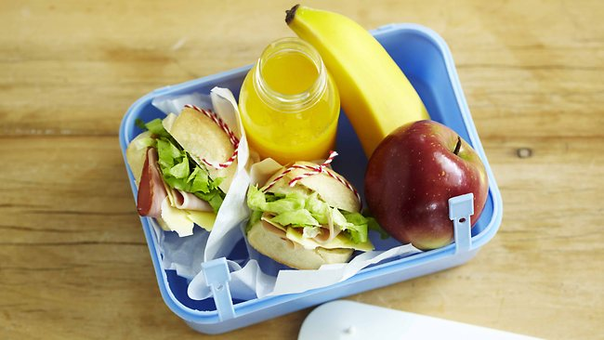
An example of an Australian lunch box

Slide 15
Activity: How to make a pavlova
Get a meringue shell (you can by little ones and larger ones at the supermarket, or you can make your own using egg white and sugar.)
Place some whipped cream on the top.
Decorate with berries and seasonal fruit.
Eat!

Slide 16
Any questions???

