Slide 1
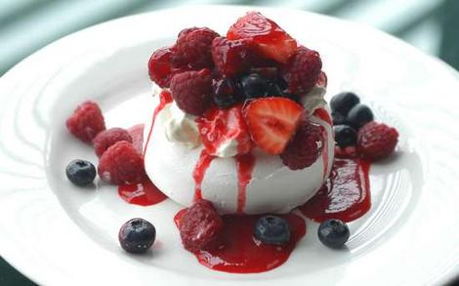
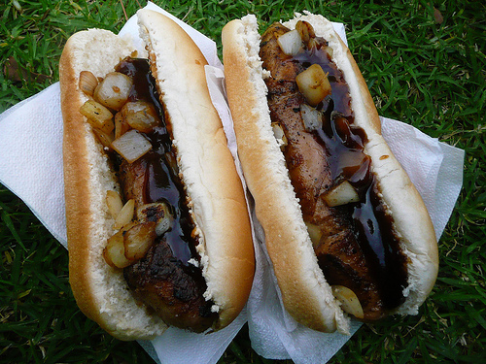
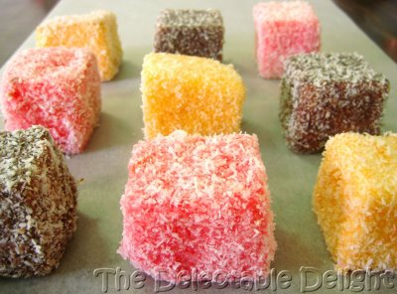
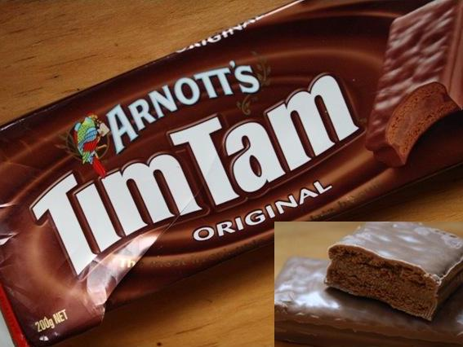
Aussie food icons!
By Hannah, Josh and Misty

Slide 2
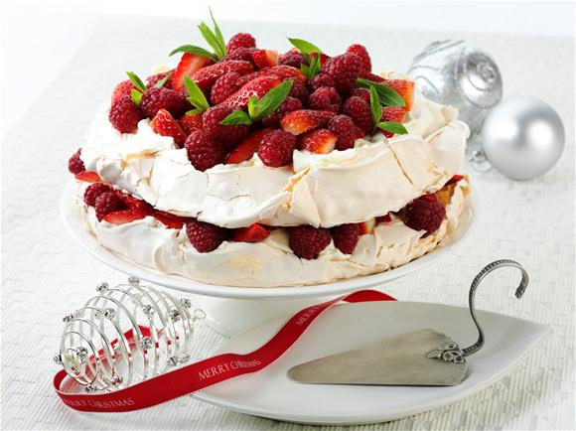
Pavlova
Pavlova is a meringue with cream and fruit on the top. We normally have this fruity desert and Christmas time.
You can put on as many different types of fruits such at strawberries, mango, kiwi fruit and many more !

Slide 3
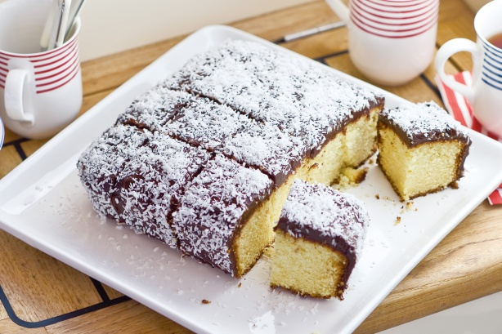
Lamingtons
Lamingtons are a Aussie sack
that most of us desire.
Lamingtons have a sponge cake
centre and then are
covered
in a coat of
chocolate and
coconut shavings
sprinkled on top
of the lamington.

Slide 4
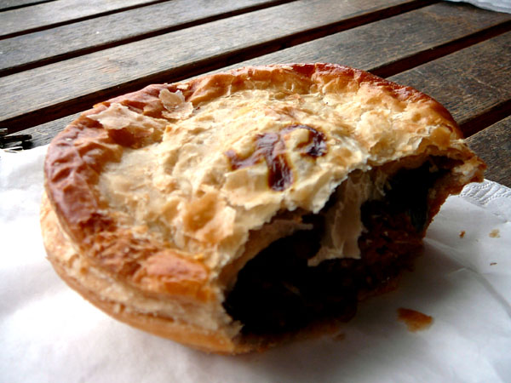
Meat pie
A meat pie is a aussie icon because we
would normally eat it when we are
at a football mach.
A meat pie is a pastiry that has meat mince in the centre of it and it is served hot.

Slide 5
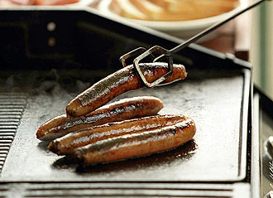
Sausage sandwich
A sausage sandwich is a food
That is a Aussie icon it can be
Eaten at breakfast, lunch and tea
It is a bread roll with a peace of meat that is added the meat can be chicken, beef and kangaroo. You can also can add sauce and
onion.

Slide 6
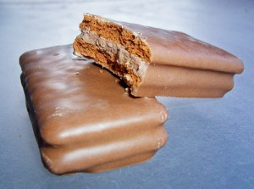
Tim tam biscuit
A tim tam is another snack that
most of us would have. It is a
chocolate biscuit with a delicious centre and a chocolate outside.

