Slide 1
Famous Australians
Presented by Sashrika and Caleb

Slide 2
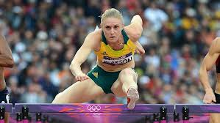
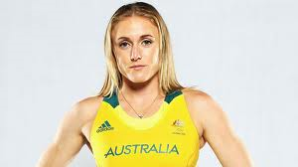
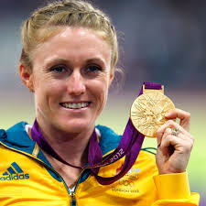
Sally Pearson
In Australia, and most other countries, we have Olympians. A very famous hurdler is Sally Pearson.

Slide 3
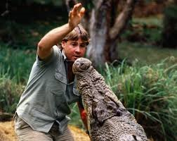
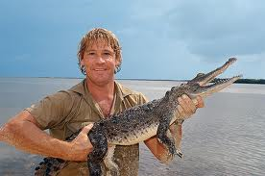
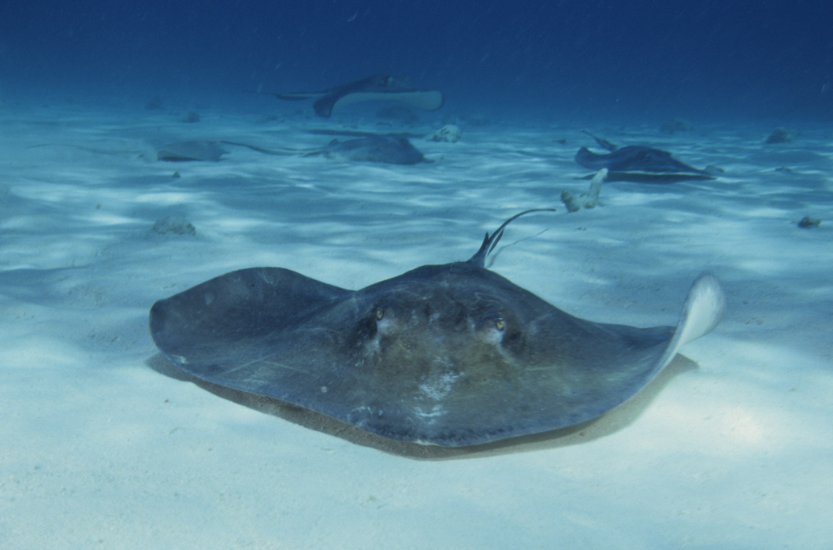
Steve Irwin
Steve Irwin, was known as the crocodile hunter. He protected and cared about the crocodiles but sadly he died from a sting-ray sting.
This is a sting-ray

Slide 4
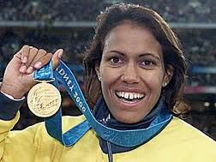
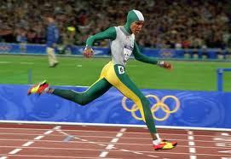
Kathy Freeman
Kathy Freeman is also an Olympian. She is a runner and has brought home many gold medals.
Click here for a link to see Cathy Freeman run!

Slide 5
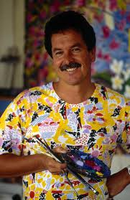
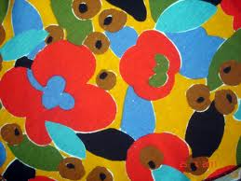
Ken Done
Ken Done is an artist. His paintings are very different to most paintings of Australia.

Slide 6
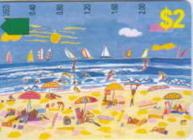
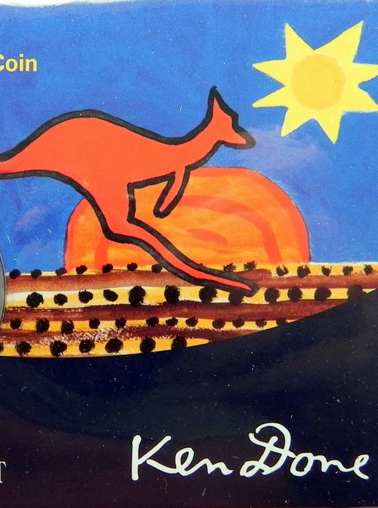
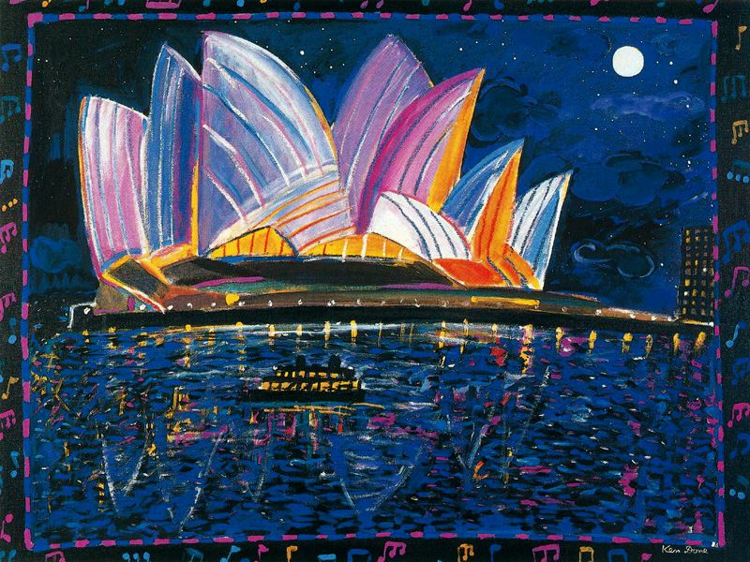
Can you guess these Australian landscapes in ken done’s paintings?
See the next slide for answers!

Slide 7
Can you guess these Australian landscapes in ken done’s paintings?
Bondi Beach
Uluru
Sydney Opera House
See the next slide for answers!

Slide 8
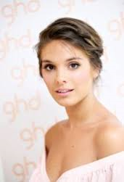
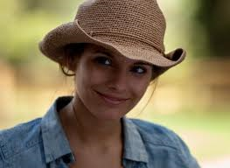
Caitlin Stasey
Caitlin Stasey is best known for her role in the TV show ‘Sleepover Club’. Her character’s name was Francesca.

Slide 9
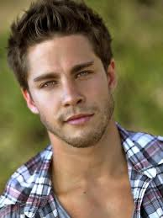
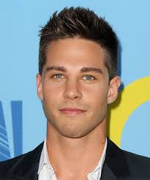
Dean geyer
Dean Geyer is an actor. He has many roles in many films. One role he has is in ‘Glee’.

Slide 10
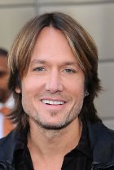
Keith URBAN
Keith Urban is a very famous singer. He is a country western song artist who is married to Nicole Kidman.

Slide 11
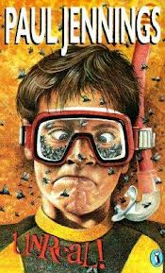
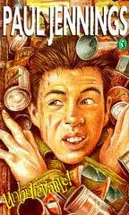
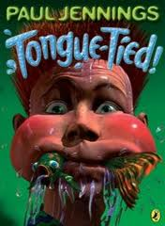
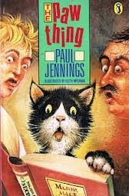
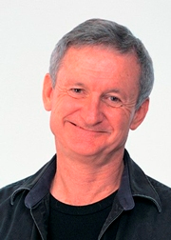
Paul Jennings
Paul Jennings writes stories. We are reading his work. Most of us have read; Tongue-Tied, The Paw Thing, Unreal and Unbelievable.

Slide 12
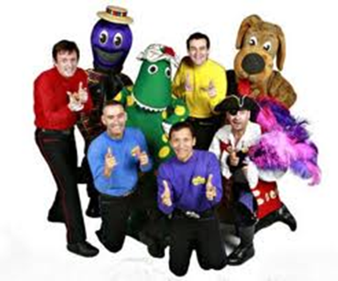
The Wiggles
The wiggles are a children's band. There are 8 main people; Jeff, Murray, Anthony, Sam, Dorothy, Waggs, Captain Feather-Sword and Henry.
We will now sing one of
their songs for you!

Slide 13
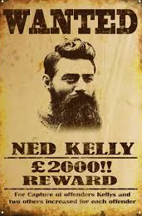
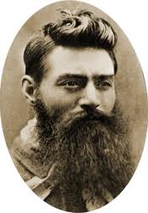
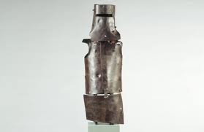
Ned Kelly
Ned Kelly is a bushranger from the 1850s. Bushrangers were criminals who lived in the bush and robbed people. Ned Kelly became famous for wearing the first bullet-proof armour.

Slide 14
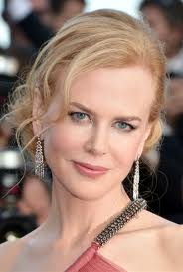
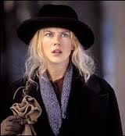
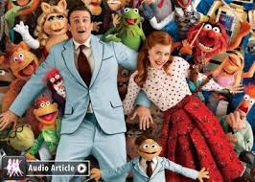
Nicole Kidman
Nicole Kidman is an actress. She is in many movies. Some well known movies she is in are Cold Mountain and The Muppets.

Slide 15
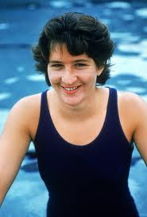
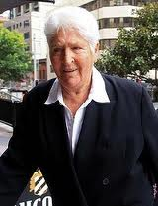
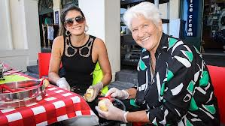
Dawn Fraser
Dawn Fraser is one of our most successful Olympian swimmers. She won many medals in the 1956 Melbourne Olympics.

Slide 16
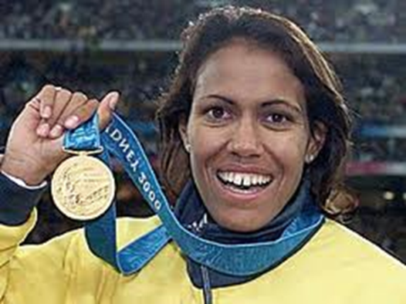
Quiz time! Who are these famous Australians?
When you have tried to guess all of the Australians, turn to the next slide for answers!

Slide 17
Quiz time! Who are these famous Australians?
Nicole Kidman
Paul Jennings
Dawn Fraser
Ned Kelly
Keith Urban
Cathy Freeman
The Wiggles
Steve Irwin – The Crocodile Hunter

Slide 18
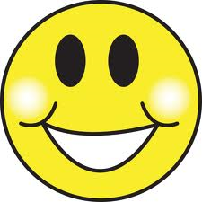
Thank You
Any Questions?

