Slide 1
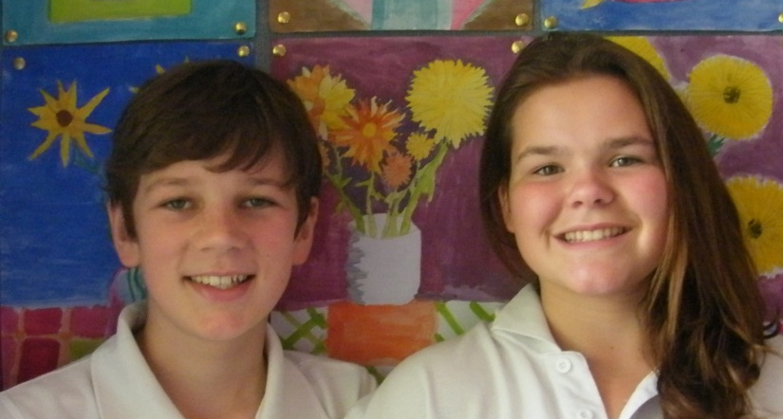
The Heel and Toe Polka!
Heel & Toe,
Heel & Toe!
By:
Angus Lawrence & Brit Turner

Slide 2

Step 1 - Organising Partners and Groups
First get a partner
Then get into a circle, with your partner (Boys on inside)
When the music starts, start dancing with your partner, after you finish the dance, the girls on the outside rotate. We all get a new partner and start again!

Slide 3
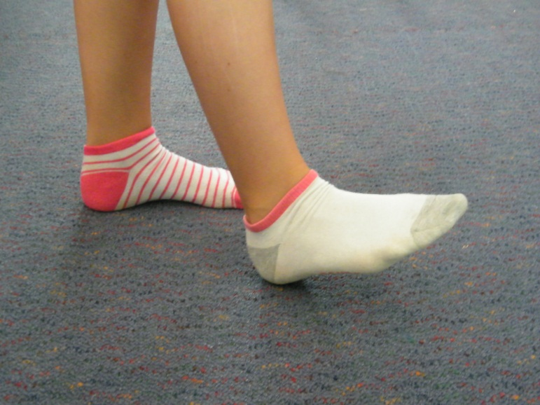
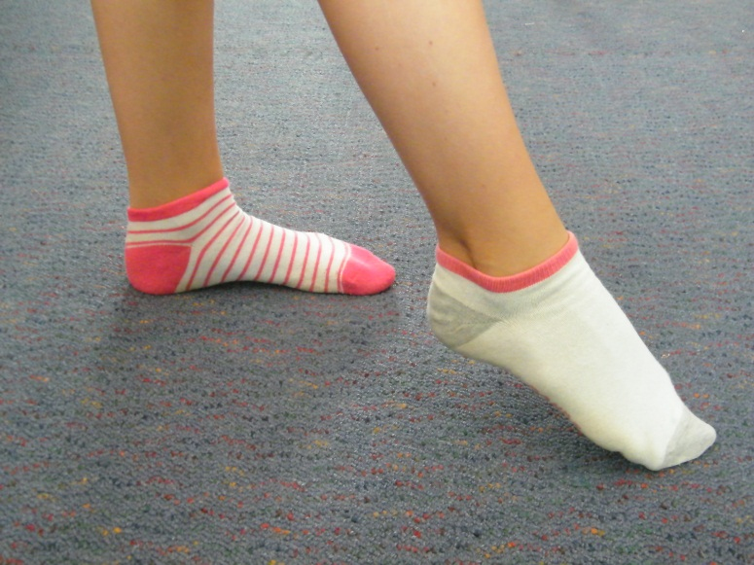
Step 2 – Learning The Dance!
Part 1
First of all, there is the ‘Heel & Toe’ Part:
A) Put your right heel on the ground and toe pointing up
B) Then switch, put your toe on the ground and heel raised.
Repeat these moves twice, the music will help you. Eg, Heel and Toe, Heel and Toe…

Slide 4
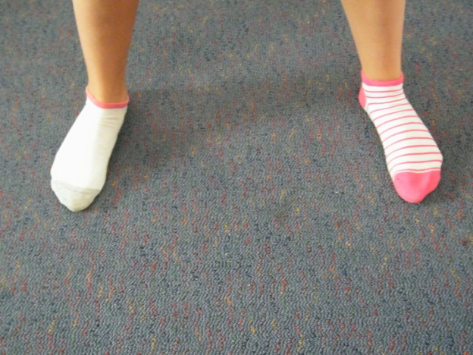
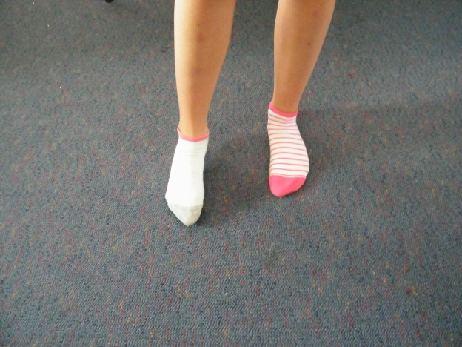
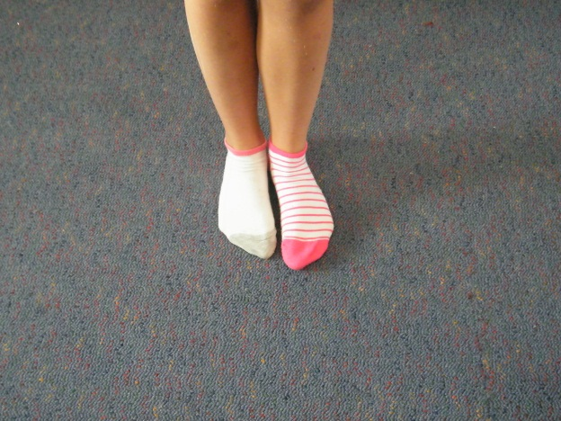
Step 2 – Learning The Dance!
Part 2
The second part, ‘Slide, 2, 3, 4!’:
A) Place your feet apart, like this.
B) Slide your Left foot across to your right, like so.
C) Put your feet together to complete a single slide.
You will repat this ‘step’ three times. The music will help you. Eg, Heel & Toe, Heel and toe, Slide, 2, 3, 4

Slide 5
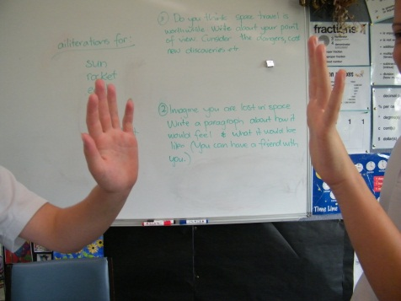
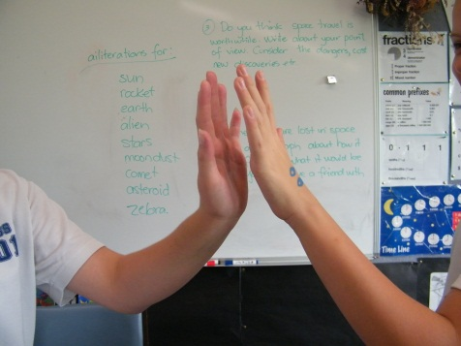
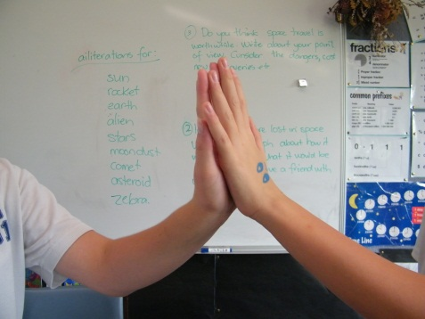
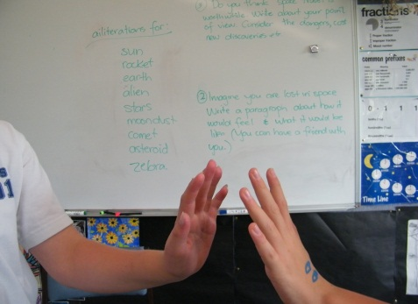
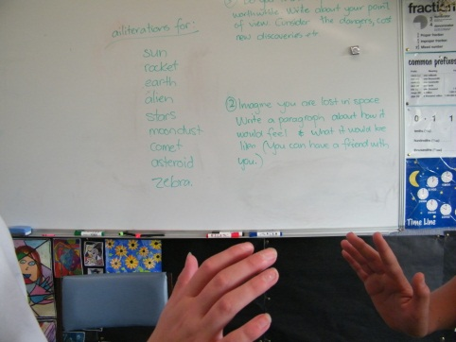
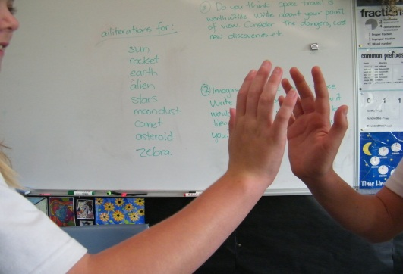
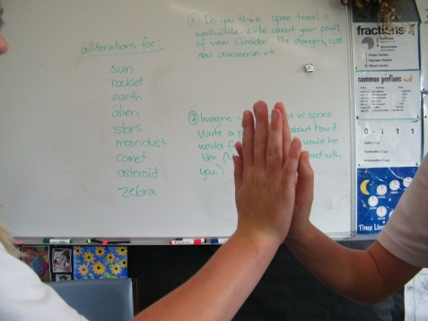

Step 3 – Clapping In The Dance
Part 1
Clapping with Partner:
Raise your right hand to your partners raised right hand and clap together, like shown. Repeat this three times. Eg: (…Slide, 2, 3, 4.) Right Hand Clap. For every word, clap!
Repeat the process but this time with your left hand. Eg: Right Hand Clap, Left Hand Clap.

Slide 6
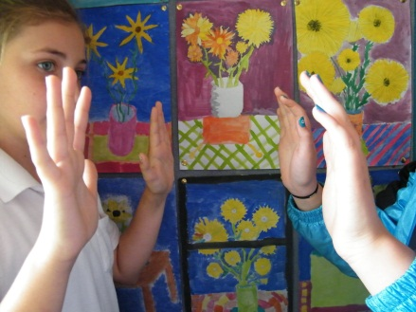
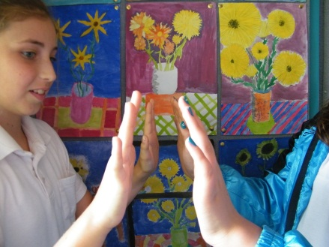
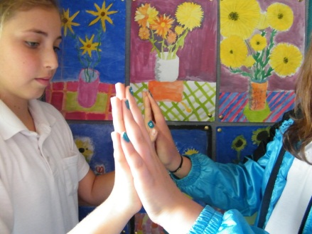
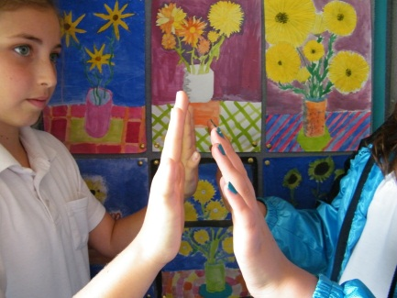
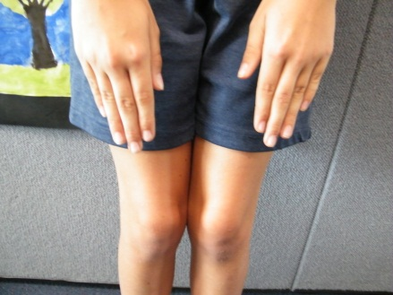
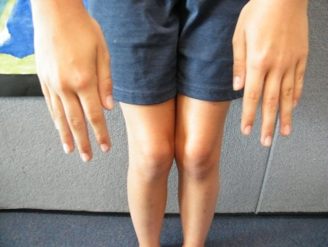
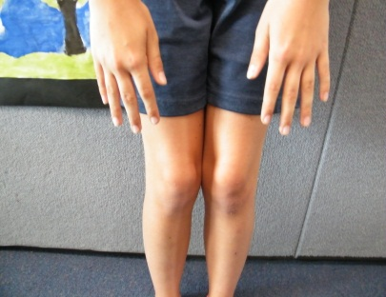
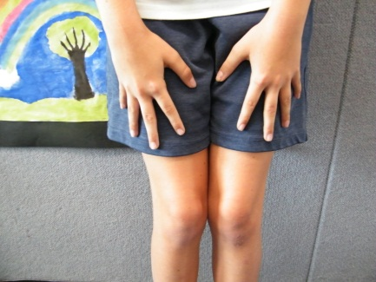
Step 3 – Clapping In the Dance
Part 2
Clapping Both hands & Clapping By Yourself
Just like the other ‘hand claps’ you raise your hands to your partner’s. BUT This time you raise BOTH of your hands and claps them with your partner’s. Like shown above ☺
This ‘clap/move’ is different as you DO NOT clap with your partner, you clap on your thighs/knees, like shown above.

Slide 7
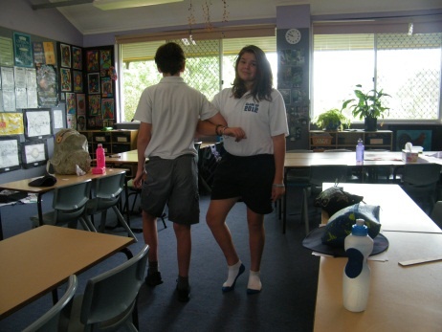
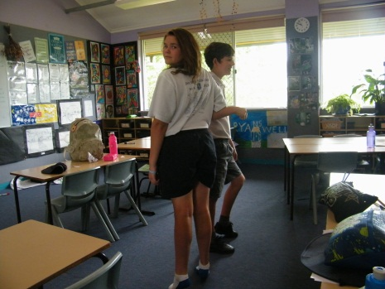
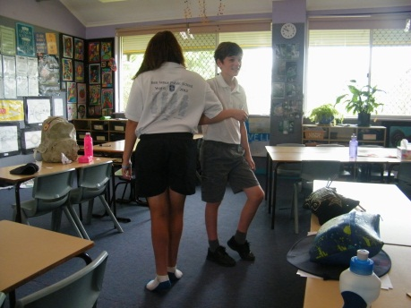
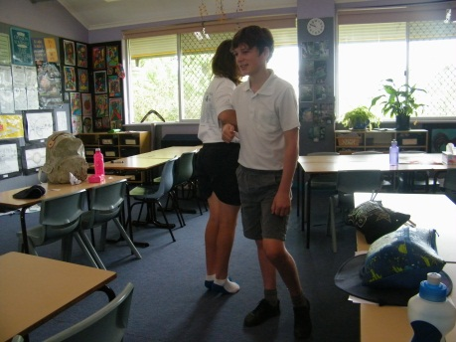
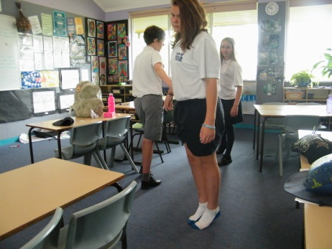
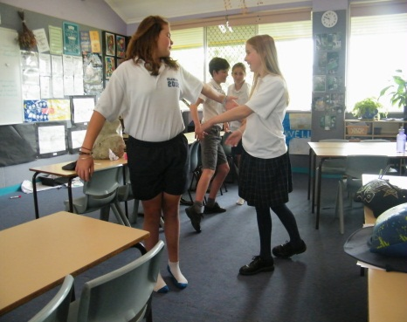
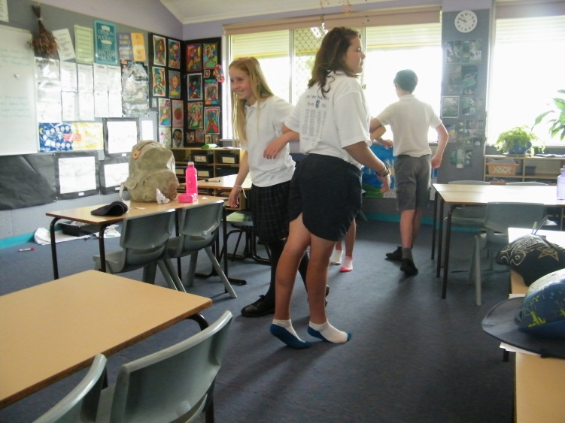
Step 4 – Departing from your partner (girls)
Link arms, like this.
Rotate once, while still linking arms, like this ^ ^ ^ ^ ^ ^ ^
Start to move away from your partner, like this
The girls approach their partner, and start to hold hands
Now continue the dance with your new partner! …Heel & Toe…

Slide 8
From the Top!
Now we’re going to go through these steps again, just to make sure you have got it, don’t worry we’ll shorten the instructions to make this quicker. You will need music for this. The music we are using is at this website: http://youtu.be/2jB8qbjlKek
EVERYBODY, From the Top (without the music)!
Find your partner – Boys with girls, girls with boys!
Get into a circle with the boys on the inside,
READY – GO!
Heel and toe, heel and toe, slide, 2, 3, 4 (x2)
Right-hand-clap, left-hand-clap, both-hand-clap, clap-on-knees
Girls swing around on the right and boys stay where they are
REPEAT – Heel and toe… etc.!

Slide 9
Dancing with the music!
This time we are going to do it with the music!
Be careful, the music is VERY fast, it is quite hard to keep up!
Just remember these key things,
- Girls on the outside rotate to the right, while the boys stay
- Slide to the right 4 times, then back to the left 4 times
It goes: Right-hand clap (three times), Left-hand clap (three times), both hand clap (three times) and clap on knees (three times)
The music is found at http://youtu.be/2jB8qbjlKek
Have Fun Dancing!

