Slide 1
Hand and Cardboard prints By Zoe Davidson and Georgia Vaughan

Slide 2
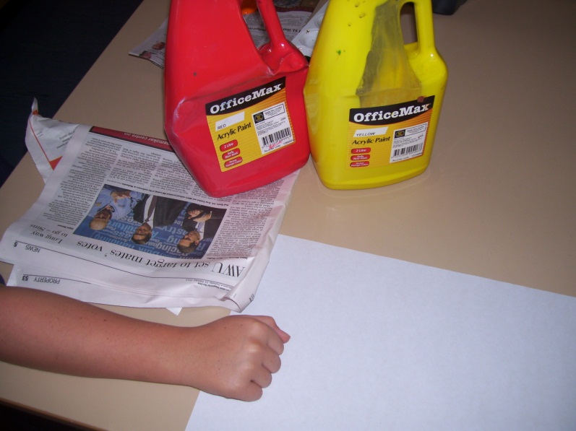
Seahorses
You will need an piece of art paper.
Red and yellow paint on a paper plate
News paper
A tiny bit of black paint
And your own hand!!
Paper towel to clean your hands

Slide 3
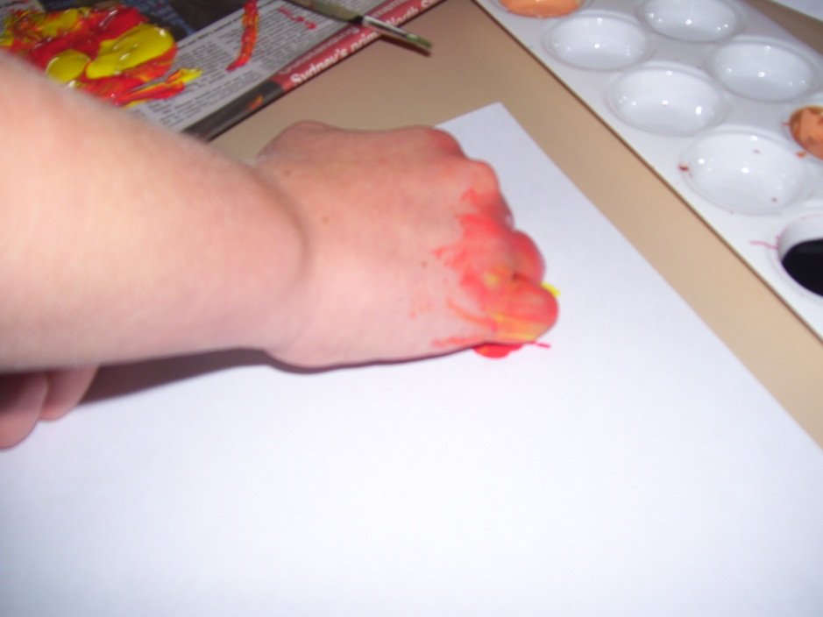
Step 1
Pour two shades of paint onto a piece of newspaper.

Slide 4
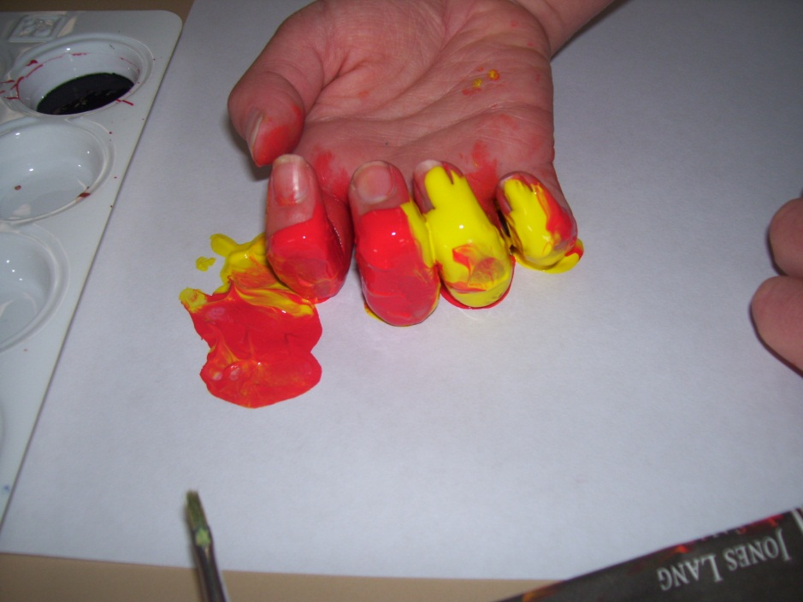
Step 2
To make the seahorses head, dip the top of your fingers in the paint. Place your fingers on the paper.

Slide 5
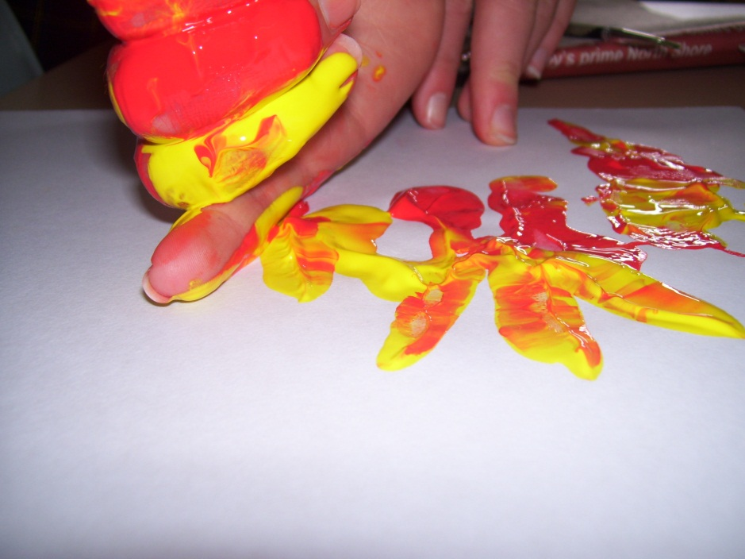
Step 3
Press your knuckles into the paint. Turn your hands sideways and print a body for your seahorse.

Slide 6
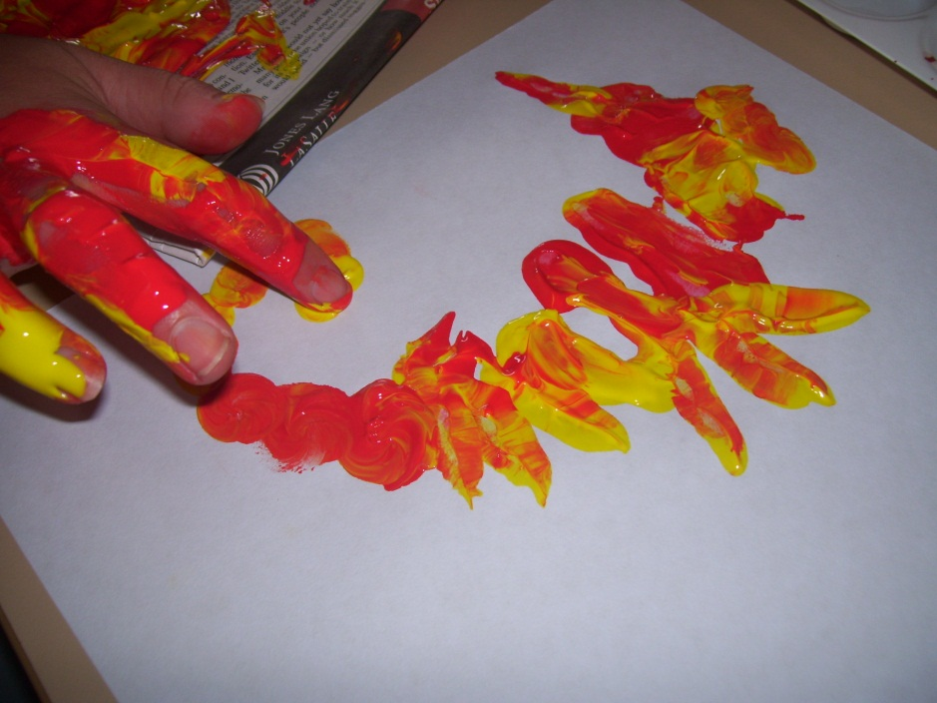
Step 4
Dip one of your fingers in the paint and paint on a long snout.

Slide 7
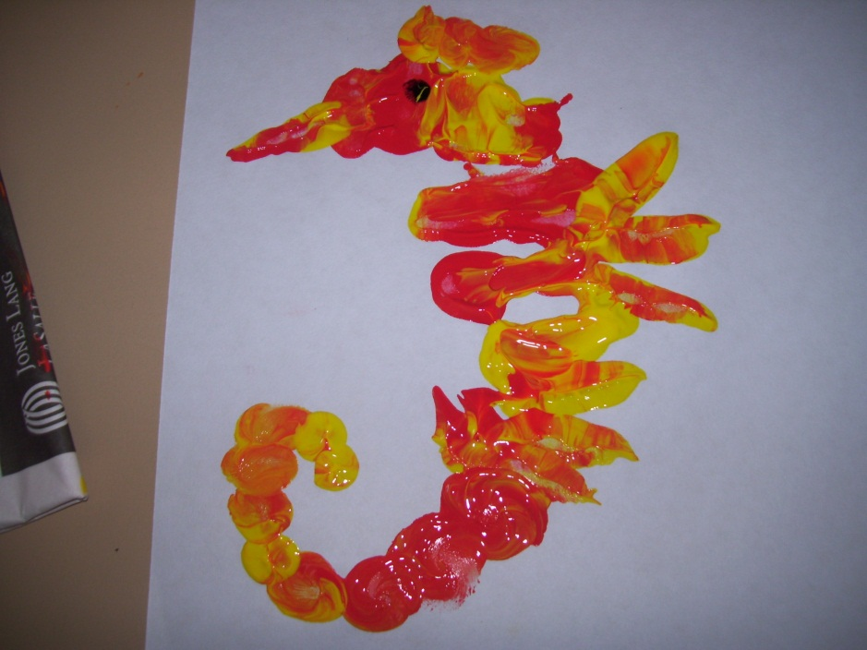
Step 5
Use the same finger to print three fins. Also paint on more of the tail.

Slide 8
Step 6
Use two finger tips and dip them in the paint. Print a two circles at the end of the snout. also print some along the head.

Slide 9
Step 7
Finish the tail by doing several prints with a fingertip. Curve them around as you go.

Slide 10
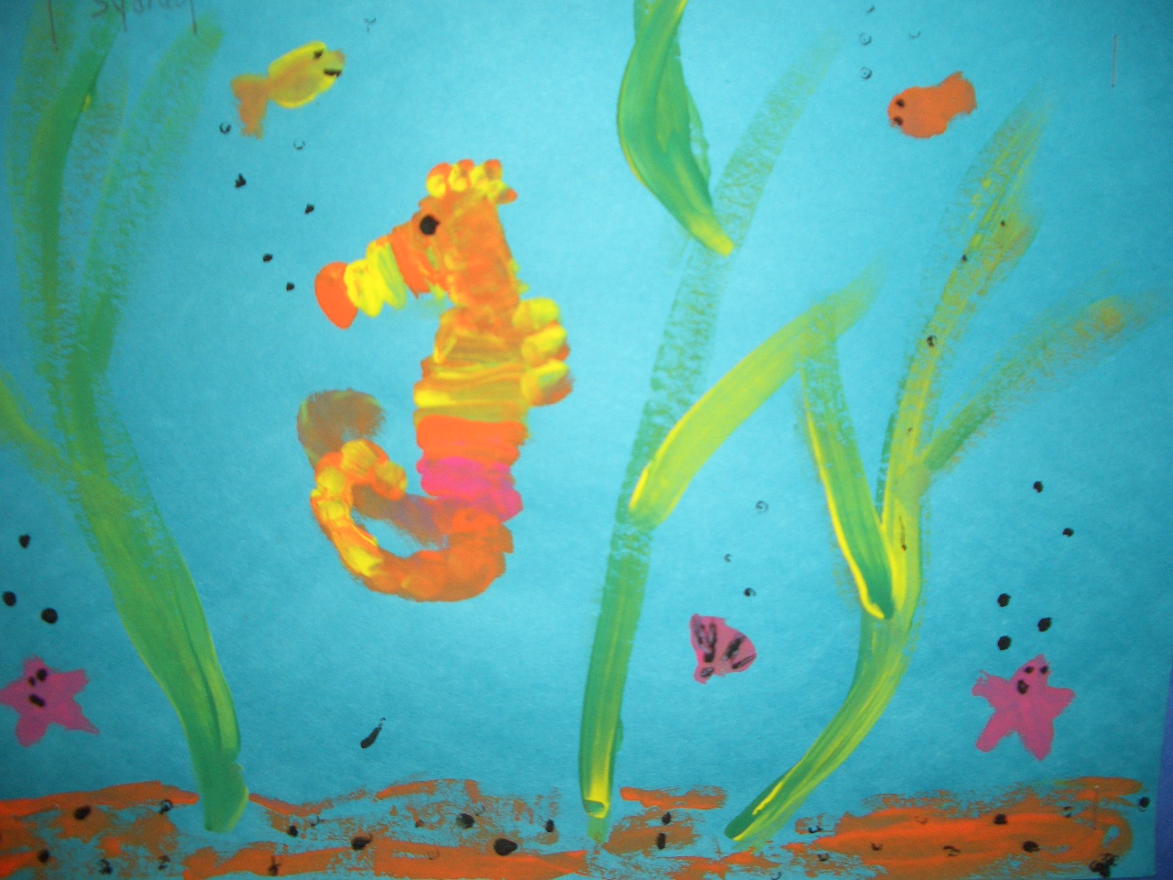
Step 8
To make the eye dip a finger tip in black paint and print a dot in the middle of the head.

Slide 11
Little Rainbow fish
What you need
Pink and orange paint on a paper plate
Black paint

Slide 12
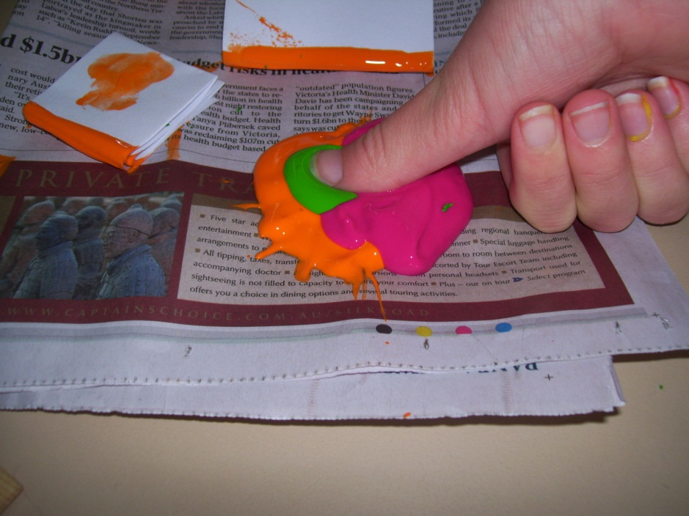
Step 1
Press the fat part of your thumb into the mixed paint.
Print it onto the page

Slide 13
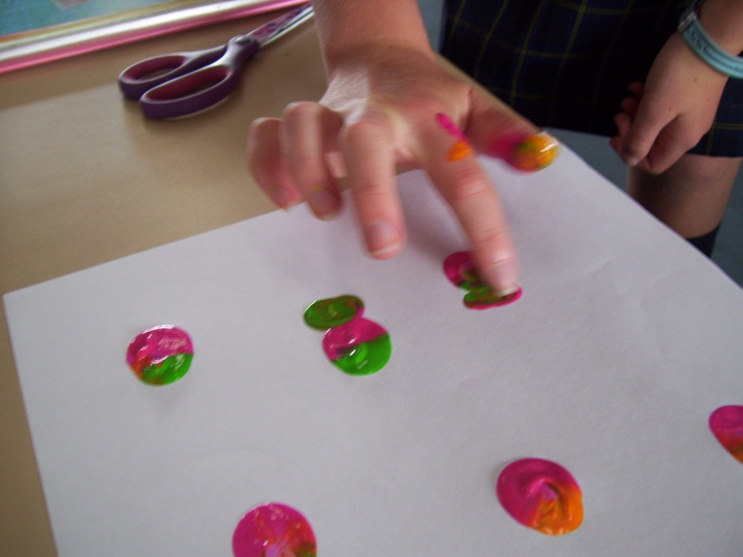
Step 2
Add a tail with a fingertip. For the eye place a dot of black paint

Slide 14
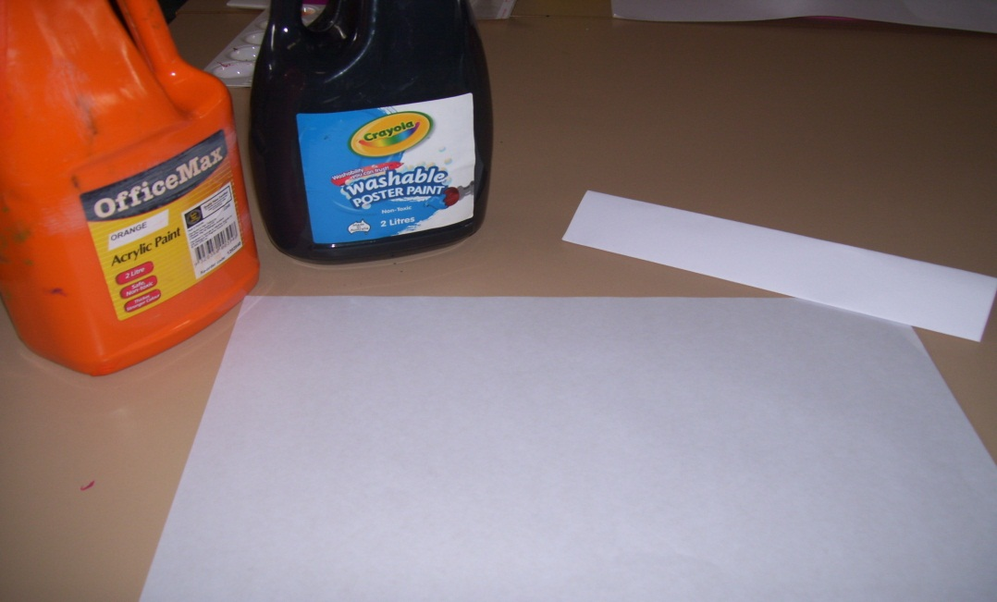
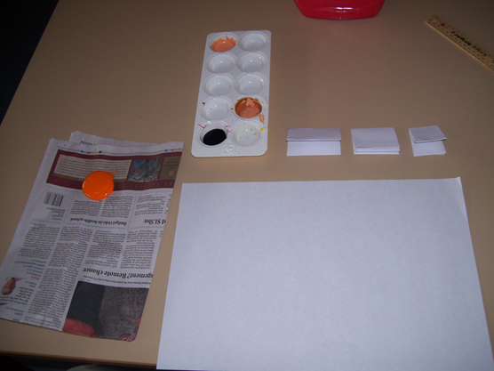
How to make Crabs.
You will need,
A piece of normal white cardboard, orange paint, piece of A4 white paper per person and some black paint.

Slide 15
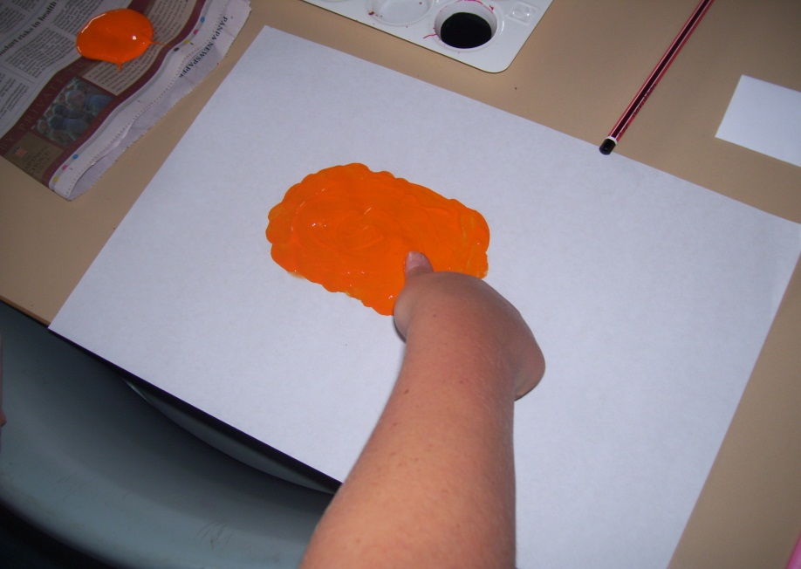
Step 1
Print the crab’s body with your thumb. Cut a piece of thin cardboard, about 3cm long, then cut a 2nd piece of cardboard about 3cm long, them cut the 3rd piece of cardboard 4cm long!

Slide 16
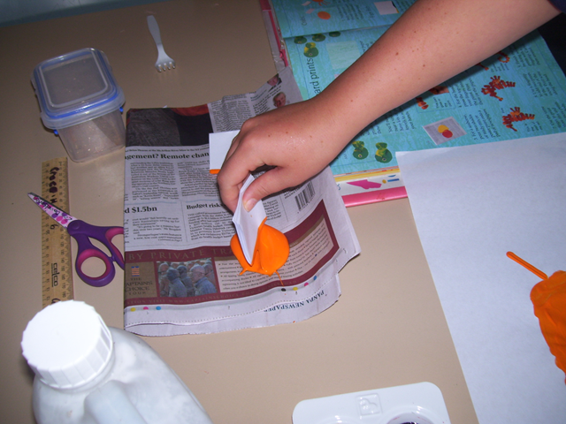
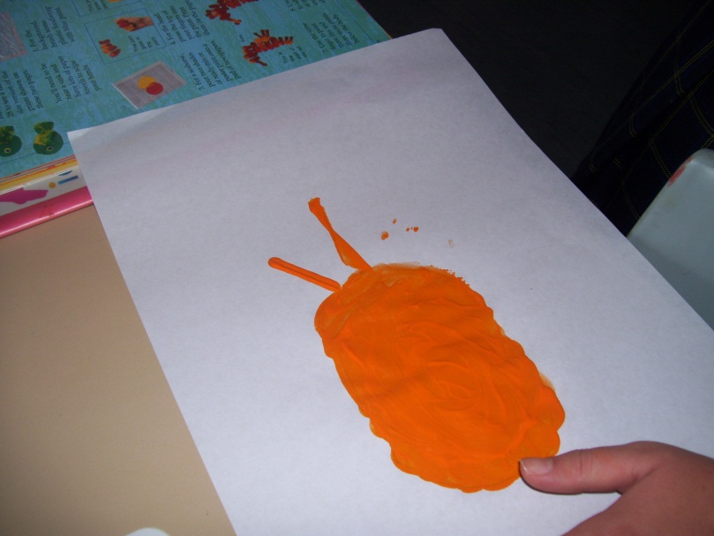
Step 2
Dip the edge of the cardboard into paint and use it to print legs. Curve it as you print.

Slide 17
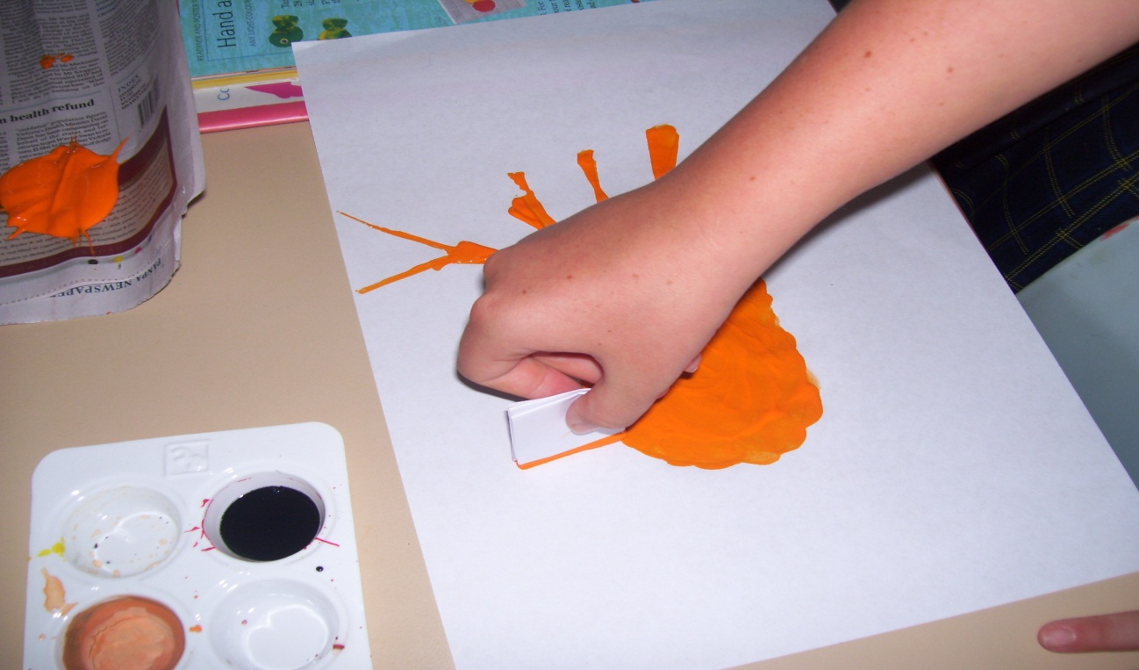
Step 3
Use a small piece of cardboard to print V-shaped pincers on the front legs

Slide 18
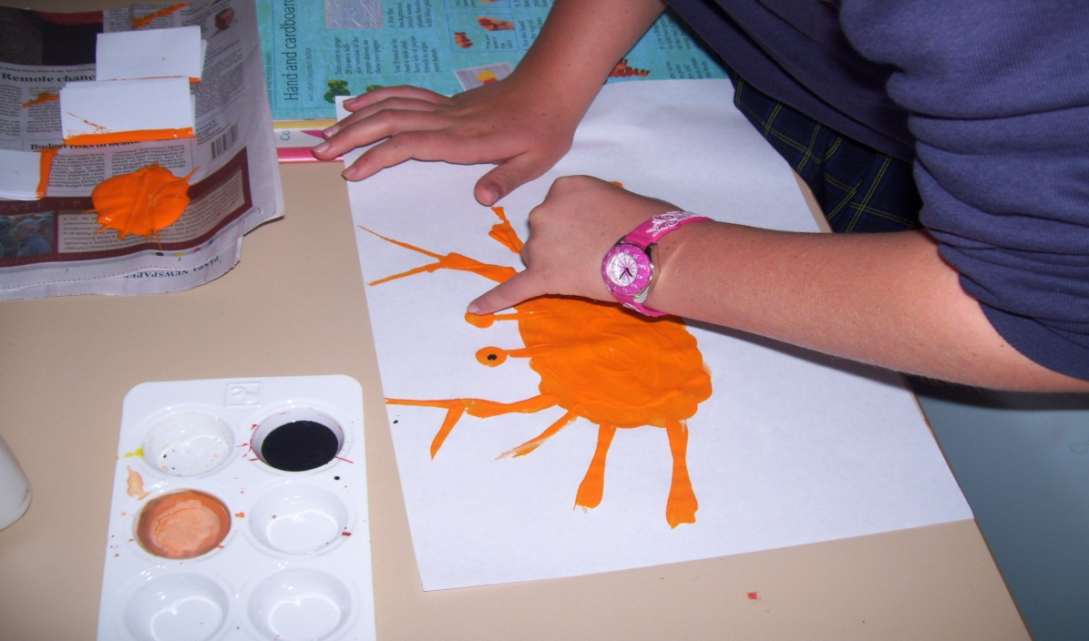
Step 4
Print stalks for eyes. Do the eyes with a fingertip. Add dots when the paint is dry.

Slide 19
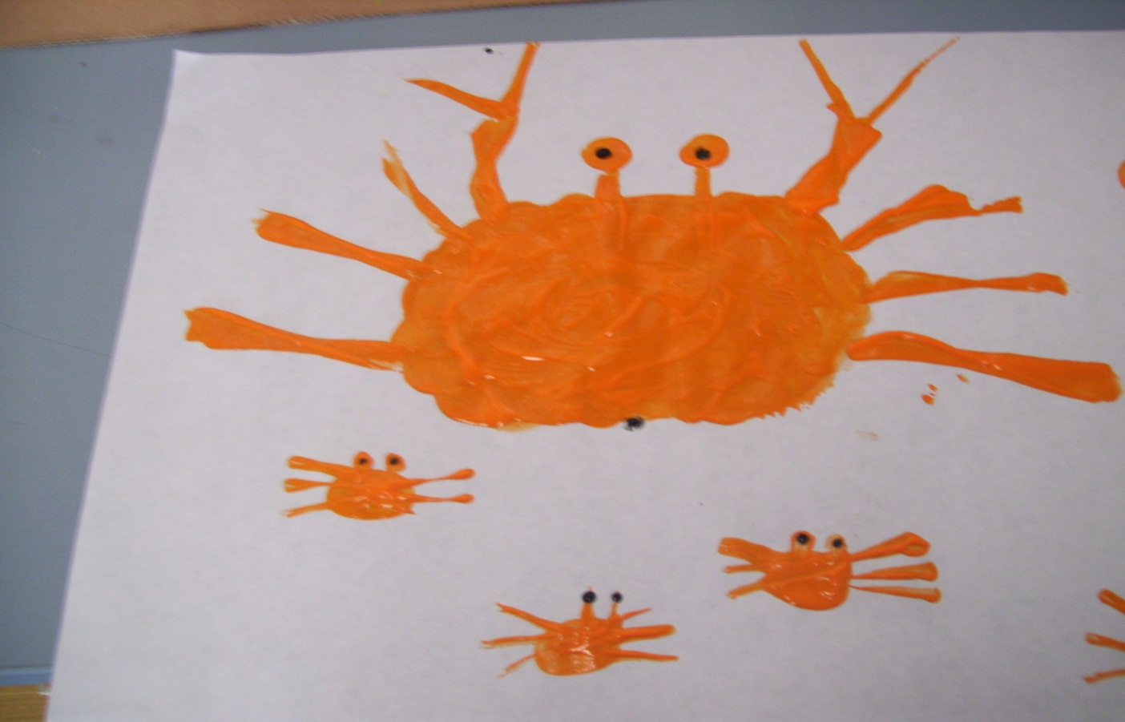
THEN ENJOY

Slide 20
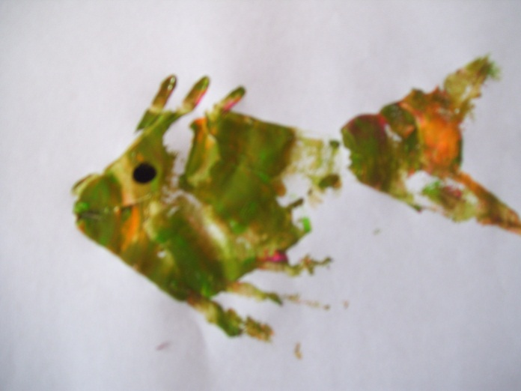
How to make Fan Fish
1- Dip the end of a thin piece of cardboard into two or three types of colours.
2-press it onto your paper, then twist one end to make a fan shape. Turn the paper.
3- Print another fan to finish the body. Then print a narrow one for the tail.
4- Print the fins with cardboard. Do the eye with a fingertip when the paint is dry.

