Slide 1
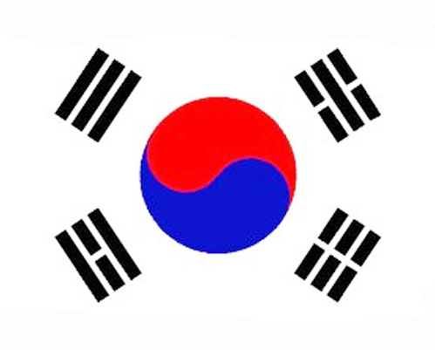
Korea
Made by Kay, Steven, Andy, Victor.
The Korean flag

Slide 2
list
1. Where is Korea?
- location
- South Korea’s Capital
2. About Korea
- famous food
- famous places
3. Busan, Korea
- About Busan

Slide 3
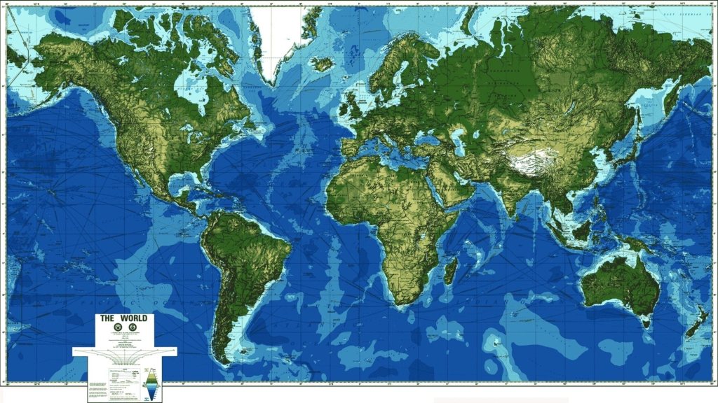
1.Where is Korea?-location

Slide 4
South Korea is located in the east of North Asia. The sea surrounds it on three sides. The traditions and culture of each region is different. If you look on a map you will see that Korea is located south of Russia and between China and Japan. Korea has over 5,000 years of history.

Slide 5
Capital of South Korea
Seoul is the capital of South Korea. The Summer Olympics were held there in 1988.
It is a very modern city with a large population.

Slide 6
About Korea – Korean Food
Kimchi is one of Korea's representative foods. There are many kinds of kimchi. The main ingredients are cabbage and chili powder. It adds a nice spicy taste to meals, especially when the other food you are eating is not too hot.

Slide 7
Korean Food continued
Bibimbap is another representative food of Korea. A variety of food is used to make this dish. Rice, vegetables, egg, red pepper paste and, sometimes some meat An advantage of Bibimbap is that many people can eat and share it. It was originally made in the past by collecting a lot of side dishes and leftovers.

Slide 8
Busan , Korea
It is located on the southern coast of South Korea. Busan, is the largest and main port in Korea and is famous throughout Asia. Some famous coastal products are seaweed, kelp, and anchovies.
The Chukche Festival will open soon to celebrate these marine items.
There is a lot to do in Busan as the mountains are near by and there are also many international festivals. It is a city brimming with affection.

Slide 9
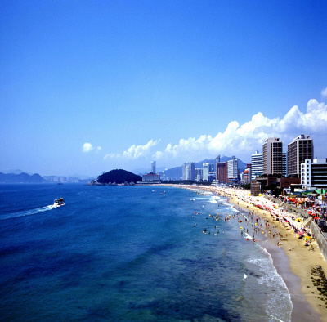
Busan, Korea
There are many beaches in Busan, including Haeundae and Gwangalli, where you can enjoy swimming in the summer. There are many shops, restaurants and cafes near them.
Many events are held at the beaches during the year. Such as a Sand Sculpture event, International Film Festival and International fireworks display. The views from the beaches are beautiful, especially at sunrise.

Slide 10
Thank you for listening!

