Slide 1
Research Data Management
Thomas Reeson
Research Data Librarian
University Library
treeson@une.edu.au
02 6773 5989
Gabrielle Lamb
Researcher Services Librarian
University Library
glamb2@une.edu.au
02 6773 3697
Dr. Paddy Tobias
eResearch Analyst
Intersect / Research Services
ptobias2@une.edu.au
02 6773 5304

Slide 2
Section 2. Mgmt of research data and primary materials, Aust Code for the Responsible Conduct of Research
“The responsible conduct of research includes the proper management and retention of the research data. Retaining the research data is important because it may be all that remains of the research work at the end of the project.”
Data storage and management = accountability, verifiability
“The central aim is that sufficient materials and data are retained to justify the outcomes of the research and to defend them if they are challenged.”
A definition of “research data”
Open Access = sharing, allowing reuse, making research data a research output
“The potential value of the material for further research should also be considered, particularly where the research would be difficult or impossible to repeat.”
Notes:
Previously is stipulated RDM as “an important part” of research conduct; now it says "The ARC strongly encourages the depositing of data arising from a Project in an appropriate publically accessible subject and/or institutional repository. Where appropriate, the Final Report must outline how data has been made publically accessible.”

Slide 3
Aust Code for the Responsible Conduct of Research (Sect. 2)
Institutional responsibilities:
Provide “safe and secure storage of research data” (consistent with confidentiality, legislation, privacy rules), including:
Preventing unauthorised access to research IT infrastructure, documents and data
Protecting all IT hardware/software associated with research
IT personnel and those holding the primary material must understand their responsibilities
Maintain “records of where research data are stored”
Have policies on “research data ownership and storage”
“Research data and primary materials must be stored in the safe and secure storage provided”
University must support researchers in managing research data
Projects that “span several institutions” should have an agreement about storage
Researcher responsibilities:
Retain data for “sufficient time” and maybe even permanently
Make available research data unless for “ethical, privacy or confidentiality matters”
If challenged, research data must be retained until resolved
Must follow institutional policy for research data disposal
Must keep records of research methods and data sources, even after research project
Must ensure research data are “safe and secure”
Retain research data in a “durable, indexed and retrievable form”
Maintain a “catalogue of research data in an accessible form”
Maintain confidentiality

Slide 4
Aust Research Council
ARC Funding Rules (2016 edition, effective 2018)
(A11.5.2) Researchers and institutions have an obligation to care for and maintain research data in accordance with the Australian Code for the Responsible Conduct of Research (2007). Researchers must outline briefly in their Proposal how they plan to manage research data arising from a Project. The ARC strongly encourages the depositing of data arising from a Project in an appropriate publically accessible subject and/or institutional repository. Where appropriate, the Final Report must outline how data has been made publicly accessible.
ARC Funding Agreement (2016 edition, effective 2018)
(19.2) For any Material produced under this Agreement, the Administering Organisation must ensure that all Specified Personnel:
take reasonable care of, and safely store, any data or specimens or samples collected during, or resulting from, the conduct of their Project;
make arrangements acceptable to the ARC for lodgement with an appropriate museum or archive in Australia of data or specimens or samples collected during, or resulting from, their Project
(39.2) The Administering Organisation acknowledges that:
in respect of data, including personal information, held in connection with this Agreement, any unauthorised and intentional access, destruction, alteration, addition or impediment to access or usefulness of the data stored in any computer in the course of performing this Agreement is an offence under Part 10.7 of the Criminal Code Act 1995 which may attract a substantial penalty, including imprisonment
(27.2) The ARC may at any time conduct ad hoc on-site reviews to ensure that the terms of this Agreement are being, or were, met and that reports submitted to the ARC are an accurate statement of compliance by the Administering Organisation.
Notes:
Following the UK REF rules, considering research data as a research output since 2014.

Slide 5
New Journal standards (Education)
Ranging from:
No mention of data sharing or publication | e.g. Australian Journal of Teacher Education, Postcolonial Directions in Education, Globalization
Encourages data sharing (not mandatory) | e.g. E-learning and Digital Media, Mind, Brain, and Education, Sex Education,
Requiring statement of where data Author’s willingness to share underlying data | e.g. International Journal of Learning, Teaching and Educational Research, International Journal of Child Care and Education Policy
Require all data underlying a journal article to be made available with no or minimal restrictions | e.g. Empirical Research in Vocational Education and Training
No Open Access requirement
Full Open Access requirement
Notes:
Education version

Slide 6
Why these changes?
Research data value between $AUD 1.9 billion (labour costs) and $AUD 6 billion (total expend) per annum
Estimated value of sharing research data, $1.4-$4.9 billion (Houghton & Gruen 2014)
Data from journal articles still existing decreases by 17% per year (Vines et al 2014)
Data sharing can lead to improved Research Impact and Engagement (ANDS)
Data-linking in publications can improve citations (e.g., Drachen et al 2016)
Notes:
Data from journal articles being extant decreased by 17% per year (Vines et al, 2014, ‘The Availability of Research Data Declines Rapidly with Article Age’, Current Biology, 24, 94-97) Study related to morphological dimensions from plants or animals, typically biologists or taxonomists

Slide 7
How is UNE responding?

Slide 8
Management and Storage of Research Data and Materials Policy (2012): Responsibilities
Research Services Director/PVCR
Corporate oversight of research data management (6a&6b)
University Librarian | ITD Director
Metadata store (7a) Training (7b) | Computer storage for research data (7a) Technical support (7b)
Heads of Schools & Research Centres
Implementing discipline-specific guidelines (8a) Engaging researchers (8c)
Researcher
Maintaining records of research data (i.e., data management plans) (9a) Managing data in durable and retrievable way (9b) Ensuring research data is stored in central storage (9c) Ensuring research data is recorded in metadata store (9c) Disposing of research data at end of retention period (9f)

Slide 9
Management and Storage of Research Data and Materials Policy (2012): Guidelines
Minimum retention drawing from the Code of Conduct
Ownership and custodianship of the research data collection
Research Collaboration agreements
Data accessibility standards
Disposal (not before retention period ends)

Slide 10
Management and Storage of Research Data and Materials Procedures (2017)
Makes distinction between active research data and completed or archived research data and outlines separate management procedures
Clarifies department responsibilities
Outlines specific services and support that are now in place for researchers
Gives options for data sharing and publishing
Provides Exit Plan and Destruction procedures
Training and Communication responsibilities
Notes:
Clarifies some confusing aspect of the Policy
Makes distinction between active research data and completed or archived research data. This opens up a whole new issue; what provisions are being made for archiving research data?
Clarifies some responsibilities in the Policy (e.g., while the onus is on the researcher to manage durability and retrievability of the archived datasets, there must be a systematic way of doing so which is the responsibility of ITD in being able to manage research data with persistent identifiers)
Outlines specific software solutions that are now in place, such as cloud.une.edu.au and the interroperability between the metadata store and RDA and e-publications
Gives some options for data sharing and publishing (however we do not yet have the solutions for these)
Gives Exit Plan procedures, upon a researcher leaving the institution, and the procedures for destroying the archived research data

Slide 11
Research Data Management Standards
UNE’s Management and Storage of Research Data and Materials Policy: http://policies.une.edu.au/view.current.php?id=00208
UNE’s Management and Storage of Research Data and Materials Procedures: http://policies.une.edu.au/view.current.php?id=00375
Australian Code for the Responsible Conduct of Research: https://www.nhmrc.gov.au/guidelines-publications/r39
NHMRC Funding Agreement: https://www.nhmrc.gov.au/_files_nhmrc/file/grants/policy/nhmrc_funding_agreement_effective_october15_150807.pdf
ARC Funding Agreement (Discovery Projects): http://www.arc.gov.au/discovery-program-funding-agreements#DP
The Australian Privacy Principles (APP): https://www.oaic.gov.au/individuals/privacy-fact-sheets/general/privacy-fact-sheet-17-australian-privacy-principles
The NSW Health Records and Information Privacy Act 2002 (HRIPA) Health Privacy Principle: http://www.legislation.nsw.gov.au/#/view/act/2002/71/
National Statement on Ethical Conduct in Human Research (2007, updated May 2015): https://www.nhmrc.gov.au/_files_nhmrc/publications/attachments/e72_national_statement_may_2015_150514_a.pdf

Slide 12
Research Data Management Standards
 | Research Activity | Data Archiving | Data Sharing | Data Disposal
What is the requirement? | Researchers must: Keep clear and accurate records (1); Follow ethics protocols and abide by legislation (1, 2, 3, 8) Institutions must: Provide facilities for “safe and secure storage of research data” (1, 2, 3, 4); Maintain records of where research data are stored (1,2 3, 5); Have policies and procedures in place to ensure security and prevent unauthorised access (consistent with confidentiality requirements, legislation, privacy rules and guidelines) (3,4,5,7) Institutions must: provide safe and secure storage for research data (3) | Researchers must: Store a copy of research data in institutional data archive (2); Retain sufficient materials and data to justify the outcomes of research and defend them if challenged (3) Institutions must: Provide facilities for “safe and secure storage of research data” (3, 4); Maintain records of where research data are stored (3); Have policies in place to ensure security and prevent unauthorised access (consistent with confidentiality, legislation, privacy rules and guidelines) (3,4,5,7, 8). For ARC funded research, institutions must: Make acceptable arrangements for lodgement of data collected during, or resulting from, their Project, with an Australian archive (5) | Researchers are encouraged to: Make data available for reuse, especially where the research would be difficult or impossible to repeat (2, 3); Maintain confidentiality when given access to confidential information (3, 8) | Institutions must: Have a policy covering safe and secure disposal (3) Must dispose of health and personal information when no longer required - while observing minimum retention requirements (6, 7, 8)
Are there restrictions on where the data can be stored or the activity should happen? | Researchers must: use cloud.une.edu.au unless not a viable solution (2) Personal information must be within Australia without prior approval (4, 5, 6) Health information must be within NSW without prior approval (7) Research spanning several institutions should have storage agreement with all parties (3) | Researchers must: Submit data underpinning a publication to university data archive and create metadata record (2) Institutions must: support depositing data in a departmental or other appropriate institutional repository (3) Personal information must be within Australia without prior approval (4, 5, 6) Health information must be within NSW without prior approval (7) | NHMRC and ARC funded research: Should deposit in an appropriate publicly accessible subject and/or institutional repository (4, 5)
How long does this need to be retained? |  | Varies on a case by case basis. The general minimum is 5 years, but can be much longer (e.g. 20 years, 25 years, or permanent) (1, 3, 4, 5). | Data should be retained for as long as interest and discussion persist following publication (3)
Who should have access? | For personal, sensitive or health information: Approval is governed by ethics protocols (6) For other research: no specific – researcher to determine. | For personal, sensitive or health information: Approval is governed by ethics protocols (6) For other research: no specific requirements – researcher to determine. | For all research: Open access is encouraged (3) NHMRC funded research: May require open-access (4) ARC funded research: Encourages open-access (5)
Where to go | For storage: Cloud.une.edu.au Contact: ITD Servicedesk une.edu.au/research/digital-research-support | Published record: e-Publications@UNE Contact: Research Data Librarian une.edu.au/research/digital-research-support | Published record: e-Publications@UNE Contact: Research Data Librarian une.edu.au/research/digital-research-support | Contact: Research Data Librarian

Slide 13
RDM Services at UNE

Slide 14
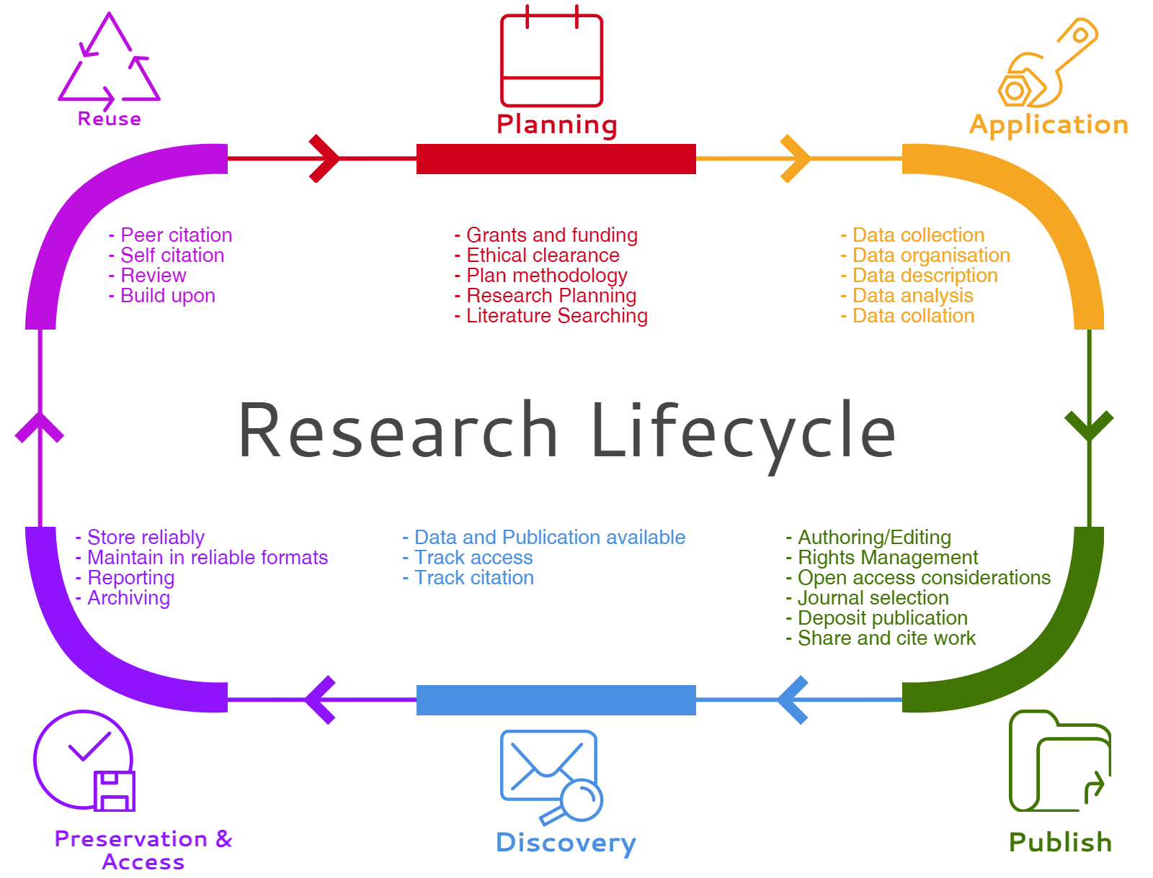
Research Lifecycle
Consultation with Researcher Services Librarian
Notes:
Usually at the point after a research question has been developed, researchers seek advice on research strategies - creating a search plan, which databases to use, what other tools can be used eg. EndNote. We also advise on where to publish, measuring impact

Slide 15
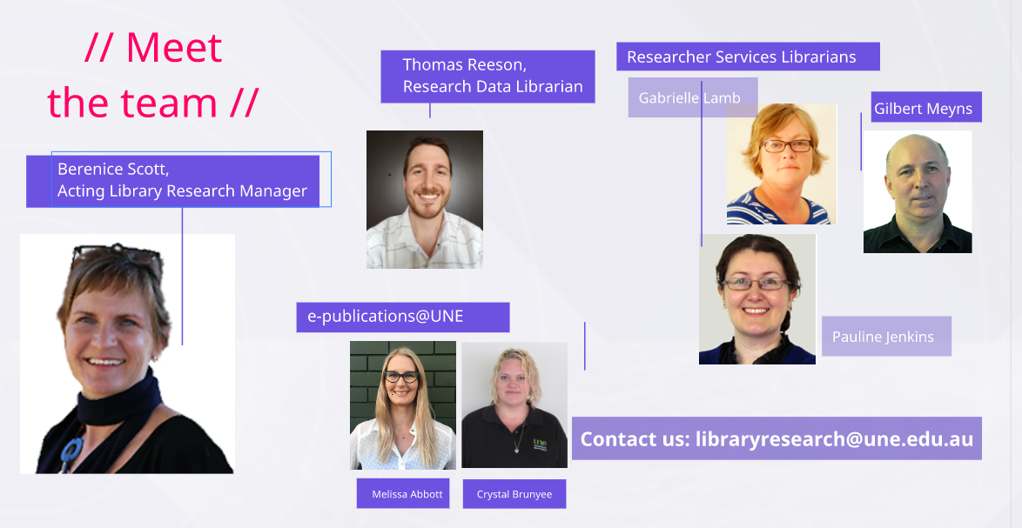
RDM lifecycle model by USCS Library
available at: http://guides.library.ucsc.edu/datamanagement/ under a CC-BY-SA 3.0 license
Notes:
Within the new Library structure the remainder of the vacant positions in the RAES team have been filled, just awaiting new recruits to take up their positions this month. A more comprehensive strategic team plan should eventuate once the Library Research Manager is in place, along with a Senior Researcher Services Librarian and a Senior Research Publications and Data Librarian, as well as another Researcher Services Librarian. For the time being I’m looking after Education, BCSS, Health, etc, but this could change. Each of us has specific areas that we concentrate on and lead eg. Chute and ORCID promotion are mine. Pauline is focusing on EndNote and updating online resources, Gilbert will be focusing on bibliometrics and Open Access.

Slide 16
Our services
Library resources & consultations
databases
subject guides
EndNote
strategies
Managing information
staying current
setting up alerts
copyright
data
Maximising impact
online researcher profiles
bibliometric tools
e-publications@UNE and Chute

Slide 17
Resources
UNE Library’s Guide to Researcher Support
http://une.au.libguides.com/research
Recent presentations on SciVal(Scopus) and Incites (Web of Science) from the above guide > Managing your profile
https://capture.une.edu.au/ess/portal/section/9a7a42b2-ab39-4786-9748-3aacc51f5d2e
bibliometric tools and more

Slide 18
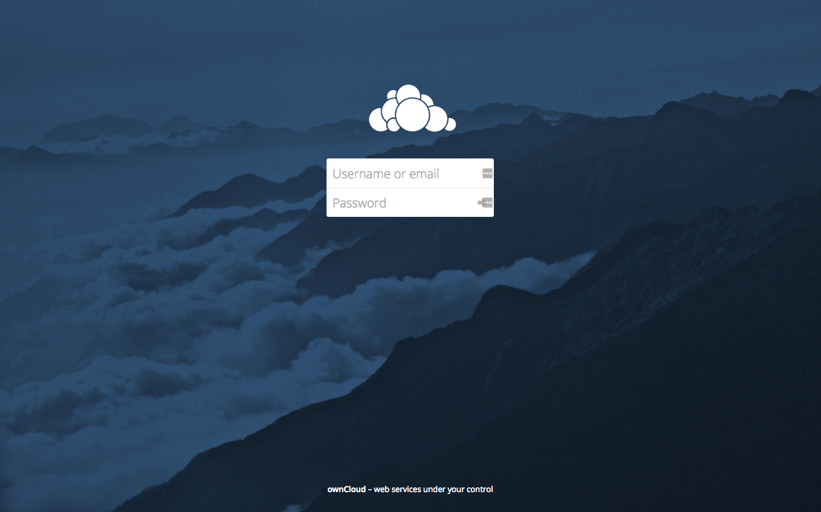
Storing your Research Data
https://cloud.une.edu.au/
Notes:
Log in with UNE user name and password.
Every UNE researcher/hdr will have access automatically. 500GB storage by default. Project spaces can be set up for groups of users.

Slide 19
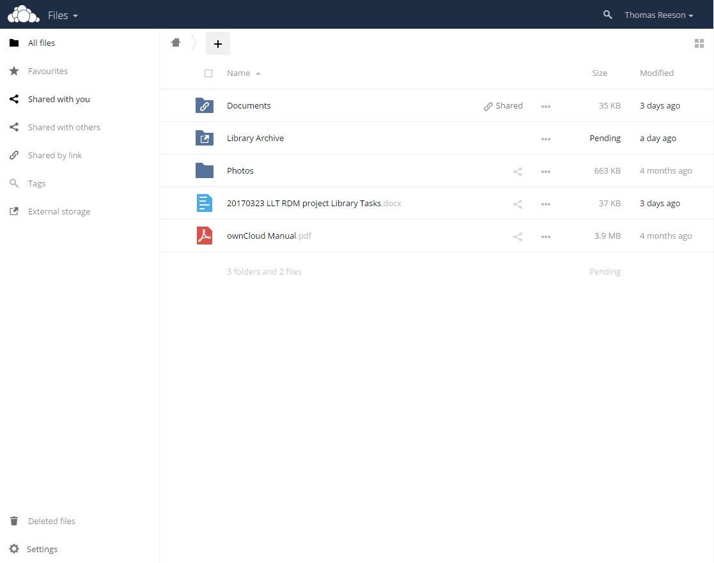
Storing your Research Data
https://cloud.une.edu.au/
Notes:
Under user name in the top right and into ‘personal’.
Can scroll down to find the sync apps. Allowing you to install directory files on your PC or mobile device that sync stored files and folders up to your cloud space.

Slide 20
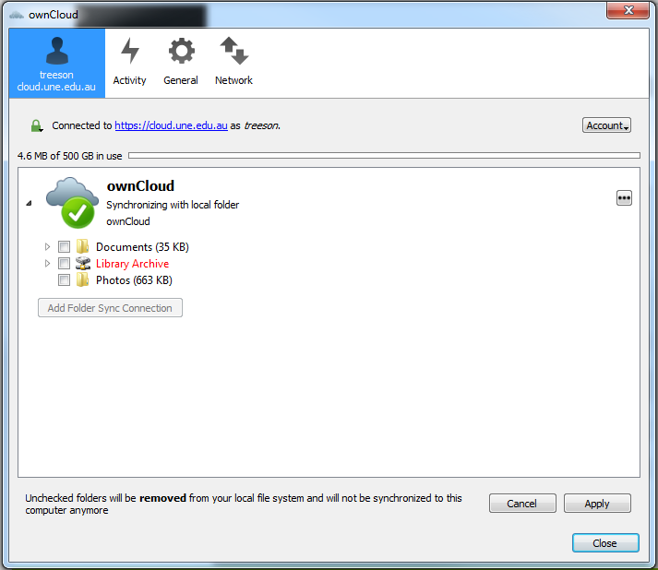
Storing your Research Data
https://cloud.une.edu.au/
Notes:
Can choose what files and folders are being synced to your device via settings.

Slide 21
Importance of description
‘Data about your data’ improves data quality
Descriptive, technical, access and rights, and preservation
Discoverability
You want people to be able to find your data, even if they don’t have access to it
Facilitates citation, which benefits your career
Facilitates potential collaboration
Good project management
Data doesn’t stop being valuable when the project ends
Reuse by you or your peers is aided by good description
Requirements from funders and publishers

Slide 24
What to do next?
Store your data in cloud.UNE
Think about how to describe your data assets
Think about what research data could be made Open Access
Instructions available at:
http://www.une.edu.au/research/digital-research-support/research-data-management

Slide 25
Library Services for Researchers
The University Library
Research Advisory and Engagement Services
libraryresearch@une.edu.au

Slide 26
Thank you!
Thomas Reeson
Research Data Librarian
University Library
treeson@une.edu.au
02 6773 5989
Dr Paddy Tobias
eResearch Analyst
Research Services/Intersect
ptobias2@une.edu.au
02 6773 5403

