Slide 1

The value of
information and information sharing
in the Australian beef and sheep meat supply chains
PhD Candidate:
Yue (Nikki) Zhang
Supervisors:
Prof. Derek Baker
Dr. Emilio Morales

Slide 2
1
Background
Presentation outline
2
Research gap
3
Research problem
4
Research questions and objectives
5
Research focus
6
Theoretical framework and hypotheses
7
Research methodology and data sources
8
PhD thesis outline
9
PhD study timeframe

Slide 3
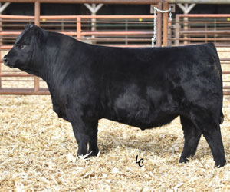
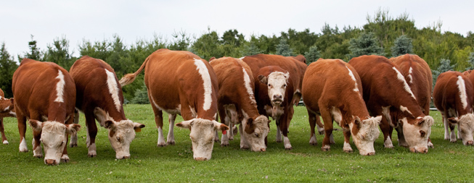
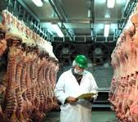
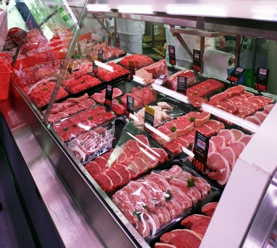
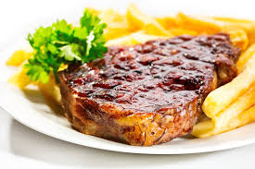
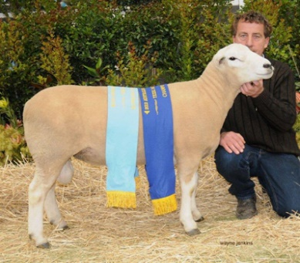
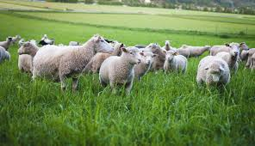
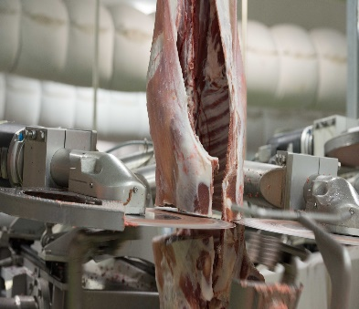
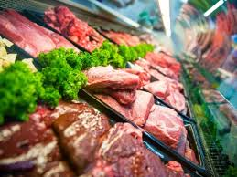
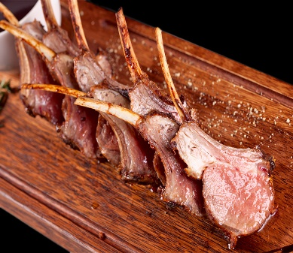
Background
The Australian beef and sheep meat supply chains
Payments
Materials
Payments
Information
Materials
Information

Slide 4


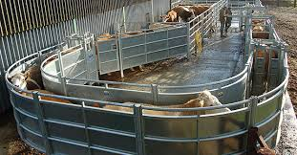

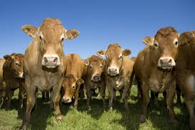
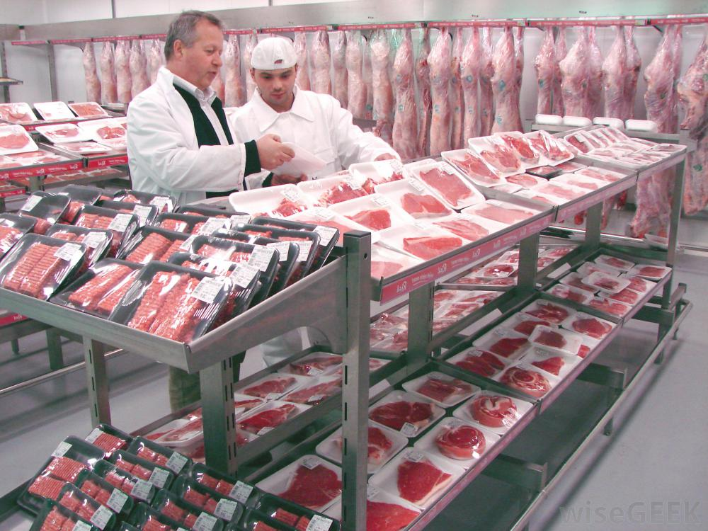




Background
SC information
facilities
inventory
transportation
costs
prices
customers

Slide 5
Background
Improve decision making
Chopra & Meindl, 2016; Morgan, Anderson, & Mittal ,2005;
Value of information
Improve SC performance
Hugos, 2011; Akerlof, 1970
Improve firms 'competitive advantage
Racichandran, Lertongdstien, 2005; Porter and Millar, 1985; Nelson, 1970; Grunert, Bredahl, & Brunsø, 2004; Shapiro & Varian, 2013; Cicia & Colantuoni, 2010; Loureiro & Umberger, 2007

Slide 6
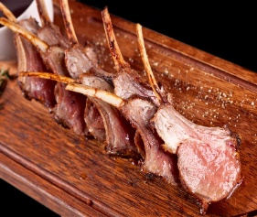
Background
SC information sharing
Strategic
&
tactical
data

Slide 7
Background
Reduce the cost of information acquisition
Value of information
sharing
Reduce the Bullwhip Effect
H.L.Lee, Padmandabhan,& Whang,1997;
Improve SC performance
Choon Tan, Kannan, Hsu,& Keong Leong, 2010; S. Li& Lin, 2006;
Premus & Sanders, 2008; Lin, Huang et al.,2002

Slide 8
Research gap
Identified key information and its measurement in the Australian beef and sheep meat SCs
Value of information and information sharing in the Australian beef and sheep meat SCs
Mechanism for optimal information sharing in the Australian beef and sheep meat SCs
Role of government or governing agencies in optimal information provision and sharing

Slide 9




Research problem
The value of SC information
The value of information sharing
The value of information quality and quantity

Slide 10
Research questions and objectives
Research questions
Research objectives
Q1: What is the key information and its measures?
O1: To identify the key information and its measures.
Q2: What is the value of key information？
O2: To analyse the value of key information.
Q3: What is the value of sharing key information？
O3: To analyse the value of sharing key information.
Q2: What is the value of key information’s quantity and quality？
O4: To analyse the value of information quality and quantity.
Q5: What is the optimal mechanism for information sharing?
O5: To identify the optimal mechanism for information sharing.
O6: To characterise the role of government or governing agencies in the optimal sharing.

Slide 11
Research focus
1
Key information
Product quality information
2
Upstream inventory information
3
End consumer demand information

Slide 12
Research focus
Product quality information
EBVs/ASBVs regarding meat quality
breed
weight
certified
credence
attributes
MSA
carcass quality
certified
credence
attributes
MSA
shelf life
storage
brand
certified credence attributes
MSA
preferences and related WTP for product quality dimensions

Slide 13
Research focus
Upstream inventory information
The volume of beef-cattle/sheep at a point in time by different quality attributes
The volume of beef/sheep carcass/ meat at a point in time by different quality attributes
The volume of beef/ sheep meat at a point in time by different
quality attributes

Slide 14
Research focus
End consumer demand information
The volume of beef-cattle/sheep at a point in time by
different quality attributes
price
The volume of beef/sheep carcass/ meat at a point in time by
different quality attributes
price
The volume of beef/ sheep meat at a point in time by
different quality attributes
price

Slide 15
Theoretical framework and hypotheses
Firm’s decision-making about information utilization and information sharing
Information
Potential cost
Information sharing
Presence
Absence
Information utilization
Potential value
Source of information
cost
Measured
Analysis
value
Shared by
Information
quality
Utilization
Society
Third parties
Sharing
Industry
Horizontal partners
Information
quantity
SC
Vertical partners
cost
Others
Firm

Slide 16
Theoretical framework and hypotheses
H1: Information is positively associated with several levels of performance.
H2: The positive association between information and performance is strengthened by a higher degree of information quality and quantity.
H3: Several levels of information sharing are positively associated with several levels of performance.
Hypotheses
H4: The positive association between information sharing and performance is strengthened by a higher degree of information quality and quantity.
H5: These positive associations are moderated by market uncertainty, and government or governing agency intervention.

Slide 17
Research methodology
Q2: The value of key information
Q3: The value of sharing key information
Q4: The value of information quality and quantity
Q1: Key information and its measure
Statistical
hypotheses
testing
Literature review
Expert interview
Contingent
valuation
Behavioural
modelling
optimization
Q5: The optimal mechanism for information sharing

Slide 18
Measurements
Firm performance: cost reduction, profitability increase, on-time delivery, customer satisfaction
SC performance: cost reduction, profitability increase, lead time reduction, ECR
Industrial performance: meat quality, productivity, innovation
Social performance: consumers' surplus
Information: type, source, cost of collecting, purpose of collecting
Information sharing: type, source, cost of collecting and sharing, key people, media, purpose of sharing
Information quality: accuracy, timeliness, readability, relevance, credibility, comparability
Information quantity: updated/sharing frequency, number of the information’s variables or dimensions
Market uncertainty: demand variability, market competition, changing of consumer preference
Government/governing agency intervention: infrastructure, open data, legislation
Firms’ characteristics: firm size, degree of specialization, stage of processing

Slide 19
Thesis outline
1
Chapter 1: Introduction
2
Chapter 2: Literature review
3
Chapter 3: Research methodology
4
Chapter 4: Hypotheses testing
5
Chapter 5: Contingent valuation
6
Chapter 6: Optimization modelling
7
Chapter 7: Conclusions and Implications

Slide 20
References
Chopra, S., & Meindl, P. (2016). Supply chain management. Strategy, planning & operation: Springer.
Morgan, N. A., Anderson, E. W., & Mittal, V. (2005). Understanding firms' customer satisfaction information usage. Journal of marketing, 69(3), 131-151.
Hugos, M. H. (2011). Essentials of supply chain management 3rd Edition. John Wiley & Sons.
Akerlof, G. (1970). The market for “lemons”: Quality uncertainty and the market mechanism. The Quarterly Journal of Economics 84(3),488-500
Ravichandran, T., & Lertwongsatien, C. (2005). Effect of information systems resources and capabilities on firm performance: A resource-based perspective. Journal of Management Information Systems, 21(4), 237-276.
Porter, M. E., & Millar, V. E. (1985). How information gives you competitive advantage: Harvard Business Review, Reprint Service.
Nelson, P. (1970). Information and consumer behaviour. Journal of political economy, 78(2), 311-329.
Shapiro, C., & Varian, H. R. (2013). Information rules: a strategic guide to the network economy. Harvard Business Press.
Grunert, K. G., Larsen, H. H., Madsen, T. K., & Baadsgaard, A. (1995). Market orientation in food and agriculture. Springer Science & Business Media.
Cicia, G., & Colantuoni, F. (2010). Willingness to pay for traceable meat attributes: a meta-analysis. International Journal on Food System Dynamics, 1(3), 252-263.
Loureiro, M. L., & Umberger, W. J. (2007). A choice experiment model for beef: What US consumer responses tell us about relative preferences for food safety, country-of-origin labeling and traceability. Food policy, 32(4), 496-514.
Global Logistics Research Team at Michigan State University. (1995). World class logistics: the challenge of managing continuous change. Council of Logistics Management, Oak Brook, IL, 183-215.
Lee, H. L., Padmanabhan, V., & Whang, S. (1997). Information distortion in a supply chain: The bullwhip effect. Management Science, 43(4), 546-558.
Choon Tan, K., Kannan, V. R., Hsu, C.-C., & Keong Leong, G. (2010). Supply chain information and relational alignments: mediators of EDI on firm performance. International Journal of Physical Distribution & Logistics Management, 40(5), 377-394.
Li, S., & Lin, B. (2006). Accessing information sharing and information quality in supply chain management. Decision support systems, 42(3), 1641-1656.
Premus, R., & Sanders, N. R. (2008). Information sharing in global supply chain alliances. Journal of Asia-Pacific Business, 9(2), 174-192.
Lin, F. r., Huang, S. h., & Lin, S. c. (2002). Effects of information sharing on supply chain performance in electronic commerce. Engineering Management, IEEE Transactions on, 49(3), 258-268.

Slide 21
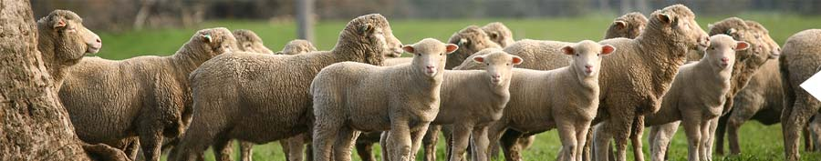
PhD Candidate:
Yue (Nikki) Zhang
Supervisors:
Prof. Derek Baker
Dr. Emilio Morales

