Slide 1
Retail Food Purchase Behaviour in the Presence of New Supermarket Entry
AARES 2017 - Brisbane
Derek Baker, Renato Villano, Stuart Mounter, Garry Griffith and Shawn Leu

Slide 2
Study motivation and goals
Aldi came to Armidale in April 2016
This was an opportunity to observe changes in consumer behaviour associated with a shift from supermarket duopoly to… something different.
With a jaded consumer base, this was a chance to observe and compare expectations with reality.
We took the opportunity to look at consumers’ branding behaviour, particularly that associated with shopping choices.
Goals today:
Describe the study
Provide some early insight into the data
Talk about next steps
Make contact with others with similar interests
Notes:
This was an opportunity not to be missed: a supermarket entry in the presence of Coles and Woolworths, and IGA.

Slide 3
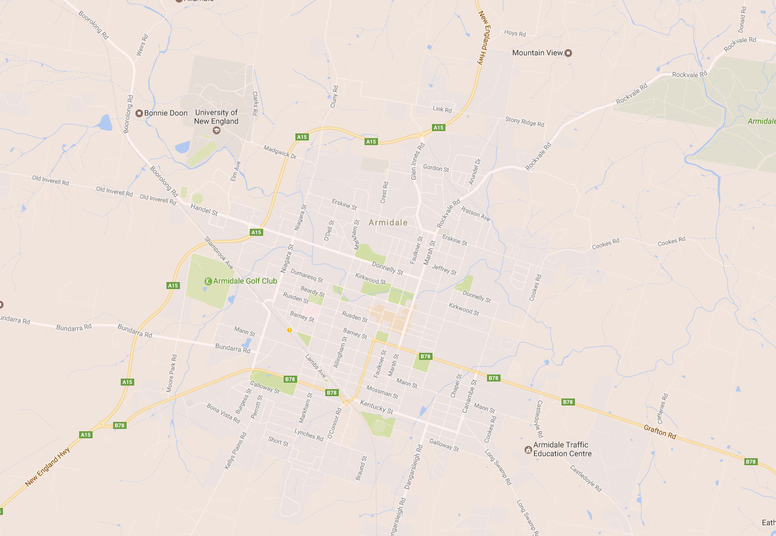
For those that don’t know
Aldi is the only supermarket NOT in a mall (i.e. NOT adjacent to other stores)
Opened April 2016
Notes:
In addition to the data presented today, we also collected prices in nearby Tamworth, and on promotions and pricing in al the Armidale supermarkets during the study. Using these data we will be able to better frame the analysis in due course. For today, we present some preliminary analysis of the survey data.

Slide 4
Sampling, setup and switching
 | Oct-15 “Before” Aldi opening | Nov-16 “after” Aldi opening | Total
Sample sizes | 189 | 224 | 413
Face-to-face interviews
8-minute interview Sampling:
In mall near to each of 3 (4) supermarkets | 50%
On street | 25%
Door-knock in suburbs | 25%
Questions
Demographics
Home post code
Income band
"Origins" (rural/town/city)
Shopping behaviour
Choice of supermarket and reasons
Knowledge of Aldi opening
Expectations about Aldi opening and reasoning
Branding behaviour
Source: UNE Business School Centre for Agribusiness Survey of Retail Shoppers
Notes:
Sample of 413; and note that the “After” sample includes shoppers outside Aldi, so is somewhat larger.

Slide 5
Reasons for supermarket choice
What is the biggest single reason you choose a supermarket?
 | Before | After
Location | 29% | 33%
Opening hours | 1% | 5%
Price | 12% | 22%
Service in store | 6% | 1%
Parcel pickup | 2%
Self check-out | 1%
Quality | 18% | 8%
Variety | 6% | 13%
Parking | 7% | 5%
Co-location with other stores | 11% | 1%
Others | 8% | 14%
Notes:
An interesting shift in stated preferences due to co-location – apparently becoming less important.
Also some interesting shifts regarding price (more important); and quality (less important).
Just after the “before” survey, Woolworths started on-line ordering, which we were unable to cover here – in reospect we should have included int in the “After” survey.

Slide 6
Price expectations of shoppers
Notes:
These are survey responses on expectations and impressions after the fact: not actual price changes. We recorded actual price changes and that analysis will appear in due course.
Across a range of products (we present just two here) and a range of shoppers (again just two here), few expected prices to rise – but we all know what has happened to beef prices.
What is notable is that so many people expected prices to fall, and they were disappointed.

Slide 7
Brand loyalty
What do you do when your preferred brand is not available?
Notes:
Sorry that Before and After are in the wrong order – the trends go upwards.
Theories of brand loyalty were tested in Scandinavia in the 2000s as supermarkets became “superdominant” – that means that 4-5 supermarkets held 60% of the market… obviously Australia’s situation has eclipsed those pf the past!
In any case, we examine shoppers’ stated behaviour when confronted with a stock-out on their preferred brand.
We see an increase in the already large numbers that simply buy a different brand: hence being “store loyal” rather than “brand loyal”. Similarly, a big decline in those dogged enough to return to the same shop to find the brand. However, against these trends we observe an increase in the number of shoppers that will pursue the brand to a different shop (hence being brand loyal and not store loyal.

Slide 8
Brand loyalty, by origins of respondent
Notes:
We examined brand loyalty for small town origin effects. We found that across the board, brand loyalty is in decline in favour of store loyalty. An interesting question is which brands the shoppers pursue to other stores.

Slide 9
Overall preferences
Would you/have you change(d) to shopping at Aldi?
Overall, is the opening of Aldi a good or bad thing?
Notes:
Turning to Aldi: a positive response after the fact, but hesitant beforehand.
Strategically and tactically, one wonders what the incumbents may have done to exploit shoppers doubts before Aldi opened.

Slide 10
Some lessons learned
Don’t cross the security staff in malls!
The Before/After sampling split saw considerable change in shopping behaviour and stated preferences
The reasons for supermarket choice seem to have changed in this period
Woolworths and Coles customers reacted differently to Aldi’s opening
Price changes were much different than those expected
Brand loyalty is changing in two dimensions: less brand loyalty overall but some increase in willingness to go to different shops to find a brand
Changes in brand loyalty have seen reduced differences in behaviour across “origins” (rural/urban and town size where the respondent grew up).
A grudging acceptance that Aldi’s opening is a good thing overall
Notes:
We had some adventures collecting data in crowded malls, but all was resolved eventually. This did affect our sample composition in the second survey.

Slide 11
Next steps
No more crossing of the security staff in malls!
Comparison of price expectations/reported changes with actual data on prices
Comparison of price changes with those in a control area
Limited Dependent Variable regression modelling of
supermarket choice and
budget share allocation amongst supermarkets
Profiling of consumers with regard to switching between supermarkets
The nature and influence of brand loyalty
Expansion to other supply chain actors, and linkage to local economy

Slide 12
Contacts
Derek Baker Professor of Agribusiness and Value Chains, UNE Business School
Director, UNE Centre for Agribusiness
UNE Business School
University of New England Armidale NSW 2351 Australia Phone 61 2 67732627 Email derek.baker@une.edu.au

